Slide 1
Gender Issues in Caregiver Health
Mieke Beth Thomeer, PhD
Associate Professor of Sociology
University of Alabama at Birmingham
mthomeer@uab.edu

Slide 2
Presented at the
“Sex and Gender Differences in Aging” Meeting at the Research Centers Collaborative Network of the National Institute on Aging
June 7, 2019

Slide 3

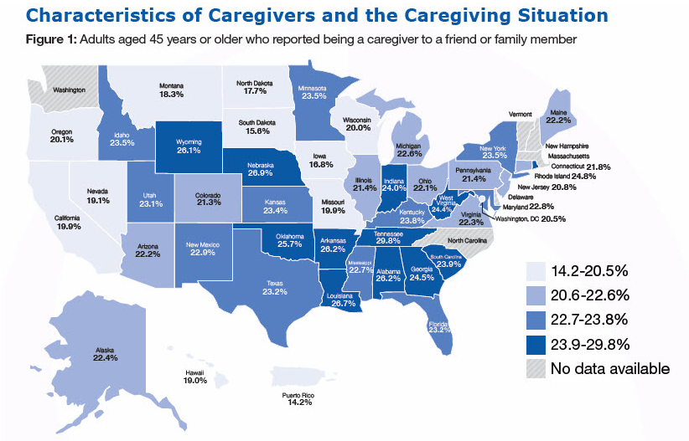
22.3% of US adults reported providing care to friend/family member in past 30 days.
One in four (25.4%) women are caregivers compared to one in five (18.9%) men (CDC 2019)
Daughters typically provide more informal care than sons (Schmid et al. 2012; Tolkacheva et al. 2014)
“The best long-term care insurance is a conscientious daughter” (Bott et al. 2017)
Mieke Beth Thomeer, “Sex and Gender Differences in Aging” June 6-7, 2019

Slide 4
In recent years, more gender equality in who provides care
Early Baby Boom Cohort
Mieke Beth Thomeer, “Sex and Gender Differences in Aging” June 6-7, 2019
Gender gaps in parental care and spousal care have narrowed in recent cohorts (Glauber 2017, 2019) (HRS Original: 1931-1941; Early BB 1948-1953)

Slide 5
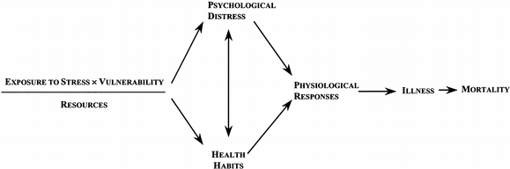
Providing care comes with health consequences (but also some positive benefits)
Most caregiving studies show that caregivers are more likely to experience depressive symptoms and have poorer physical health outcomes than noncaregivers (Schulz & Sherwood 2008; Pinquart & Sörensen 2003)
Role engulfment (Skaff and Pearlin 1992)
Caregiving (and even being married to someone with health issues) more negatively affects the mental and physical health of women compared to men (Pinquart & Sörensen 2006; Yee & Schulz 2000; Thomeer 2016)
  WHY?
Mieke Beth Thomeer, “Sex and Gender Differences in Aging” June 6-7, 2019

Slide 6
Gender differences in initial health and received support
Percentage of Married Adults with ADL/IADL Limitations Providing Spousal Care, by Age and Gender (HRS, 1998-2014)
Women provide care even when have health issues themselves; men less likely to do so
Women caregivers have more health issues than men caregivers
Men receive support from wives when they are caregivers (Thomeer et al. 2015)
  “I knew he got weary and he needed a break. And he did take a vacation and went away for two weeks.” (Gwen, age 52) `
Men
Mieke Beth Thomeer, “Sex and Gender Differences in Aging” June 6-7, 2019

Slide 7
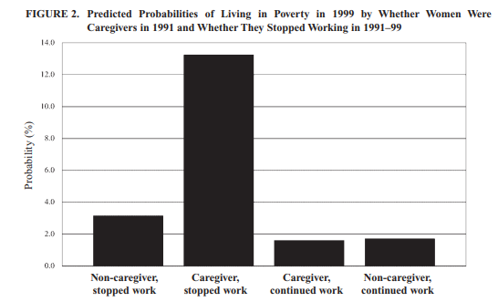
Gender differences in role conflict and in financial consequences of providing care
Many women caregiving for parents are also caregivers for their own children/families (including as single mothers) and (increasingly) in paid workforce (Do et al. 2014)
For most women, caregiving leads to substantial reduction in weekly hours worked and annual earnings (Wakabayashi & Donato 2005)
Caregiving for parents raises women’s poverty risks in later life (Wakabayashi & Donato 2006; Lee et al. 2015)
But the impact of men’s caregiving for parents on wages is negligible (Glauber 2019)
Mieke Beth Thomeer, “Sex and Gender Differences in Aging” June 6-7, 2019
(Wakabayashi & Donato 2005)

Slide 8
Gender differences in types of care provided
Women provide more emotional support and intensive care than men ⁽Pinquart & Sörensen 2006; Umberson et al. 2016; Thomeer et al. 2015)
“Doing it all” v. “Doing the best I can”
Lori, age 54: I know by the way he is breathing in the morning if he is going to wake up and have a good day or a bad day… He was in the hospital so we had medical people taking care of him, but I needed to be sort of a caregiving person… I worked hard to meet his needs and make sure that his nursing care was good, that he wasn’t in any pain.
Interviewer: Did you have home help aides that came in or nurses, physical therapy?
Sara, age 72: No, because I did it. I mean why should they come when I can do it.
Interviewer: Did you do the wound care?
Sara: I just did the wound care. And even the doctor said that I did a good job.
Marc, age 77: You're going to hurt your arm patting yourself on the back.
Mieke Beth Thomeer, “Sex and Gender Differences in Aging” June 6-7, 2019

Slide 9
Key caveat: Gender-as-relational
Gender of self, gender of spouse, same-gender or different-gender context
Women try to reduce stress for spouse
(even when they have the health issue)
Illness most stressful for relationship for women married to men.
Patient Report: Worrying/Trying Reduce Stress for Spouse
Spouse report: Stress of illness for relationship
Mieke Beth Thomeer, “Sex and Gender Differences in Aging” June 6-7, 2019

Slide 10
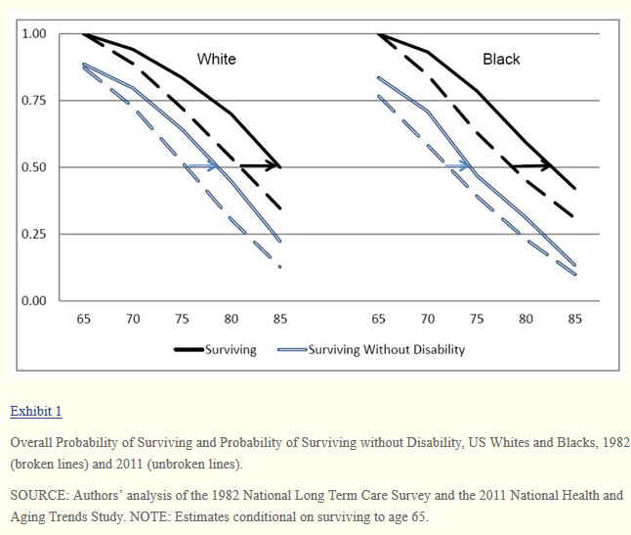
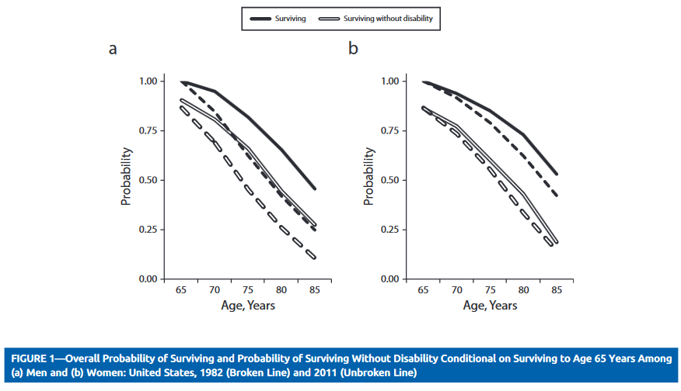
Future research: Intersectional perspective on caregiving, gender, and health
Mieke Beth Thomeer, “Sex and Gender Differences in Aging” June 6-7, 2019
Limited available research on differences among subgroups in caregiving
Need to know:
  How is caregiving and receiving distributed within and across families, in ways that reflect, reduce or exacerbate gender-, SES-, racial/ethnic-, and sexual orientation-based health disparities?
  What role do institutions, policies, and other structural forces play?
Source: Freedman & Spillman 2016
Source: Freedman et al. 2016

Slide 11
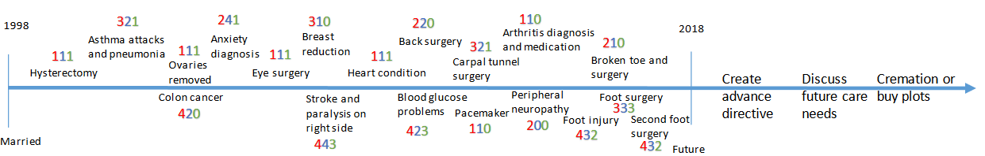
Future research: Life course perspective on caregiving
How do patterns of care develop throughout the life course, and how does this contribute to cumulative (dis)advantage processes?
  Experiences build to affect health over days, years, decades, lifetime
How have gender caregiving patterns, processes, and consequences changed across cohorts?
  Especially critical to consider as family forms continue to diversify
Thomeer & Clark 2019
Mieke Beth Thomeer, “Sex and Gender Differences in Aging” June 6-7, 2019

Slide 12
Future research: Data and methods needs
Benefit from survey and semi-structured interview data (multiple methods)
  Longitudinal: capture multiple caregiving processes as well as pre-caregiving and post-caregiving health and conditions; disentangle causal impacts of caregiving (positive and negative); need nationally-representative longitudinal data for caregiving in same-sex relationships
  Intergenerational: identify how caregiving provided within and across generations in ways that “ripple” through families
  Family-level: include information from spouses, adult children, parents—those providing care and those not providing care; would benefit from data from cohabiting partners and other “non-traditional family” arrangements
Types of data
  Biomarkers, particularly assessed on daily basis and in response to ongoing caregiving demands.
  Multi-faceted measures of caregiving
  Multiple validated measures of mental and cognitive health
Mieke Beth Thomeer, “Sex and Gender Differences in Aging” June 6-7, 2019

Slide 13
Thank You!

Slide 14
Citations
Slide 3: Centers for Disease Control and Prevention. 2019. Caregiving for Family and Friends– A Public Health Issue. Division of Population Health, National Center for Chronic Disease Prevention and Health Promotion. https://www.cdc.gov/aging/caregiving/caregiver-brief.html ; Schmid, T., M. Brandt, & K. Haberkern. 2012. Gendered Support to Older Parents: Do Welfare States Matter? European Journal of Ageing 9, 39-50.; Tolkacheva, N., M.B. van Groenou, & T. van Tilburg. 2014. Sibling Similarities and Sharing the Care of Older Parents. Journal of Family Issues 35(3), 312-330.; Bott, N.T., C.C. Sheckter, & A.S. Milstein. 2017. Dementia Care, Women’s Health, and Gender Equity: The Value of Well-timed Caregiver Support JAMA Neurology 74(7), 757-578.
Slide 4: Glauber, R. 2019. The Wage Penalty for Parental Caregiving: Has It Declined Over Time? Journal of Marriage and Family 81(2): 415-433.; Glauber, R. 2017. Gender Differences in Spousal Care across the Later Life Course. Research on Aging 39(8), 934-959.
Slide 5: Schulz, R. & P. Sherwood. 2008. Physical and Mental Health Effects of Family Caregiving. The American Journal of Nursing 108(9 Suppl.), 23–27.; Pinquart, M. & S. Sörensen. 2003. Differences between Caregivers and Noncaregivers in Psychological Health and Physical Health: A Meta-analysis. Psychology and Aging 18, 250–267.; Skaff, M. M. & L. I. Pearlin. 1992. Caregiving: Role Engulfment and the Loss of Self. The Gerontologist 32(5), 656-664.; Pinquart, M. & S. Sörensen. 2006. Gender Differences in Caregiver Stressors, Social Resources, and Health: An Updated Meta-Analysis. The Journals of Gerontology Series B 61(1), P33-P45.; Yee, J. L., & R. Schulz. 2000. Gender Differences in Psychiatric Morbidity among Family Caregivers: A Review and Analysis. The Gerontologist 40(2), 147-164.; Thomeer, M. B. 2016. Multiple Chronic Conditions, Spouse’s Depressive Symptoms, and Gender within Marriage. Journal of Health and Social Behavior 57(1), 59-76.
Slide 6: Wakabayashi, C., & K. M. Donato. 2006. Does Caregiving Increase Poverty among Women in Later Life? Evidence from the Health and Retirement Survey. Journal of Health and Social Behavior 47(3), 258-274.; Lee, Y., F. Tang, K. H. Kim, & S. M. Albert. 2014. The Vicious Cycle of Parental Caregiving and Financial Well-being: A Longitudinal Study of Women. Journals of Gerontology Series B 70(3), 425-431.; Wakabayashi, C. & K. M. Donato. 2005. The Consequences of Caregiving: Effects on Women’s Employment and Earnings. Population Research and Policy Review 24(5), 467-488.; Glauber 2019 see Slide 4.; Do, E. K., S. A. Cohen, & M. J. Brown. 2014. Socioeconomic and Demographic Factors Modify the Association between Informal Caregiving and Health in the Sandwich Generation. BMC Public Health 14(1), 362.
Slide 7: Pinquart and Sörensen 2006 see Slide 5; Umberson, D., M. B. Thomeer, C. Reczek, & R. Donnelly. 2016. Physical Illness in Gay, Lesbian, and Heterosexual Marriages: Gendered Dyadic Experiences. Journal of Health and Social Behavior 57(4):517.; Thomeer, M. B., C. Reczek, & D. Umberson. 2015. Gendered Emotion Work around Physical Health Problems in Mid-and Later-Life Marriages. Journal of Aging Studies 32:12-22.
Slide 9: Thomeer et al. 2015 see Slide 7
Slide 10: Freedman, V.A., & B. C. Spillman. 2016. Active Life Expectancy in the Older U.S. Population, 1982–2011: Differences between Blacks and Whites Persisted. Health Affairs 35(8) 1351-1358. Freedman, V. A., D.A. Wolf, & B. C. Spillman. 2016. Disability-free Life Expectancy over 30 Years: a Growing Female Disadvantage in the US Population. American Journal of Public Health 106(6), 1079-1085.
Slide 11: Thomeer, M.B., and K. O. Clark. 2018. Marital and Caregiving Dynamics among Older Adults with Health Issues. Presentation at Gerontological Society of America, Boston, MA.
Slide 12: Spillman, B.C., J. Wolff, V.A. Freedman, & J.D. Kasper. 2014. Informal Caregiving for Older Americans: An Analysis of the 2011 National Study of Caregiving. Office of the Assistant Secretary for Planning and Evaluation, Office of Disability, Aging and Long-Term Care Policy: Washington, D.C. https://aspe.hhs.gov/report/informal-caregiving-older-americans-analysis-2011-national-study-caregiving

