Slide 1

Mechanisms of Behavior Change for Healthy Aging: The NIH Science of Behavior Change Program
Donald Edmondson, PhD, MPH
NIA’s Research Centers Collaborative Network (RCCN) | May 8, 2019

Slide 2
Chronic diseases undermine healthy aging
7 out of 10 deaths in the U.S.
85% of U.S. health costs
Primary cause of years lived with a disability
Many are preventable
Per capita 2016
OECD Health Statistics, 2017. http://www.oecd.org/els/health-systems/health-data.htm. Accessed April, 2018.

Slide 3

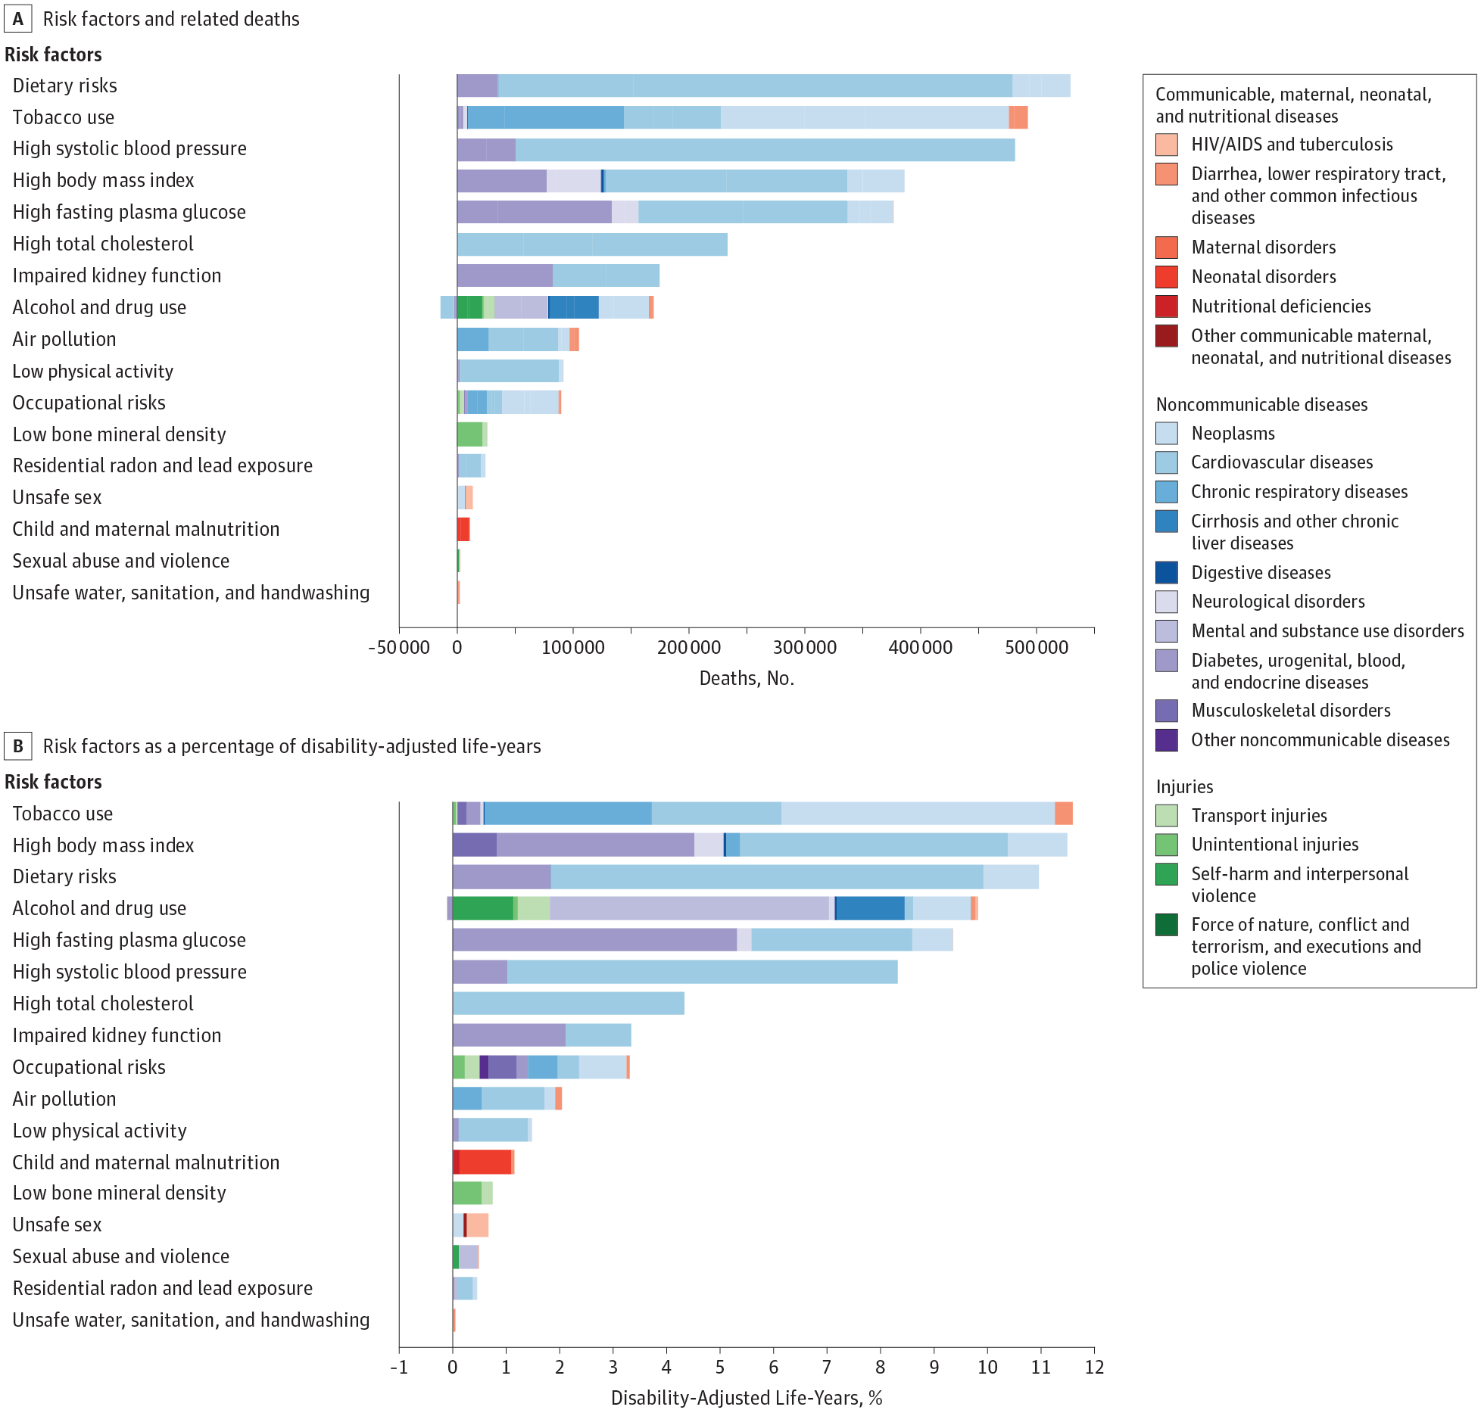
From: The State of US Health, 1990-2016: Burden of Diseases, Injuries, and Risk Factors Among US States; JAMA. 2018;319(14):1444-1472.

Slide 4

Behaviors are the most important determinants of healthy aging
US Burden of Disease 2016
Behavioral risk factors accounted for 43.5% of DALYs due to all causes
The US Burden of Disease Collaborators JAMA. 2018;319:1444-1472.

Slide 5
What is our most impactful behavior change intervention?

Slide 6
Few interventions exist that reliably produce, lasting behavior change for large numbers of people.

Slide 7
Office of Strategic Coordination - The Common Fund

Slide 8
Experimental Medicine Approach
Aims to identify key mechanisms underlying successful behavior change
Offers intermediate targets on the causal path to behavior change
Helps us understand why an intervention worked or didn’t work

Slide 11
A Common Method
for understanding behavior change.

Slide 12
Experimental Medicine Approach

Slide 13
Mediation Model
Mechanism
Indirect Path (a)
Indirect Path (b)
Covariates
Intervention
Behavior
Direct Effect (c’)

Slide 14
Keys to progress
Unite basic and applied researchers
Focus on mechanisms of change
Develop and apply a common scientific method
Optimize interventions to promote effectiveness

Slide 15
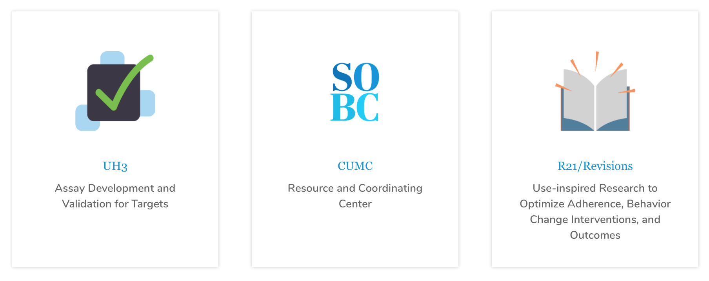
SOBC Research Network

Slide 16
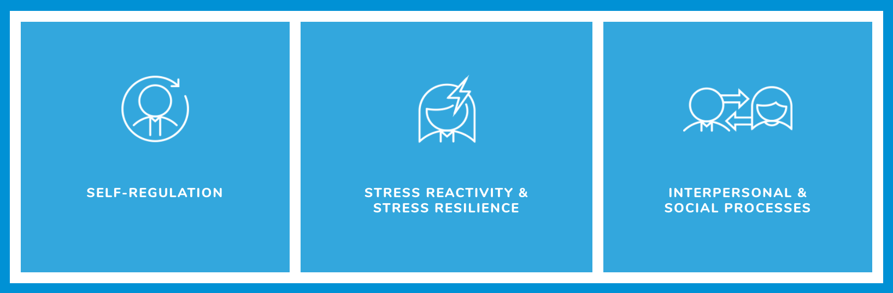
Initial Domains

Slide 17
Developing resources for behavior change scientists

Slide 18
Measures Repository
Developing a repository of measures assessed using the SOBC method
Documents progress through steps of the method
Open Science Framework (OSF) documentation
113 measures…and more to come!
Resource for the scientific community
www.scienceofbehaviorchange.org/measures

Slide 19
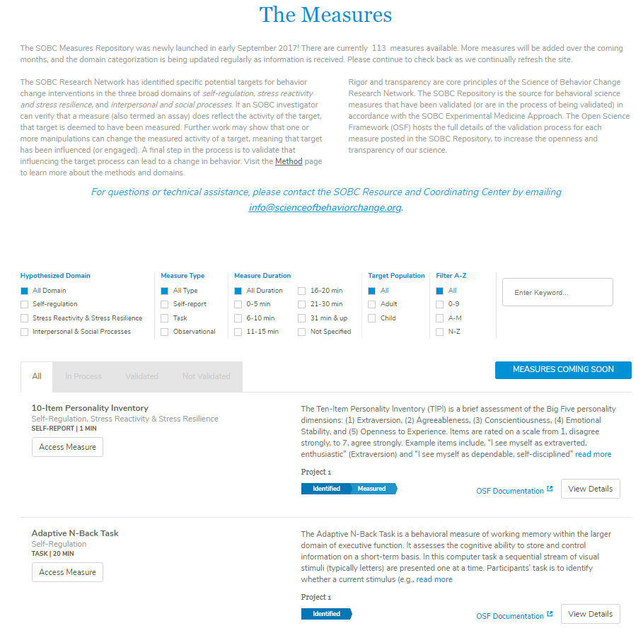

Slide 20
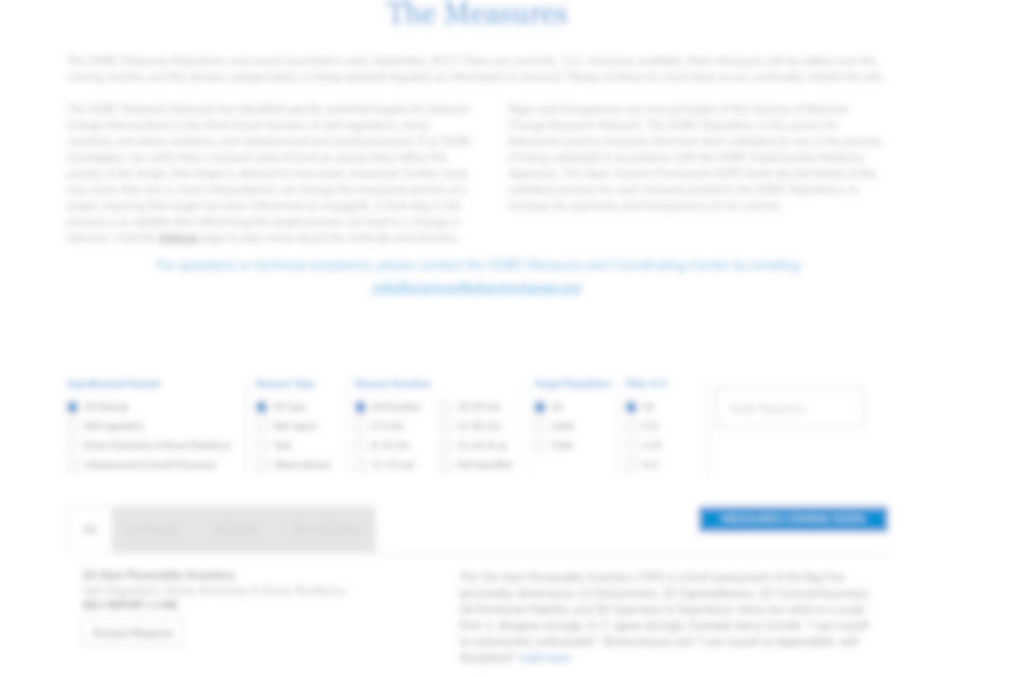
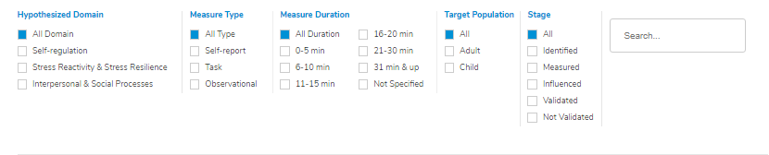

Slide 21
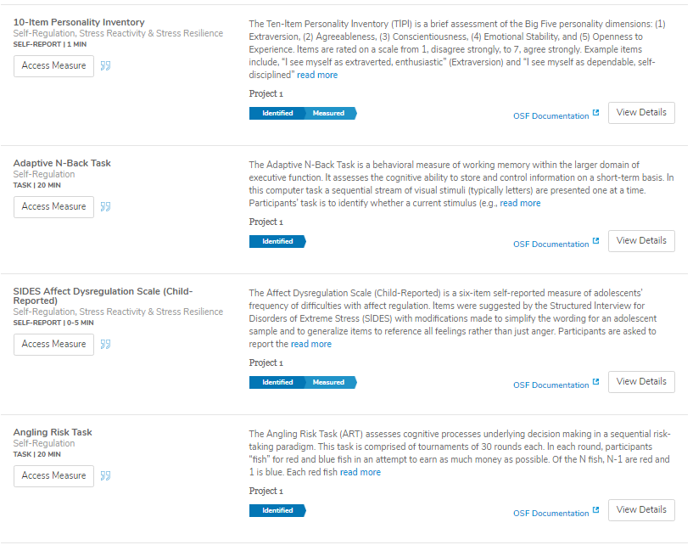

Access the Measures

Slide 22

Open Instruments Project

Slide 23
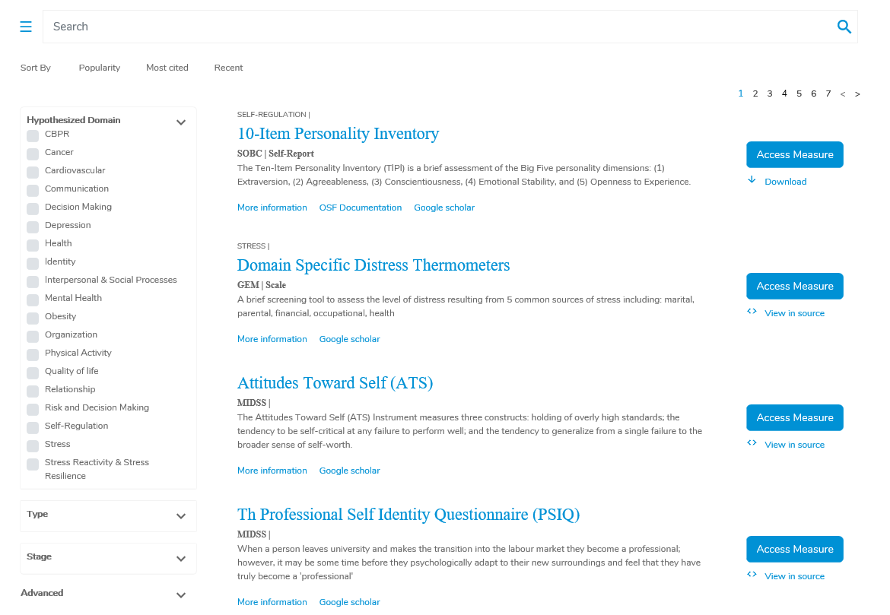


Slide 24
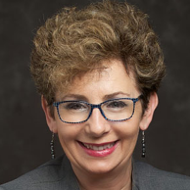

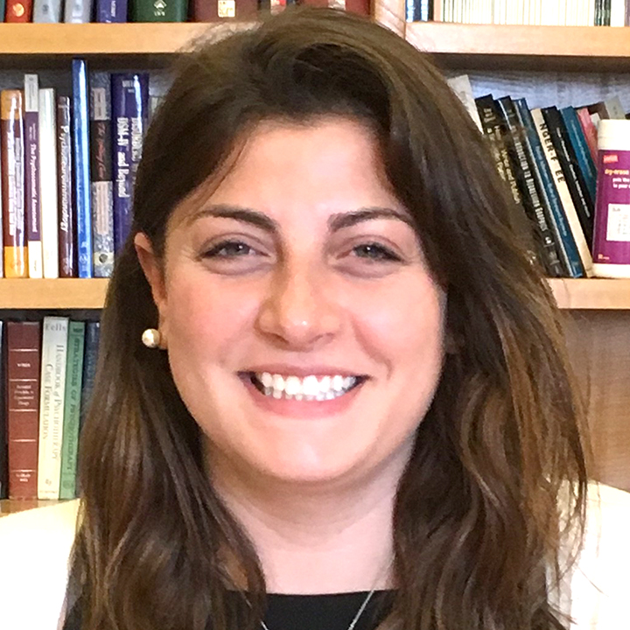
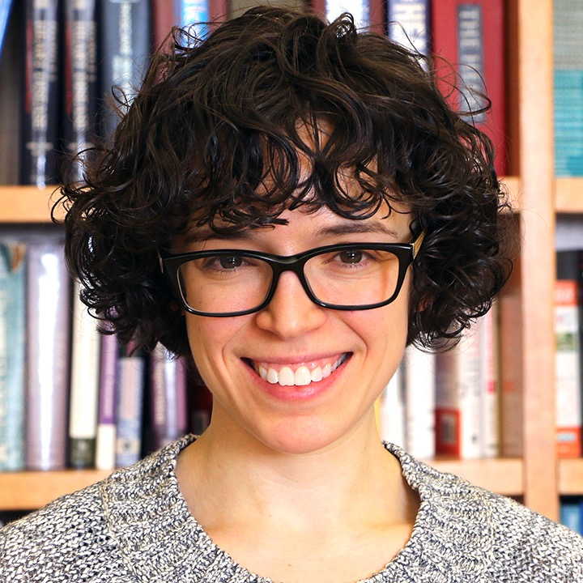
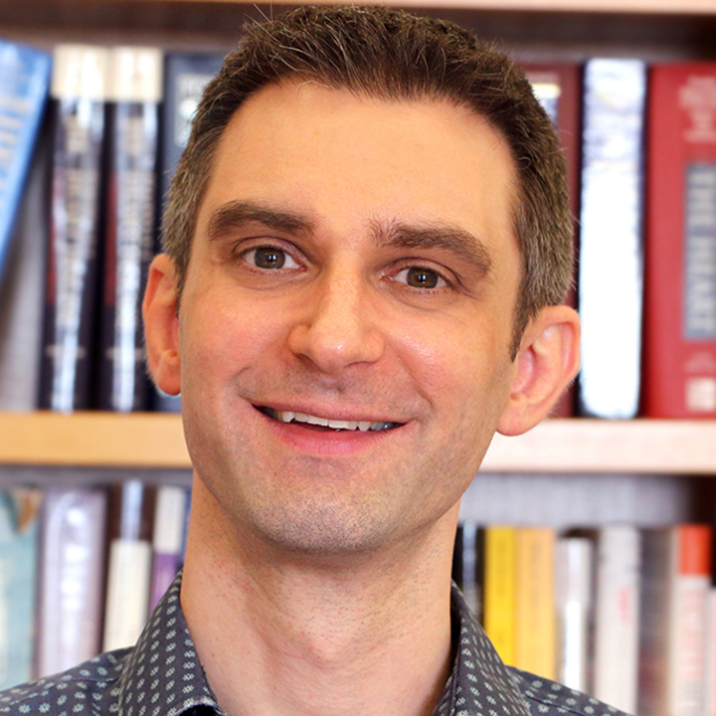
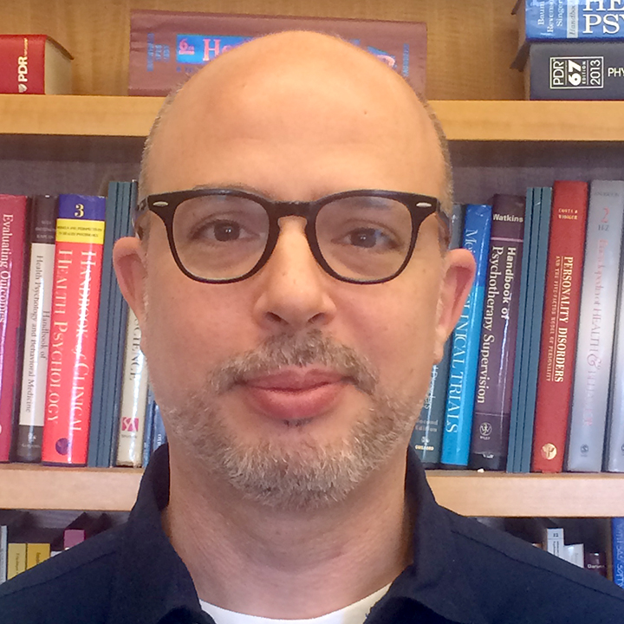
Karina Davidson, PhD
Co-PI, Project Director
Acknowledgements
Jennifer Sumner, PhD
Co-Investigator
Lilly Derby
Project Coordinator
Talea Cornileus, PhD, MSW
Project Scientist
Resource and Coordinating Center
Email: ld2778@cumc.columbia.edu
Jeffrey Birk, PhD
Project Scientist
Luis Blanco
Media Director
U24AG052175

Slide 25
Thank you.
www.scienceofbehaviorchange.org

