Slide 1

targeting emotions to facilitate behavior change
JANEY PETERSON, EdD, MS RN
Associate Professor of Clinical Epidemiology in Medicine
Associate Professor of Clinical Epidemiology in Cardiothoracic Surgery
Weill Cornell Medicine

Slide 2
Background
Efforts aimed at changing health behavior usually focused on theoretical frameworks comprised of social and cognitive factors (e.g., self-efficacy, knowledge, values) (Conner & Norman, 1996, 2017)
Health behavior interventions have been limited in effectiveness even when exposure to intervention components is adequate, and delivered with high fidelity (Breitenstein, 2010)
Converging evidence over the past 2-3 decades suggests that affective states are critical elements in health decision-making and health behavior change (Damasio, 1994; Lerner & Keltner, 2000, 2001; Loewenstein & Lerner, 2003), yet the mechanisms by which affect influences behavior change and change maintenance remains poorly understood

Slide 3
The Hedonic Principle
Positive shift in
hedonic valence
More frequent performance of behavior
Positive affective response
Negative affective response
Negative shift in hedonic valence
Less frequent performance of behavior
Kahneman, Diener,1999

Slide 4
Measurement of affect
State affect
Hedonia: well-being, happiness – short-term measures
Trait affect
Eudaimonia: meaning, purpose in life – long term measures
Distal outcomes
Proximal Outcomes
Kahneman, 1999; Waterman, 1993; Pressman, Jenkins & Moskowitz, 2018

Slide 5
Negative affect – stress, depression, anger, fear, disgust
Biomarkers
Health Behaviors
Clinical Outcomes
▪Coronary angioplasty patients demonstrate signiﬁcantly elevated levels of C-reactive protein in response to mental challenges
▪In lab studies where stress is induced in healthy people, subjects’ IL-6 levels increased
▪In the Copenhagen City Heart Study, stress was inversely related to physical activity levels▪In the ▪INTERHEART study, those with greatest stress had significantly higher BMI and cholesterol, and were more likely to smoke (P < 0.0001 for all)
▪Several studies have found that men with high job demands had the greatest progression of carotid artery atherosclerosis over four years
▪Depressed people are more likely to develop CHD (meta-analytic eﬀect size, 1.5–2.7) and people with established CHD who are depressed have increased risk of morbidity and mortality (meta-analytic eﬀect size, 1.6– 2.2)

Slide 6
Positive affect
Epidemiologic studies- pleasurable emotions (i.e., happiness, joy, pleasure, contentment)
Intervention studies- positive mood state induced by small events, such as receiving a small, unexpected gift, seeing a few minutes of comedy, or receiving a report of success on a small task (Ashby, Valentin, & Turken, 2002)
Effects of induction of positive affect
  Increases positive feelings ● Promotes pro-social behavior
  Enhances self-efficacy ● Stimulates prioritization of effortful tasks
  Improves flexible thinking ● Promotes working toward a goal
  Increases intrinsic motivation ● Enhances engagement in healthier behaviors

Slide 7
Positive affect and health outcomes
MORTALITY
PA extends life in healthy older adults (Zhang & Han 2016)
MORBIDITY
High PA predicts resistance to both ﬂu and cold (Cohen et al. 2003)
High PA associated with a reduced risk of frailty over 2 years of follow-up (Park-Lee et al. 2009)
Higher PA associated with slower functional decline (e.g., inability to walk, self-feed, and bathe) in older adults (Hirosaki et al. 2013)
Purpose in life protected against decline in walking speed over four years in HRS (Kim, 2017)
PHYSIOLOGICAL OUTCOMES
Lower inflammation, C-reactive protein, IL-6 (inconsistent)
Lowers HR/BP/lipids, lowers cortisol, increases heart rate variability, improved healing, allostatic load
Pressman, Jenkins & Moskowitz, 2018
Steptoe, 2019

Slide 8
Induction of positive affect studies
Interventions used to induce positive affect
  Thinking positive thoughts
  Unexpected small gifts
  Practicing gratitude
  Engaging in mindfulness
Outcomes
  Improved well-being (including PA)
  Decreased depressive symptoms, with small effect sizes
  Increased physical activity

Slide 9
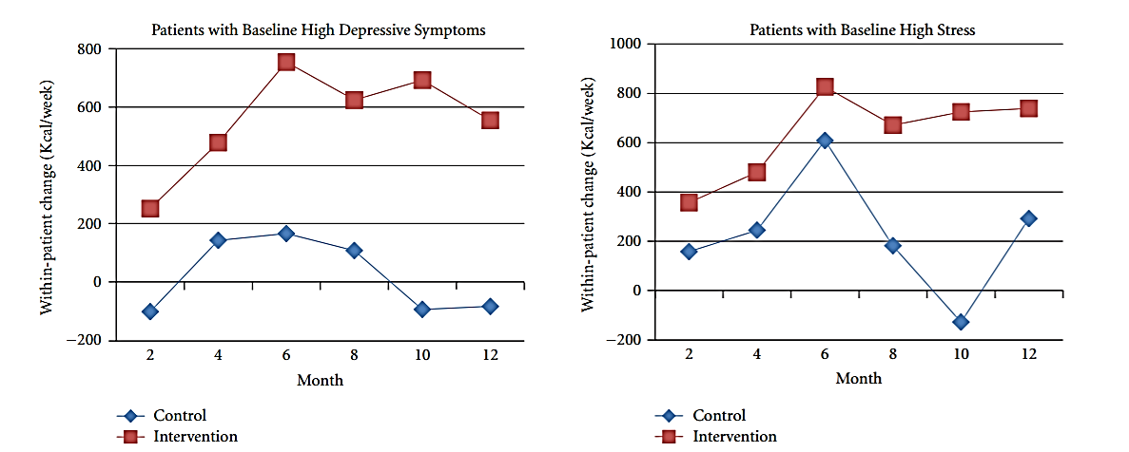
Positive affect/self-affirmation enabled CVD patients to overcome high depressive symptoms and stress
Peterson JC. The adaptive neuroplasticity hypothesis of behavioral maintenance. Neural Plast. 2012; 516364

Slide 10
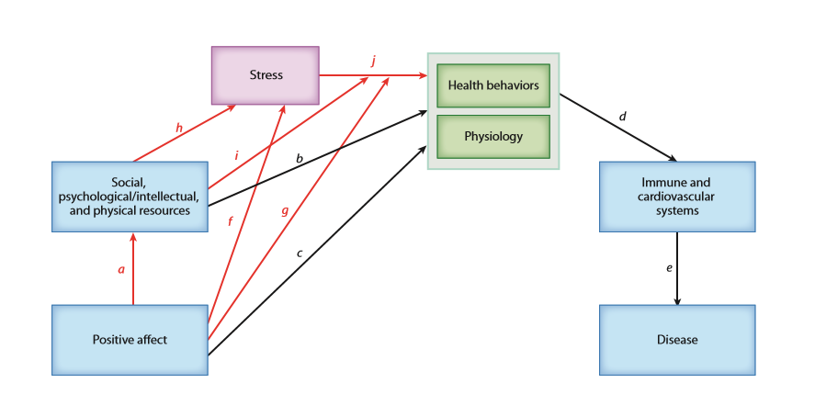
Stress buffering model of positive affect
Pressman, Jenkins & Moskowitz. Positive Affect and Health: What Do We Know and Where Next Should We Go? Annu Rev Psychol. 2018 Sep 27.

Slide 11
Where to go next
Gaps in the literature
Next steps
1. Studies underpowered and poorly controlled
2. PA not yet demonstrated to be a mediator of health outcomes in intervention studies
3. Stress-buffering effects of PA poorly understood
4. More work to assess PA arousal levels (e.g., high, mid, and low arousal) and health outcomes in different conditions and age groups
1. Larger, well-controlled studies in older adults with chronic disease
2. Studies with well-defined mediators & carefully measured clinical outcomes
3. Carefully measure stress, evaluate as mediator & moderator
4. Employ formal PA instruments (e.g., PANAS), evaluate arousal levels in disease/age groups

