Slide 1

Gender Issues and Addiction
Alison A. Moore, MD, MPH, FACP, AGSF
Division of Geriatrics and Gerontology
University of California San Diego

Slide 2
DSM-5 criteria for Substance Use Disorder
Criteria | Severity
Using larger amounts than intended Persistent desire to cut down or quit Significant time spent taking or obtaining substance Craving or urge to use substance Failure to fulfill obligations Continued use despite negative interpersonal consequences Reduced social or recreational activities Use in physically hazardous situations Use despite knowledge of harms Tolerance (excludes prescription medication) Withdrawal (excludes prescription medication) | 0–1 criteria = no SUD 2–3 criteria = mild SUD 4–5 criteria = moderate SUD >5 criteria = severe SUD
Table 2. DSM-5 criteria for substance use disorders (SUDs)

Slide 3

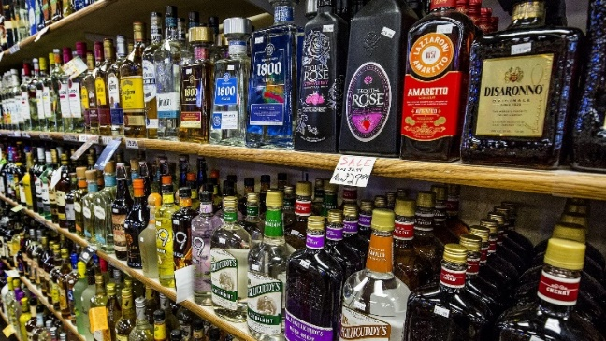
Substance abuse is growing in older adults and women
Estimated that the number of older adults who will need treatment will increase from 1.7 million in 2000-01 to 4.4 million in 2020.
Partially attributed to baby boomer population who has had more exposure to drugs, alcohol and tobacco from a younger age.
Yet substance abuse is often undetected and undertreated.
Chhatre et al. 2017 BMC Health Serv Res

Slide 4

Aging and Substance Use Disorders (SUDs)
Aging increases risk for harm from substances
Aging-related changes to the brain, body, substance pharmacokinetics, metabolism increase effect of substance.
Comorbid conditions and medications may exacerbate risks
Kuerbis, Sacco, Blazer, Moore. 2014 Clin Geriatr Med

Slide 5
Sex/Gender and Substance Use Disorders (SUDs)
Sex/Gender influences on risk/prevalence
Biological sex differences: Women tend to have lower body mass, more body fat, less body water, and reduced alcohol dehydrogenase (increase alcohol effect, increase effect fat soluble substances) increasing risk for harm. Conflicting evidence for differences in brain function and structure.
Gender differences: ? due to access to substances, cultural/social norms, later onset of substance initiation for women.
McHugh RK et al, 2017 Clin Psych Rev

Slide 6
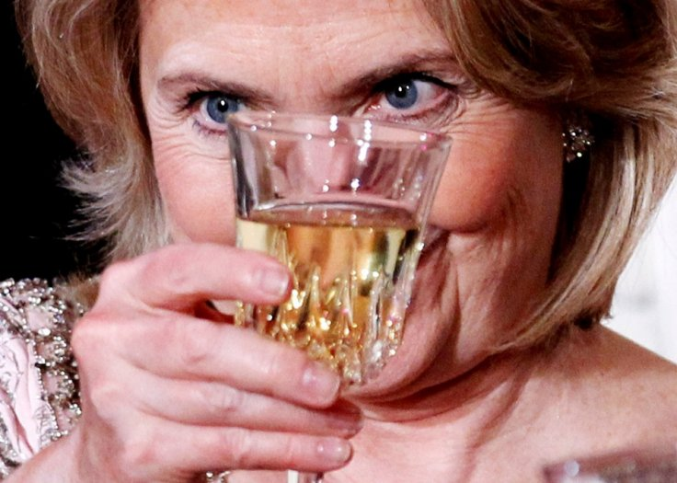

Age, Gender, and Substance Use Disorders (SUDs)
Aging and Gender
Compared to younger persons, older persons use less substances and have lower rates of SUDS, however, use and SUDs are increasing over time
Compared to men, women use less substances (aside from sedatives-all ages and tobacco-in older ages) but women are catching up to men.

Slide 7
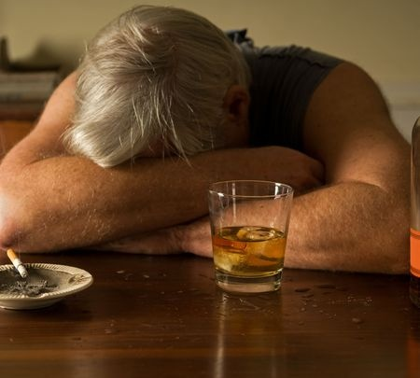
Adverse consequences and co-occurring psychiatric disorders
Aging: Symptoms of SUDs may include cognitive impairment, isolation, insomnia, falls, impairments in function.
Gender: Women have more functional impairment, and poorer quality of life. Alcohol increases risk for breast cancer. SUDs increase risk for victimization, and sexual risk behaviors.

Slide 8
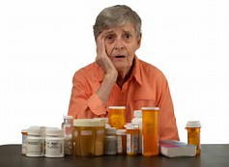
Adverse consequences and co-occurring psychiatric disorders (con’t)
Aging and gender:
Increased risk for cause or worsening of myriad medical conditions as well as injury.
Co-occurring psychiatric disorders, particularly in women. Higher anxiety and depression in women, anti-social personality disorder in men.
Polysubstance disorders also more common

Slide 9

Treatment of SUDs
Women and older adults are less likely to seek treatment.
For women this is particularly true for alcohol use disorders.
Women more likely seek treatment at mental health treatment settings while men receive specialized SUD treatment.
Women and men do not differ with respect to treatment retention or outcomes.
Stigma, childcare, particular barriers for women.
Greenfield SF et al. 2007, Drug Alcohol Depend

Slide 10

Treatment of SUDs (cont’d)
Treatment specialized for women (e.g., focus on trauma, co-occurring psychiatric disorders, relationships with children) showed better treatment outcomes and participant satisfaction.
Some evidence this is also true for treatment specialized for older adults, but there are few programs.
Older adults who enter treatment, have high rates of treatment retention.
Newer pharmacotherapies haven’t been specifically tested in older adults but likely work as well as with younger populations.
McHugh RK et al 2017 Clin Psychol Rev, Kuerbis A et al.2014 Clin Geriatr Med

Slide 11
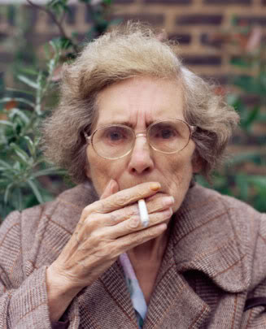

Knowledge Gaps
Few studies examining intersection of age and sex or gender related to any aspect of substance use disorders.
Epidemiology is most studied and alcohol is most studied substance.
More work has been done on unhealthy substance use but again, little on the intersection of age and sex or gender.

