Slide 1

The STRIDE Study: A pragmatic cluster randomized trial
Nancy Latham PhD PT
Siobhan McMahon PhD GNP-BC

Slide 2
Outline
STRIDE Study Design
STRIDE Intervention
Preliminary Intervention Implementation Data
Next Steps and New Questions

Slide 3
The Strategies to Reduce Injuries and Develop Confidence in Elders (STRIDE) Study
Funders: Patient-Centered Outcomes Research Institute (PCORI) and National Institute on Aging
Pragmatic trial designed to answer:
“Can redesigning health care practices and engaging patients to improve quality reduce serious falls-related injuries and improve other outcomes?”

Slide 4
Design
Cluster-randomized, parallel group superiority trial with practices stratified by healthcare system and patients nested within practices
Unit of randomization is the practice (clinics)
86 clinics and 5451 patients recruited from across 10 research sites over 20 months with 24 months of follow-up (maximum follow up =44 months)
Clinics randomized to 1 of 2 conditions
STRIDE Intervention
Enhanced practice (education about falls prevention and increased access to CDC published fall prevention resources)
Primary Outcome: Serious fall-related injuries

Slide 5
STRIDE Clinical Trial Sites
Mercy Health System University of Iowa
Des Moines, IA
Michigan Medicine
University of Michigan
Ann Arbor, MI
Essentia Health
Duluth, MN
Partners HealthCare
Boston, MA
Reliant Medical Group
Worcester, MA
Mt. Sinai Health System
New York, NY
Johns Hopkins Medicine
Baltimore, MD
HealthCare Partners
El Segundo, CA
University of Pittsburgh Medical Center
Pittsburgh, PA
University of Texas Medical Branch at Galveston
Galveston, TX

Slide 6
STRIDE Patients
Community dwelling persons
70 years of age or older
One or more risk factors for falls
Fallen and hurt self in the past year
Fallen 2 or more times in the past year
Fear of falling because of balance or gait

Slide 7
The STRIDE Intervention
Empirical and Theoretical Foundation
Evidence based fall risk assessment and treatment
Chronic care model
Falls Care Management (FCM) Processes
Protocol guided
Interdisciplinary Collaboration
Primary providers and clinic staff
Co-create and approve how FCM processes will be operationalized locally
Self-management
Patient centered
Motivational interviewing spirit and basic tactics
Nurse delivered in primary care settings
Assessment (7 primary fall risks)
Elicit Patient preferences
Co-create, individualized fall-reducing plan of care
Co-evaluation and refinement of individualized care plan annually (minimum)
Approve and/ or contribute to individualized care plans
Clinical and community resources
Referral sources for specific risks (e.g., physical therapy, medication therapy management )
Community based resources for specific risks (e.g., group exercise program that includes balance-challenging and leg-strengthening movements)
Co-manage fall risk
Provide counseling/ information about fall reducing behaviors

Slide 8
STRIDE Intervention Risk Factors
Medication risks ^{1, 2}
Postural hypotension^{1,2}
Visual impairment1^{1,2}
Feet and footwear problems ¹
Osteoporosis, calcium and vitamin D^{1,2}
Strength, gait, and balance disorders ^{1,2}
Home safety risks ^{1,2}
Reducing most of these risks requires behavior change among patients at risk ¹ and, often, health care provider/ prescriber^{.2}

Slide 9
Which fall risk factors are common among STRIDE patients ?
Risk factor | % STRIDE patients with this risk*
Strength gait balance problems | 100
Osteoporosis | 92
Visual impairment | 64
Foot and footwear problems | 51
Medication risks | 24
Home safety risks | 17
Postural hypotension | 12
*percent of patients in the intervention arm of STRIDE whose assessments revealed the presence of these risks

Slide 10
Which fall risk factors do STRIDE patients prioritize (e.g., choose to learn about and consider treatment options)?
Risk factor | % STRIDE patients with risk that also prioritized risk*
Strength gait balance problems | 89
Osteoporosis | 66
Visual impairment | 84
Foot and footwear problems | 73
Medication risks | 34
Home safety risks | 65
Postural hypotension | 92
*percent of patients in the intervention arm of STRIDE, with this positive risk factor who prioritized it

Slide 11
Which fall risk factors do STRIDE patients agree to act on?
Risk factor | % STRIDE patients acted on this risk
Strength gait balance problems | 70
Osteoporosis | 43
Visual impairment | 40
Foot and footwear problems | 22
Medication risks | 6
Home safety risks | 9
Postural hypotension | 7
*percent of patients in the intervention arm of STRIDE who self-reported action(s) to reduce risk

Slide 12
Next Steps
New Questions (e.g., future research)
Intervention ends November 30, 2018
Main study results April 2020
Analyze effects of 2 STRIDE conditions on primary outcome of serious fall related injuries
Analyze intervention processes
Ancillary study to examine contextual and cultural factors influencing intervention implementation
Secondary analysis to describe patient risks, priorities and actions over time
Secondary analyses to explore intervention effects among sub-groups of patients
What behavior strategies/techniques will most efficiently& effectively lead to changes in fall-reducing behavior….
at what doses and for whom?
What are the linkages between behavior change strategies, psychosocial mechanisms of change, and behavioral outcomes?
Role of technology in supporting behavior change?

Slide 13
STRIDE References
STRIDE website: http://www.stride-study.org/
Bhasin, S., Gill, T. M., Reuben, D. B., Latham, N. K., Gurwitz, J. H., Dykes, P., ... & Basaria, S. (2017). Strategies to Reduce Injuries and Develop Confidence in Elders (STRIDE): a cluster-randomized pragmatic trial of a multifactorial fall injury prevention strategy: design and methods. The Journals of Gerontology: Series A.
Reuben, D. B., Gazarian, P., Alexander, N., Araujo, K., Baker, D., Bean, J. F., ... & Leipzig, R. M. (2017). The Strategies to Reduce Injuries and Develop Confidence in Elders Intervention: Falls Risk Factor Assessment and Management, Patient Engagement, and Nurse Co‐management. Journal of the American Geriatrics Society, 65(12), 2733-2739

Slide 14

Questions? nklatham@bwh.harvard.edu @Nancy_K_Latham

Slide 15
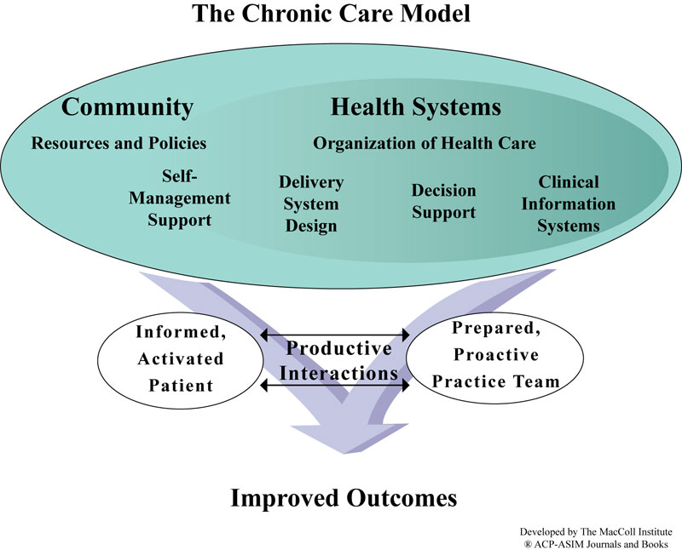
The Chronic Care Model
Extra

Slide 16
Extra Self-Management: Definition
The day to day management of a health condition
Practice of activities regarding health
Interactions with healthcare system
Monitoring the status of a condition
Making adjustments to plans over time
Everyone practices self management!

Slide 17
Extra Key concepts in Self-Management
Individualized assessment
Collaborative goal setting
Enhancing skills
Follow up and support
Overcoming barriers in the healthcare system and elsewhere
Access to community resources

