Slide 1

iCardia: A mobile health technology platform for remote collection of patient-generated health data and delivery of behavior change intervention
Spyros Kitsiou, PhD
Assistant Professor
Department of Biomedical & Health Information Sciences
College of Applied Health Sciences
University of Illinois at Chicago

Slide 2
Disclosures
No financial or other conflicts of interest

Slide 3
Outline
Brief introduction
Main components and features of the iCardia platform
Case study I: Promoting better self-care in patients with heart failure
Cast study II: Testing adaptive interventions for improving physical activity among employed sedentary women who are at high risk for cardiovascular disease

Slide 4
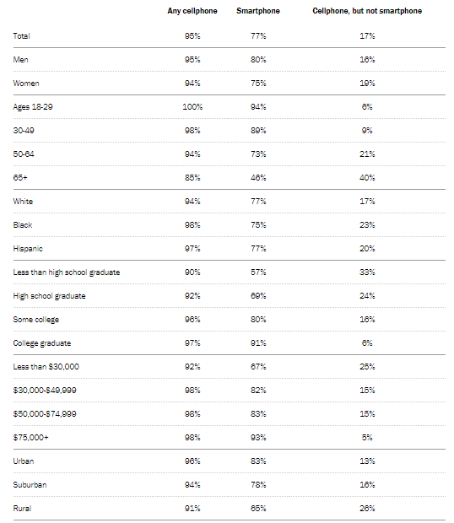
Mobile phone ownership in the US
Mobile technologies have witnessed unprecedented penetration among adults in the US
77% of Americans own a smartphone (up from just 35% since 2011) and 55% own a tablet
Lower income Americans and those over 50 have exhibited a sharp uptick in the last 3 years
Smartphone ownership is especially common among Blacks and Hispanics
Growing share of Americans now use smartphones as their primary means of online access at home
Source: Pew Research Center Survey conducted Jan 3-10, 2018.

Slide 5
Mobile apps and Connected Health Devices

Slide 6
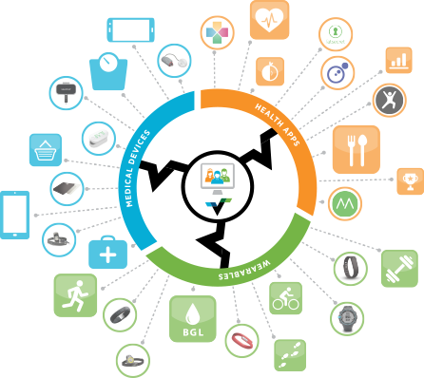
Mobile apps and Connected Health Devices
Web
APIs

Slide 7
Mobile apps and Connected Health Devices
Patient empowerment
Adherence to self-care behaviors
Motivation for lifestyle changes
Exchange of health information among consumers and between consumers and healthcare providers
Identification of new patters of markers that are informative of diseases severity or progression
Digital phenotype and precision medicine
Design of just-in-time adaptive interventions (JITAIs)

Slide 8
The iCardia platform
Passive monitoring
Heart Rate
Physical activity
Exercise
Sedentary Time
Caloric expenditure
Sleep quality
Active monitoring:
Blood pressure
HbA1c
Weight
Water retention
Body Mass Index
Muscle Mass
Bone Mass

Slide 9
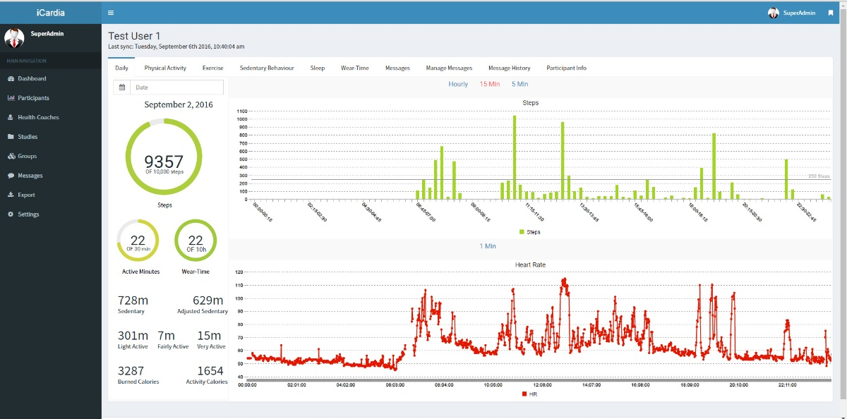
iCardia Dashboard – Intraday data

Slide 10
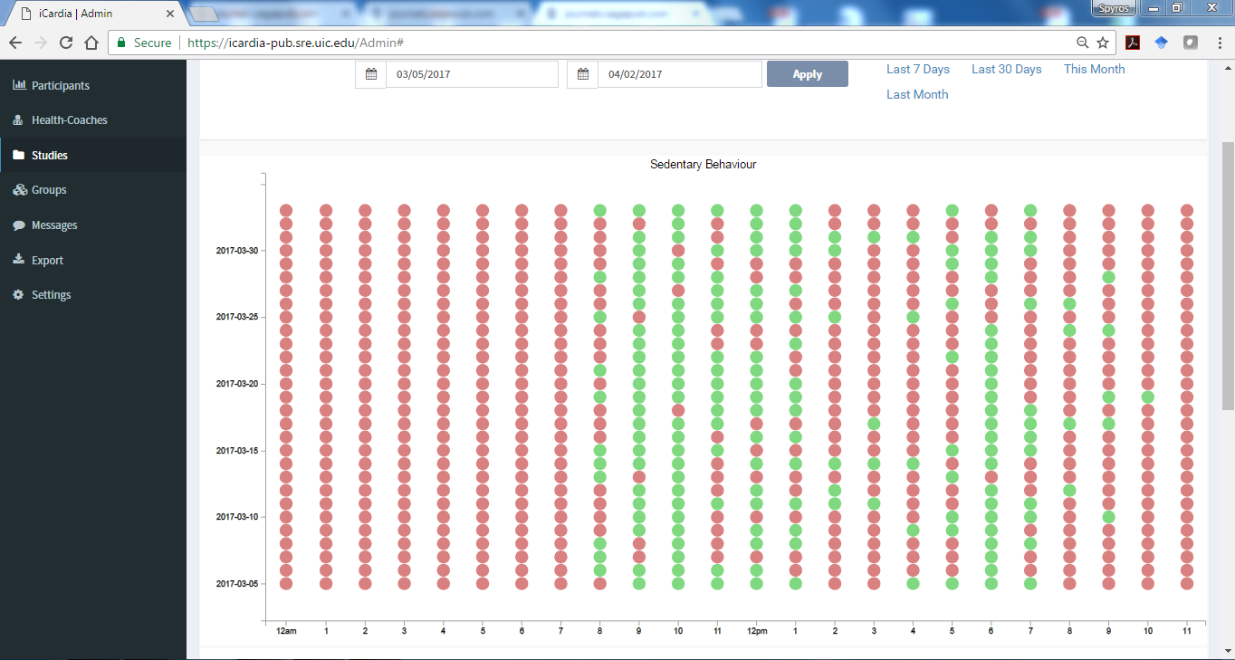
iCardia Dashboard: Sedentary behavior patterns

Slide 11
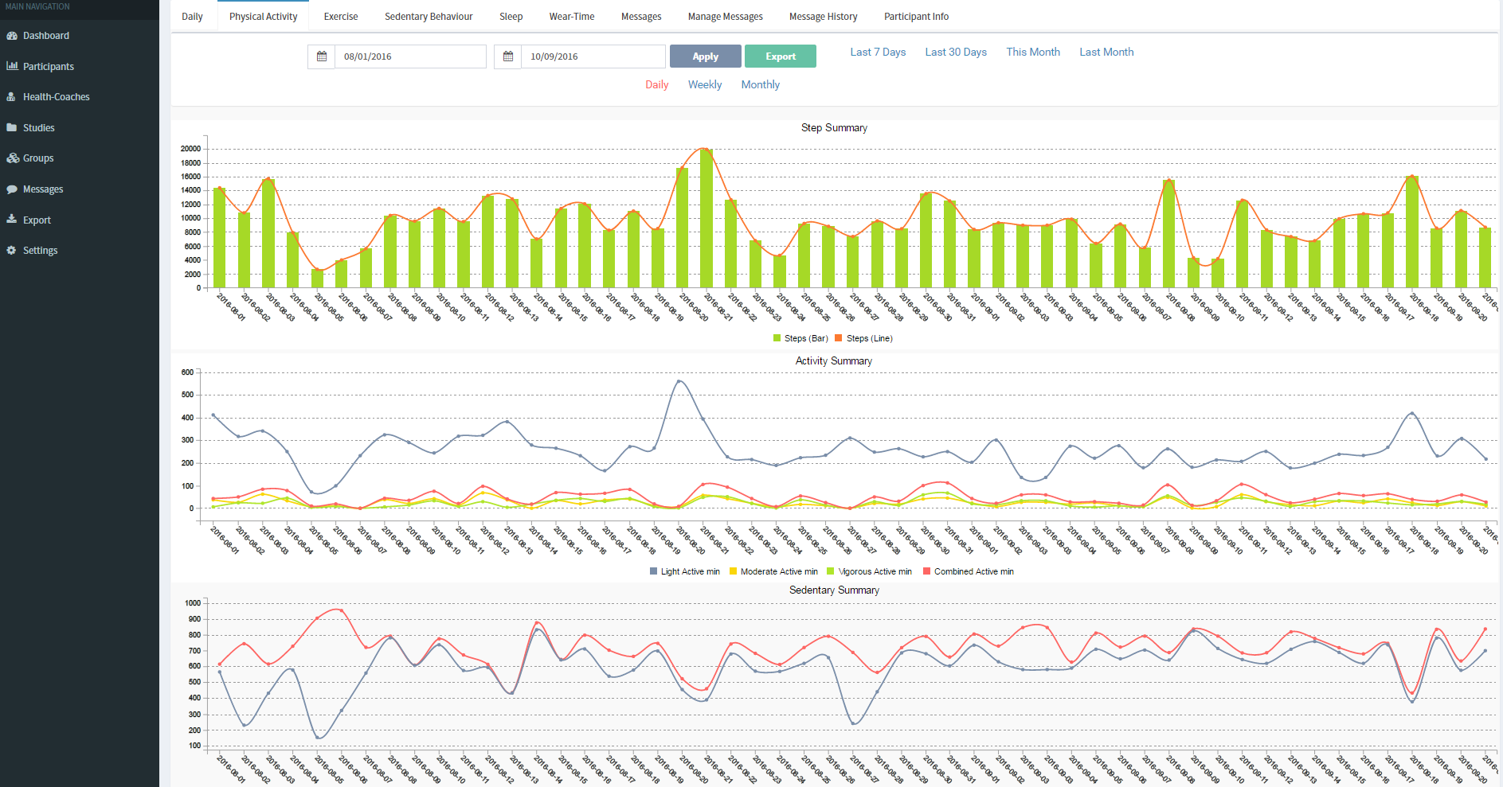
iCardia Dashboard: Physical activity over time

Slide 12
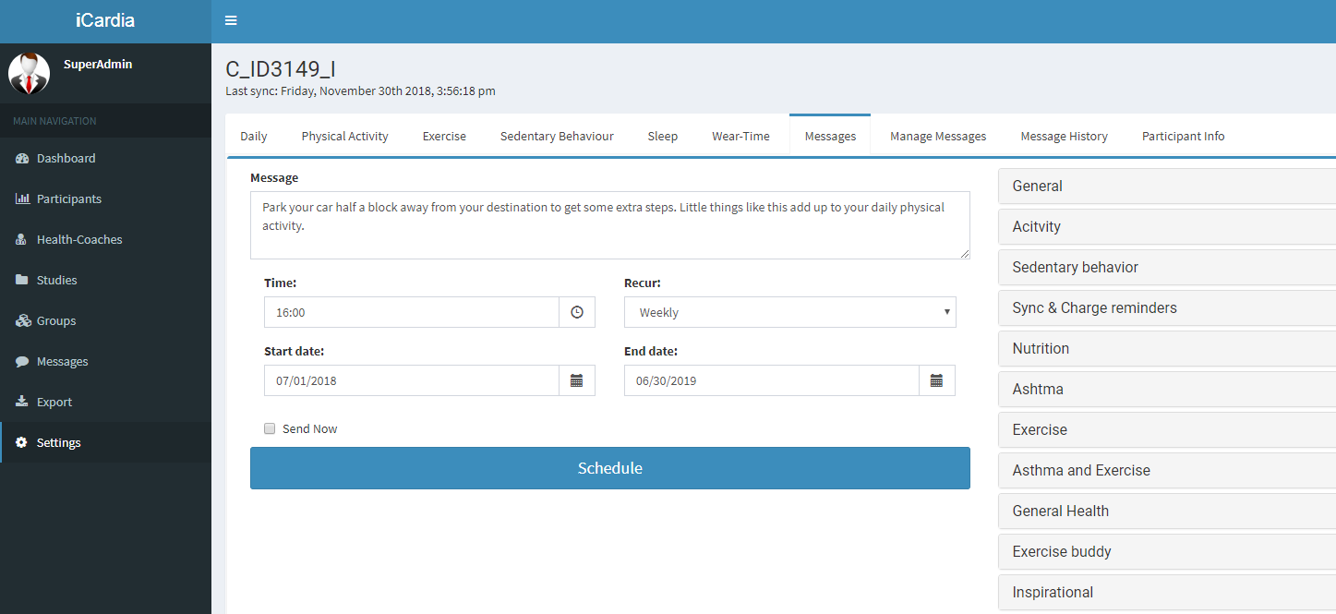
iCardia Dashboard: Tailored text-messages

Slide 13
Use of iCardia in NIH funded studies
Population Condition | Study | Funding Agency
Heart Failure | iCardia4HF: Patient-centered mHealth Intervention for Improving Self-care in Patients with Chronic Heart Failure | Midwest Roybal Center / NIA
Sedentary women at high risk for CVD | Testing Adaptive Interventions to Improve Physical Activity for Sedentary Women | NINR
Hypertension | TOUCHED: Post Acute Care Hypertension Consultation | NHLBI
Asthma | ACTION Intervention: Physical Activity in Minority Women with Asthma | NHLBI
Chronic Obstructive Pulmonary Disease (COPD) | Promoting Activity After COPD Exacerbations (PACE) | NHLBI
Osteoarthitis | Mobile Motivational Physical Activity Targeted Intervention to Improve Sleep in Older Adults with Osteoarthritis (MobMPATI) | NINR

Slide 14
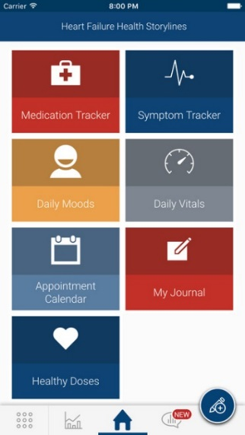
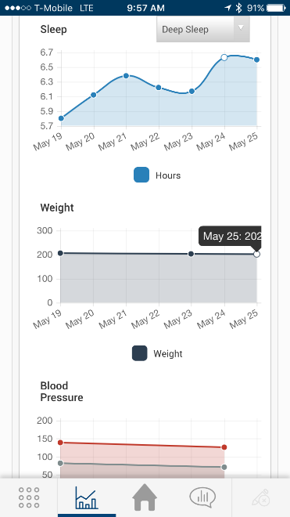
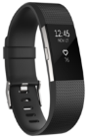
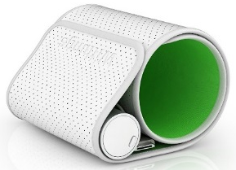
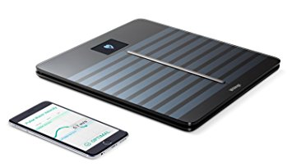
iCardia4HF – Patient-centered mHealth intervention for improving self-care in patients with chronic heart failure
Funding Agency: Midwest Roybal Center/NIA (PI: Kitsiou)
Background
More than 6.5 million Americans have heart failure (HF).
More than 25% of patients are readmitted to the hospital within 30 days and up to 50% within 6-months following a HF hospitalization.
Objective
To test the feasibility, acceptance, and preliminary efficacy of a patient-centered mHealth technology intervention (iCardia4HF) that promotes adherence to self-care in patients with chronic heart failure.
Methods
Study design: Pilot Randomized Controlled Trial (n=40)
Follow-up: 8 weeks
Population: HF Patients (≥ 50 years); hospitalized due to HF; NYHA class II-IV
Control group: Standard post-discharge care (patient education before hospital discharge, and follow-up visits at the outpatient HF clinic a week after discharge and monthly thereafter depending on the patient’s condition
Notes:
Adherence to routine self-care behaviors reduces the risk of mortality and hospitalization, and improves health-related quality of life

Slide 15
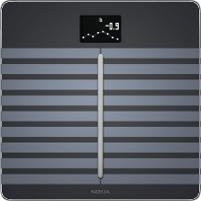
iCardia4HF – Patient-centered mHealth intervention for improving self-care in patients with chronic heart failure
Funding Agency: Midwest Roybal Center/NIA (PI: Kitsiou)
Intervention: Heart Failure Health Storylines Mobile App + Fitbit and Nokia Health Connected Devices + Tailored text-messages targeting health beliefs, self-efficacy, and HF knowledge
Monitored Data | Weight Properties | Blood Pressure | Symptoms | Medications | Heart Rate | Physical Activity | Exercise | Sedentary time | Sleep
Devices used | Nokia weight scale | Nokia BP monitor | - | - | Fitbit Charge 3 - Wearable activity tracker with heart rate sensor and automatic detection of sleep and aerobic exercise
Mobile app feature | Vital signs monitoring | Vital Signs monitoring | Symptoms tracker | Medication Tracker | Physical Activity Tracker
Type of monitoring | Active* | Active | Active | Active | Passive**
Reminders Frequency | Push notification (Daily) | Push notification (Daily) | Push notification (Daily) | Push notification (Daily) | Text-messages to remind participants to wear and charge their Fitbits as needed based on the wear-time data collected from the iCardia server
*Active monitoring: requires action by the patient (e.g. stepping on the scale); ** Passive monitoring: performed automatically by the device

Slide 16
iCardia4HF – Patient-centered mHealth intervention for improving self-care in patients with chronic heart failure
Funding Agency: Midwest Roybal Center/NIA (PI: Kitsiou)
Intervention: Heart Failure Health Storylines Mobile App + Fitbit and Nokia Health Connected Devices + Tailored text-messages targeting health beliefs, self-efficacy, and HF knowledge
Table 2: Examples of tailored text-messages
Tailoring of the TMs
Guided by patient’s responses to validates scales administered at baseline and 30-days
Health Beliefs about Medication Adherence
Benefit question: If I take my water pills, I will lower my chance of being hospitalized. | Barrier question: Taking water pills makes it hard to go away from home.
Text message: Taking your meds at the time and dose ordered by your doctor will help remove extra fluid from your body and lower your chance of being hospitalized. | Text message: Try to take your water pills earlier in the day when you are going out so that they will work before you leave the house.
Health Beliefs
Self-care efficacy
HF Knowledge
Notes:
The tailored TM program aims to improve adherence to HF self-care by targeting patients’ health beliefs, self-care efficacy, and HF knowledge in a culturally sensitive manner.

Slide 17
iCardia4HF – Patient-centered mHealth intervention for improving self-care in patients with chronic heart failure
Funding Agency: Midwest Roybal Center/NIA (PI: Kitsiou)
Primary Outcome Measures
Change in self-reported Self-Care (SCHFI v 7.2) [Time Frame: Baseline, 4 and 8 weeks]
Adherence to routine self-care behaviors (daily self-monitoring of signs and symptoms, medication taking, and physical activity) [Time Frame: Weeks 1 to 8]
Change in Health-related Quality of Life (Kansas City Cardiomyopathy) [Time Frame: Baseline, 4 and 8 weeks]
Secondary Outcome Measures
Hospital readmissions (all-cause and HF-related) [Time Frame: Weeks 1 to 8]
ER visits [Time Frame: Weeks 1 to 8]

Slide 18
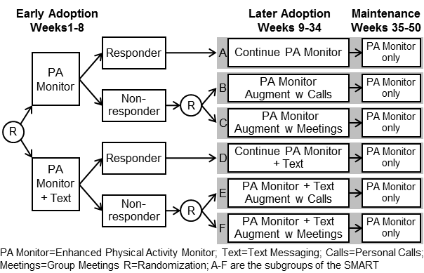


Testing Adaptive Interventions to Improve Physical Activity for Sedentary Women
NINR R01NR017635-01 (PI: Buchholz S. UIC PI: Kitsiou S; Co-Is: Wilbur J., Schoeny M, Johnson T.)
Objective:
To determine the most effective adaptive intervention combining four efficacious treatments (Fitbit activity monitor, motivational text messages, motivational personal calls, group meetings) to increase PA and improve cardiovascular (CV) health among sedentary employed women.
Methods:
Study Design: Sequential Multiple Assignment Randomized Trial (SMART)
Population: Employed Sedentary Women (n=312)
Setting: Rush University Medical Center
Interventions: Fitbit activity monitor, text-messages, motivational personal calls, and group meetings
Follow-up: 12 months
Primary Outcomes: Steps and Moderate-to-Vigorous PA (MPVA)
Secondary outcomes: Cardiovascular Health; Program and Participant costs

Slide 19
Discussion
Advances in mHealth technologies are enabling the development and delivery of scalable and affordable health interventions beyond the traditional office visit and across populations
Mobile health platforms such as iCardia have the potential to aid in modifying self-care behaviors related to physical activity, exercise, diet, weight management and lifestyle choices
Personalized coaching and goal monitoring in real-time as well as active surveillance of patients at high risk
Individualized tailoring of health interventions
Key mHealth challenges to consider:
Rapid technology changes beyond the control of the research team
Difficulty matching the rapid pace of mHealth innovation with traditional research designs (e.g. RCTs).
Reliability and validity of mHealth devices

Slide 20



Acknowledgements
University of Illinois at Chicago
Ben Gerber, MD, MPH
Tom Stamos, MD
Jun Ma, MD, PhD, FAHA, FABMR
Marquez David, PhD
Nienhuis Sharmilee, MD
Prieto-Centurion Valentin, MD
Prendergast Heather, MD, MS, MPH, FACEP
Indiana University Purdue University Indianapolis
Susan Pressler, PhD, RN, FAAN, FAHA
Rush University Medical Center
Susan Buccholz, PhD, RN, ANP-BC, FAANP
Wilbur JoEllen, PhD, APN, FAAN
University of Washington
Zaslavsky Oleg, PhD
University of Pennsylvania
George Demiris, PhD, FACMI

Slide 21
Contact Information
Spyros Kitsiou, Ph.D. Assistant Professor
Department of Biomedical and Health Information Sciences College of Applied Health Sciences University of Illinois at Chicago
Email: skitsiou@uic.edu
Tel.: (312) 355-3519 | Fax: (312) 996-8342

