Slide 1

Changing multiple behaviors to prevent Alzheimer's disease
Jeffrey a. Katula, ph.d. For the us pointer investigative team

Slide 2
Investigative team
Wake Forest School of Medicine Coordinating Center
WFSM Clinical Site
Jeff Williamson, MD
Jo Cleveland, MD
Ben Williams, MD
Bonnie Sachs, PhD
USC/ATRI
Rema Raman, PhD
Gus Jimenez-Maggiora
Robert Rissman, PhD
Karolinska Institutet & National Institute for Health & Welfare
Miia Kivipelto, MD PhD
Tiia Ngandu, MD PhD
Alina Solomon, MD PhD
Laura Baker, PhD
Mark Espeland, PhD
Jeff Katula, PhD
Nancy Woolard
Jin Su, PhD
Scott Rushing
Julia Robertson
Iris Leng, PhD
Dan Beavers, PhD
Sam Lockhart, PhD
Rush U Medical Center
Martha Clare Morris, ScD
Jennifer Ventrelle, MS
U of California – Davis *Clinical Site
Rachel Whitmer, PhD
Sarah Farias, PhD,
Charlie DeCarli, MD
Brigham & Women’s Hospital
Kate Papp, PhD
Dorene Rentz, PhD
Yakeel Quiroz, PhD
Alzheimer’s Association
Maria Carrillo, PhD
Heather Snyder, PhD
Y-USA
Valerie Lawson, MS RD
Jeffrey Katula, "Achieving and Sustaining Behavior Change to Benefit Older Adults" Dec 6-7, 2018

Slide 3

MULTIDOMAIN INTERVENTION
Nutrition
Exercise
Cognitive training
Vascular risk monitoring
N = 1260
Age: 60-77 years
2 years
REGULAR HEALTH ADVICE

Slide 4
Objectives
Cohort:
Self-Guided Lifestyle Intervention
Structured Lifestyle Intervention
Primary Outcome:
Cognitive trajectory (global cognitive composite outcome)
N=2000; 5 clinical networks
Cognitively normal older adults (60-79 years)
increased risk for cognitive decline: sedentary, poor diet, cardiovascular health status, 1st degree family history.
Random allocation:
24 months of follow up
Jeffrey Katula, "Achieving and Sustaining Behavior Change to Benefit Older Adults" Dec 6-7, 2018
Notes:
Assess effects of random assignment to a Self-Guided vs. Structured Lifestyle Intervention focused on increasing aerobic exercise, adherence to the MIND diet, cognitive and social stimulation, and guideline-based health coaching to manage cardiometabolic risk factors on 2-year cognitive trajectory (based on a global cognitive composite outcome).
The primary composite outcome for the POINTER trial will be calculated as follows:
scores for each contributing test will be converted to z-scores by dividing the differences between individual scores from the cohort-wide mean at baseline by the cohort-wide standard deviation at baseline
z-scores will be ordered so that positive scores reflect better performance and negative scores reflect worse performance
a weighted average of the contributing z-scores will be obtained by domain, provided that at least 50% are present (if not, the composite score will be considered missing)
this average will be re-normalized by subtracting it from the cohort-wide mean at baseline and dividing this difference by the cohort-wide standard deviation at baseline

Slide 5
community partnership

Slide 6
Self-guided lifestyle intervention
Healthy Lifestyle Practices Education
Annual guideline-based health monitoring
Blood pressure
CVD risk factors
Body weight
Group meetings
3 → year 1
2 → year 2
Incentives/Tools
Resources to support behavior change
Physical Activity
Diet
Cognitive Activity
CVD Risk Factors

Slide 7
Structured Lifestyle Intervention
Physical activity
Nutrition
Cognitive Training
Guideline-based Health Coaching
Jeffrey Katula, "Achieving and Sustaining Behavior Change to Benefit Older Adults" Dec 6-7, 2018

Slide 8
Group-mediated cognitive behavioral Module
Behavioral Domain Roll out
Education
Group-processes
Self-regulation
Physical activity
MIND Nutrition
Cognitive Training
Health Coaching
Exercise
Safety
Nutrition
Technology
Cohesion
Reality sharing
Normalizing
Motivation
Relapse-prevention
Success/Barriers
Goal-setting
Jeffrey Katula, "Achieving and Sustaining Behavior Change to Benefit Older Adults" Dec 6-7, 2018

Slide 9
Participant tracking/management
Wellpepper
Technology
Interactive patient management system
Integrates 3rd party vendors & study DMS
Communication with participants
Cognitive Training
Regular Contact
Group meetings
Telephone contacts

Slide 10
Behavior change
Theoretical Foundations
Social Cognitive Theory
Environment
Physical/Community
Groups/tribes
Group processes
Accountability/
Support
Navigators
Social/Interpersonal Communication
Relationships
Interventionists
Toolbox
Self-determination Theory
Motivational Interviewing
Jeffrey Katula, "Achieving and Sustaining Behavior Change to Benefit Older Adults" Dec 6-7, 2018

Slide 11
Other concerns
Nonconscious processes
Upstream Socio-cultural influences
Other behaviors (e.g., Sleep)

Slide 12

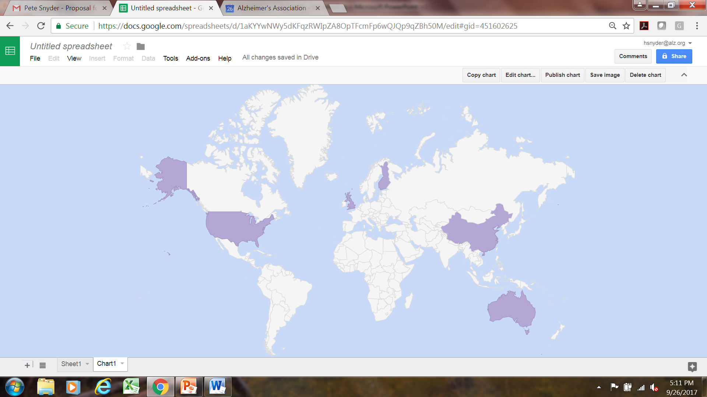
FINGER
Can-Thumb
U.K. FINGER
Netherlands
U.S. POINTER
MIND
FINGER
Germany, Spain, Italy
Japan
Mexico
India
SINGER
Maintain Your Brain
Argentina
alz.org/wwfingers

Slide 13
outcomes

Slide 14
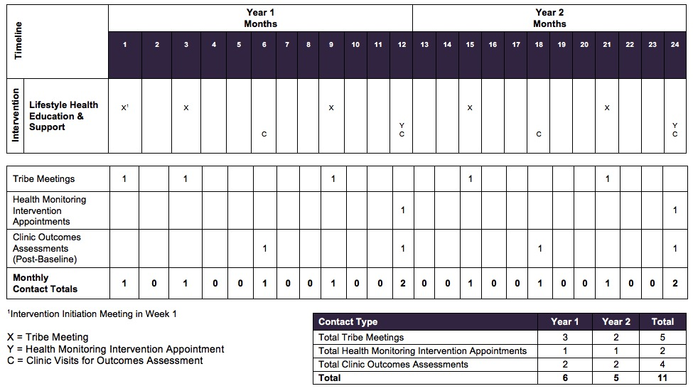
Self-guided arm contact schedule
Self-guided Lifestyle Intervention
Jeffrey Katula, "Achieving and Sustaining Behavior Change to Benefit Older Adults" Dec 6-7, 2018

Slide 15
Contact Schedule
Jeffrey Katula, "Achieving and Sustaining Behavior Change to Benefit Older Adults" Dec 6-7, 2018

