Slide 1
Arts-based Interventions
RCCN: Achieving and Sustaining Behavior Change to Benefit Older Adults
Julene K Johnson, PhD
UCSF Center for Aging in Diverse Communities (a RCMAR)

Slide 2
Background
Need for interventions that promote health, well-being, and independence for older adults, including health disparities populations
  Our population is aging.
    The global population of older adults aged ≥ 60 years is predicted to increase from 901 million in 2015 to 2.1 billion in 2050 (United Nations World Population Ageing report, 2015)
  Our population is becoming more diverse.
    The US population of adults age 65+ is increasingly diverse, with nearly 22% being from racial/ethnic minority backgrounds (US Census Bureau, 2017)

Slide 3
RE-AIM Framework for Health Promotion Interventions
R Reach | Participation by % of target population
E Efficacy | Positive minus negative outcomes
A Adoption | % of settings that adopt intervention
I Implementation | Implemented as intended in real world
M Maintenance | Sustained over time
Glasgow et al., 1999
www.re-aim.org
Notes:
For almost 2 decades, we’ve used the RE-AIM framework for helping guide how to create evidence-based interventions that are effective and sustainable.

Slide 4
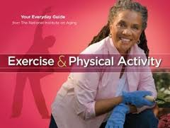
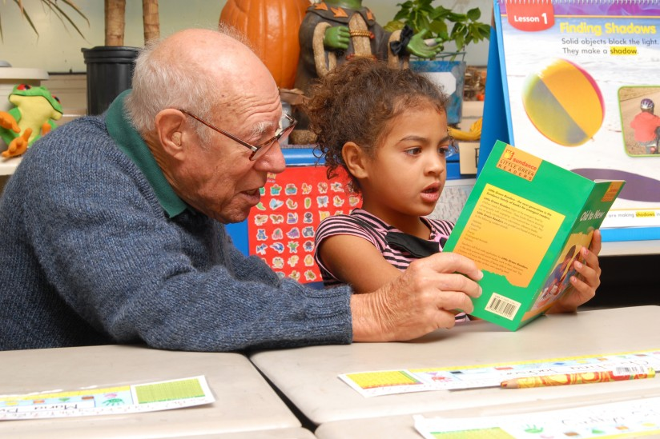
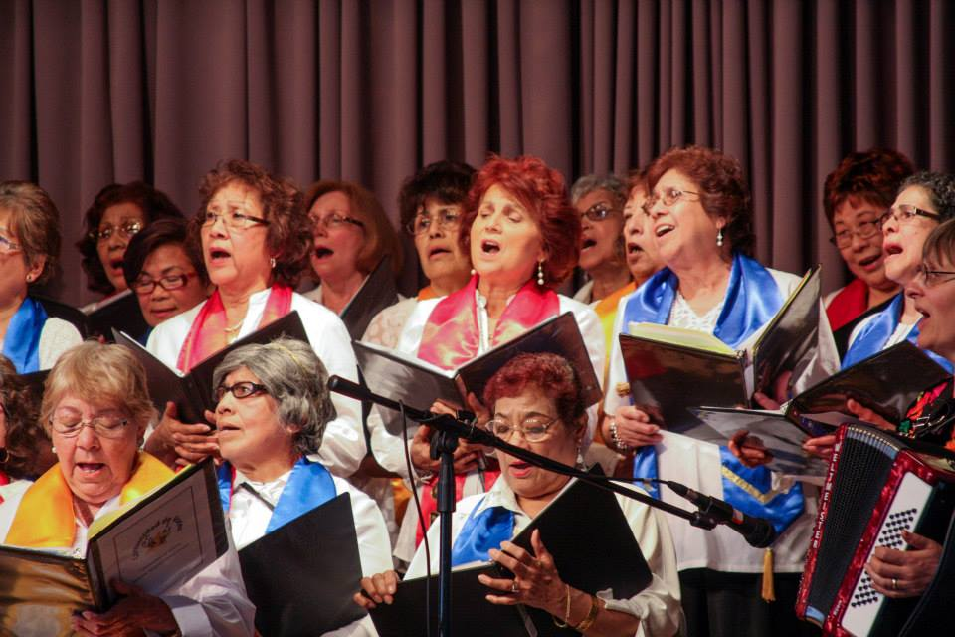
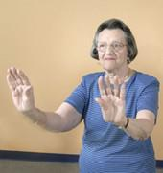
Health promotion interventions for older adults
Physical activity (~4900 studies)
Volunteering (~600 studies)
Cognitive training (~300 studies)
Tai Chi (~200 studies)
Yoga (~75 studies)
Participatory arts (~30 studies)
Photo: AARP Foundation - Experience Corps
Notes:
A number of interventions developed and tested
Most evidence-based interventions developed and tested in academic settings for mainstream, highly selected populations.

Slide 5
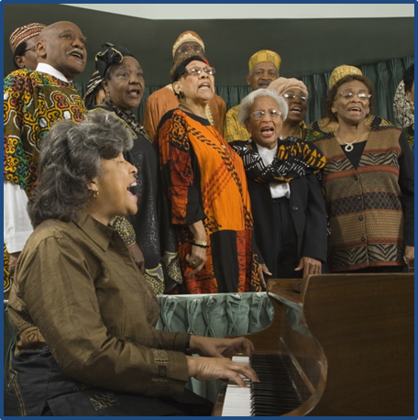
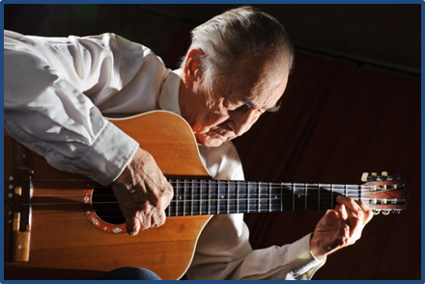
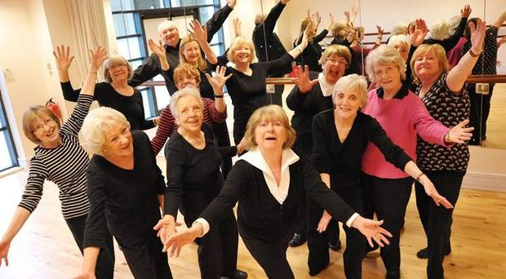
Arts Interventions for Older Adults
Music (piano playing, group singing, instrumental)
Dance (Improvised, ballroom, social, salsa)
Theater / Acting
Expressive writing (autobiographical writing, life review)
Visual Arts (painting, clay art, textiles, photography)
Noice et al. (2014) review of 31 studies

Slide 6
Potential of Arts Interventions to Promote Health for Older Adults
  R Reach
    Relatively low cost to deliver
    Easily culturally adapted, including for health disparities populations
  E Efficacy
    Research increasing and in progress
  A Adoption
    Easily embed in existing community settings
  I Implementation
    delivered as intended (adherence, music professionals as interventionists)
  M Maintenance
    Have both individual and organizational aspects for maintaining behavior change

Slide 7
Potential of Arts Interventions to Promote Health for Older Adults
Behavior change sustaining principles
  Culturally relevant and easily adapted to many cultures
  Generally inherently enjoyable and fun
  Self-motivating and naturally engaging
  Meaningful
  Gives back to and creates community
Limitations
  Mechanisms of behavior change not yet well understood
  Effectiveness not yet known

Slide 8

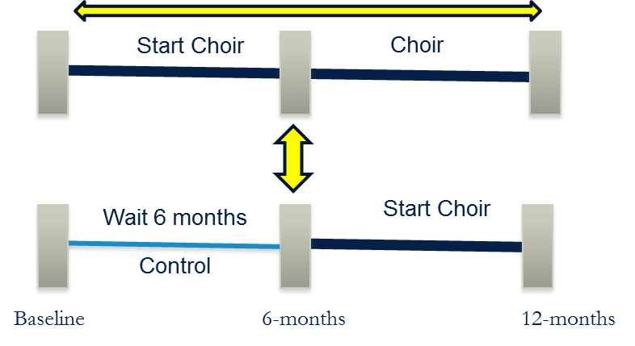
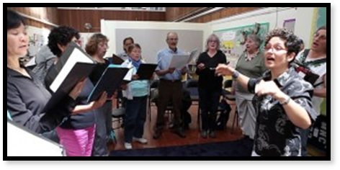
Cluster-Randomized Trial of Community Choirs to Promote Health & Wellbeing of Diverse Older Adults (n=390 at 12 senior centers)
Age (mean, SD) | 71.2 (7.1) range = 59-93
Sex (women) | 76%
Race/Ethnicity | 33% non-Latino White 27% Asian 19% non-Latino Black 19% Latino
Education (HS or less) | 26%
Not partnered | 68%
Poor to fair health | 26%
Had not previously sung in choir | 55%
92% retention in study
~3/4 attended 50%+ sessions
Johnson et al. (in press) J Gerontol: Psychological Sciences

Slide 9

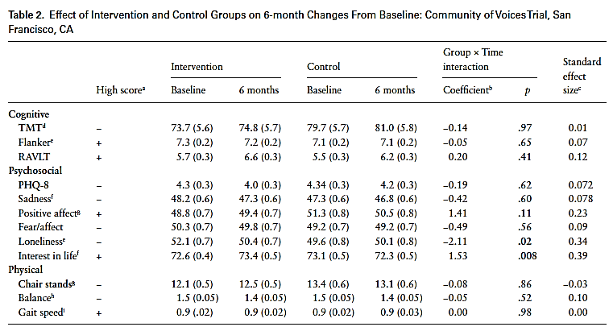
Intention-to-treat Results
Cognitive, psychosocial, and physical outcomes over 6 months
Johnson et al. (in press) J Gerontol: Psychological Sciences

Slide 10
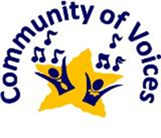
Perceived Benefits of Community Choirs
Allison et al. (submitted)
Psychosocial benefits
  Emotional well-being, self-efficacy, social network and support, reduced loneliness, self-esteem, finding their place in society, & cultural identity / appreciation
Physical benefits
  Awareness and strength of voice & stamina
Cognitive benefits
  Learning new skills & improved memory and attention

Slide 11

“You're waiting with anticipation for the day to come.”
“The base of the [African American] culture is rooted and grounded in music, going far back… the underground railroads, the Doo-Wop, the Blues, the Motown.”
“It makes them feel like they’re doing something that’s good and that they can look forward to doing.”
Allison et al. (submitted)

Slide 12
Arts Interventions to Promote Health of Older Adults are Typically Developed in the Community
Community-based participatory research (CBPR)
  Involve community stakeholders from onset
  Identify interventions that are culturally relevant and can be easily adapted for multiple groups
    subcultural differences in language, ethnicity, education, and income
Transcreation Framework for Community-engaged Behavioral Interventions to Reduce Health Disparities (Nápoles & Stewart, 2018)
  designing and delivering interventions in communities to reduce health disparities

Slide 13
Conclusions
Arts interventions have potential to become a public health promotion intervention relevant to older adults
  Meets RE-AIM principles
  Can be developed and tested in community settings, making them potentially easier to sustain (individual and organization)
Arts interventions offer new insights into behavior sustaining principles
  Culturally relevant and easily adapted to many cultures
  Generally inherently enjoyable and fun
  Self-motivating and naturally engaging
  Meaningful
  Gives back to and creates community

Slide 14


Acknowledgements
UCSF Center for Aging in Diverse Communities
UCSF Pepper Center
UCSF Institute for Health & Aging
COV choir program manual:
https://cov.ucsf.edu/
San Francisco Community Music Center
San Francisco Department of Aging and Adult Services
Funding:
  NIH R01 AG042526
  NIH P30 AG15272

