Slide 1
Jump Start Your Research Team: Establishing Expectations and Norms to Ensure Success
Presented by Holly Brower, PhD
Wake Forest University
School of Business

Slide 2
Goals for Session:
Establish Context of bringing together multidisciplinary teams to conduct high impact research on aging
Practices to convene teams
Establishing effective foundation for new teams
Effective team development
Q & A

Slide 3
Introduction
“Not finance. Not strategy. Not technology. It is teamwork that remains the ultimate competitive advantage, both because it is so powerful and so rare.”
Patrick Lencioni, The Five Dysfunctions of a Team, “Introduction,” p. vii. (First lines of the book.)
Notes:
Today, we are here to strengthen teams and, by doing, to increase the effectiveness and impact—particularly of interdisciplinary research teams. It is my hope that you will come away with process that you can apply to any teams on which you serve and lead
Let’s dive in!

Slide 4
Katzenbach & Smith Definition of Teams
“A team is a small number of people with complementary skills who are committed to a common purpose, performance goals, and approach for which they hold themselves mutually accountable.”
Notes:
Difference between a team and a group…interdependence. Use sports examples track team vs. basketball team We capitalize on the exemplary results of teams by making sure there is “tight coupling.” In other words, to be the best, teams need to be interdependent and well connected—accountable to each other and strong ties.

Slide 5
Ideas for “Finding Each Other”
With openness to potential partners outside your own discipline, read, listen, watch for publications, podcasts, seminars…
Papers and articles published within areas of interest
Conferences, webinars, etc.
Search for faculty in Coordinating Centers for Aging Research
RCCN website—contact numbers for coordinating centers
Notes:
First, some of you are convinced that interdisciplinary teams are best, but wonder—how do I find research teammates…. When you see someone doing something of interest, introduce yourself and ASK. People love to be asked—it demonstrates interest. If this particular individual isn’t available to collaborate…ask for other connections—potentially junior scholars at their institution or others who have collaborated on research with them to whom they may introduce you. At the first RCCN conference in December, researchers in Health and Exercise Science met with practicing physicians, …

Slide 6
Tuckman’s Stages of Group Development
Forming
Storming
Norming
Performing
“How do I fit
in?”
“How do I best reconcile my ideas with the group?”
“How can I
deliver what
is expected?”
“How can I sustain this level of success?”
Individual Issues
Group Issues
“Why are we
here?”
“How
do we identify the best ideas without fighting?”
“How can we
work as a
cohesive
team?”
“How de we keep everyone motivated?”
Notes:
I want to introduce 2 very widely accepted models of effective teams. The first is a classic model of team development by Tuckman that has been widely adopted for more than 50 years. These are the 4 stages. Within each stage, team members are asking specific questions. Effective team leaders pay attention to each stage and the appropriate questions of each stage.

Slide 7
The Five Dysfunctions of a Team—Patrick Lencioni
Notes:
A second model is more contemporary and yet already widely accepted and utilized. Lencioni’s work can be mapped onto the 4 stages of group development and he prescribes that paying attention to these 5 issues needs to become established in the culture of a team.

Slide 8
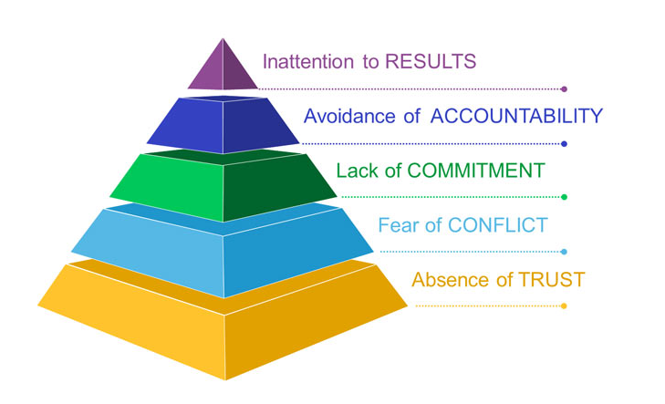
Lencioni’s Five Dysfunctions
Notes:
So , the opposite of these dysfunctions is are the 5 principles of effective teams. These are captured and an easy to read book by the same authored by Lencioni and he applies to all teams.

Slide 9
Trust Defined
“Trust is reciprocal faith in others’ intentions and behavior.”
Positive expectations from past behavior
Positive expectations from clarity

Slide 10
Research on Trust in Teams
When Trust Exists
More openness
More innovation & creativity
More willingness to listen to each other
Greater focus on goals
More efficient communication
When Trust is Missing
Attempts at openness & honesty are suspect
Members withhold ideas
Energies diverted to suspicions
Communication is guarded, ambiguous, distorted
“When trust goes out the door, suspicion comes innuendo.”
Chico Marx

Slide 11


What the Research Says about diverse teams…
Very good at generating ideas and making decisions
  Lots of diverse perspectives
  Two [diverse] heads are better than one…
Experience more conflict
Less effective at implementing their decisions…..unless
    “Deep-level” diversity is actively unearthed
    Team members work hard to understand each other’s perspectives

Slide 12
Three Types of Conflict
Task Conflict
Process Conflict
Relationship Conflict
What’s the task? What’s the goal? What’s our purpose?
How will we do it?
What process will we use?
Who will do what?
Who don’t I enjoy working with?
What do I not like about teammates?
Good for teams!
Not so much!

Slide 13
Research on Team Conflict
Teams that Fear Conflict
Have boring meetings
Create back-channel politics
Allow personal attacks to thrive
Ignore controversial topics
Fail to tap into all perspectives
Waste effort with posturing and interpersonal risk management
Teams that Engage Conflict
Have lively, interesting meetings
Extract and exploit the ideas of all team members
Solve real problems quickly
Minimize politics
Put critical topics on the table for discussion
The Five Dysfunctions of a Team by Patrick Lencioni, Jossey-Bass, 2002.

Slide 14
Achieving Commitment
BUY IN
CLARITY
Commitment

Slide 15
A team that fails to commit:
Creates ambiguity among the team about direction and priorities
Watches windows of opportunity close due to excessive analysis and unnecessary delay
Breeds lack of confidence and fear of failure
Revisits discussions and decisions again and again
Encourages second-guessing among team members
The Five Dysfunctions of a Team by Patrick Lencioni, Jossey-Bass, 2002.

Slide 16
A team that commits:
Creates clarity around direction and priorities
Aligns the entire team around common objectives
Develops an ability to learn from mistakes
Takes advantage of opportunities
Moves forward
Embraces change and continuous improvement
Changes direction without guilt
The Five Dysfunctions of a Team by Patrick Lencioni, Jossey-Bass, 2002.

Slide 17
How to build commitment
To encourage emotional commitment to the team
Encourage interaction and cooperation
Emphasize common interests & characteristics
Point out outside threats
Encourage informal interactions
To encourage task commitment to the team
Hold productive team meetings
Update and clarify the team’s goals
Give every team member a vital role
Celebrate each member’s contributions
Remind members of their need for each other for goal attainment
Notes:
These are a few ways…there are more and as you develop your team charters, you may come up with many more ideas about ways that make sense for you to build and reinforce commitment.
See the value of EVERY member’s full engagement—call out voices of each member. Create psychological safety for members with less power.

Slide 18
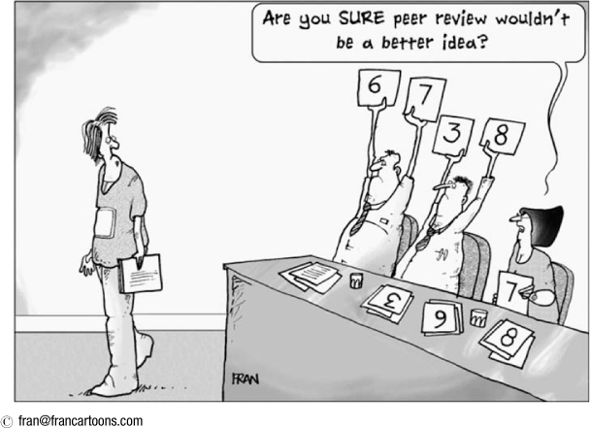
Embracing Accountability
Hot Tip: Direct, peer-to-peer is far more effective in high performance teams than outside accountability, incentives, and consequences.

Slide 19
Accountability: Hot Tip #1
You cannot hold people accountable for expectations you did not tell them you had.

Slide 20
Accountability: Hot Tip #2
It is not fair to hold people accountable for preferences, only for expectations.
Notes:
Given an example: I may personally value humor and another person is much more serious and straight forward. During the course of our discussions, I might feel that I offer very clever, light hearted relief at times. A teammate may not appreciate my humor. It is not fair for me to give my teammate feedback that says something like you need to lighten up a bit and have some fun with this project. That is a personal preference…Rather…

Slide 21
Accountability: Hot Tip #2B
Expectations and Feedback
should be directly linked to team success metrics.
Notes:
Rather…Expectations and Feedback should be related to team success metrics.

Slide 22
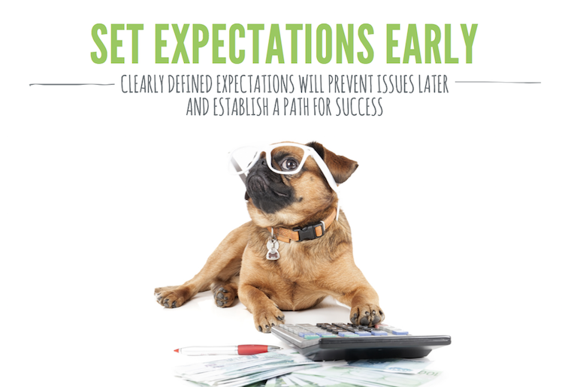
A TEAM CHARTER
A Tool to Capitalize on the Benefits of Diversity
Purpose:
to accelerate team development, clarify roles and expectations, increase individual accountability, and reduce the possibility for detrimental team conflict.

Slide 23
It’s a wrap…
Questions, Observations, Concerns…
Thank you!!
Onward and upward!

