Slide 1




Achieving and Sustaining Behavior Change to Benefit Older Adults:
Race, Ethnicity and Health Behaviors
Carl V. Hill, Ph.D., M.P.H.
Director, Office of Special Populations
National Institute on Aging
Notes:
1

Slide 2



Prevalence of Multimorbidity: Age and Race/Ethnicity
Carl Hill, "Achieving and Sustaining Behavior Change to Benefit Older Adults" Dec 6-7, 2018
Implications:
need to develop measurement tools to address both the burden and severity of chronic conditions for racial/ethnic populations
need to consider the co-occurrence of conditions at all ages (life-course issue) and not just as a geriatrics issue because causes and consequences may differ for populations
Focus on developing behavioral interventions that are appropriate, accessible, affordable, and effective in reducing the burden at the individual and population level
Need to understand pathways for disparities that undergird health behavior; e.g., social and cultural factors, access to quality medical care, etc.
Prevalence, %
Age
Increase with age
Not just geriatric but life course issue
Varies by sex, race/ethnicity
Rocca et al Mayo Clin Proc 2014;
Posner & Goodman Mayo Clin Proc 2014
Notes:
And as we see…data from the NIA sponsored Rochester Epidemiology Project (REP) Show that multimorbidity increases steeply with age. But varies by race/ethnicity over the lifespan
Because of the different dyad and triad patterns in men and women, need to develop algorithms and measurement tools to address both the burden and severity of chronic conditions
need to understand mechanisms underlying disparities; and stress may play a specific role here.
develop interventions that are appropriate, accessible, affordable, and effective in reducing the burden at the individual and population level

Slide 3
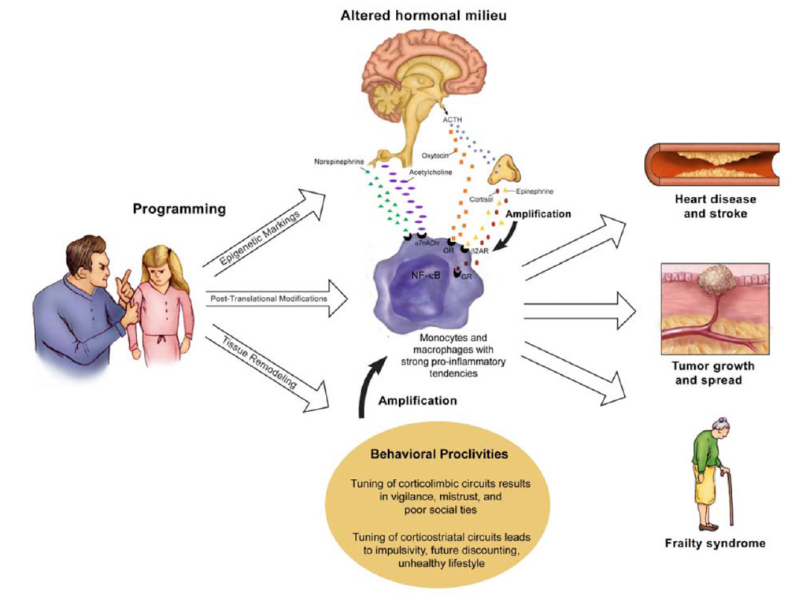
Explication of pathways aids in: Understanding how psychosocial stress becomes biologically embedded
Gregory Miller, Edith Chen & Karen Parker, Psychological Bulletin (2011)

Slide 4
NIA Health Disparities Research
Carl Hill, "Achieving and Sustaining Behavior Change to Benefit Older Adults" Dec 6-7, 2018
Health disparities research related to aging is investigating differences in population-level outcomes that are associated with a broad, complex, and interrelated array of environmental, sociocultural, behavioral, biological factors (*Anderson, 1998). Diagnosis, disease progression, response to treatment, quality of life, health behavior and morality may each be affected by age, SES, identity, sex, gender, race, ethnicity, disability status, geography and a many multi-level health determinants.
*Anderson, Norman B. Levels of analysis in health science. A framework for integrating sociobehaviroal and biomedical research. Annals of the New York Academy of Sciences. 1998; 840(1):563-576
Notes:
…well interestingly enough, there is a emerging (NOT NEW) science here at NIH that allows for a systematic, congressionally mandated… assessment of health differences by social class, race, ethnicity and geography…called health disparities research. Early findings indicate that:
Environmental
Sociocultural
Behavioral
…and biological factors are critical for understanding and addressing health disparities.
However, relationships between these factors are not as clearly understood.
How do environmental, sociocultural, behavioral and biological factors link to sustain health disparities?
What phenomena might help us make connections and theorize pathways?

Slide 5
Health Disparities Research Related to Aging
December 2012 TFMAR provides recommendations to NIA
that include development of a Framework to guide HD activities
September 2014 NIA Health Disparities Research Framework approved by National Advisory Council on Aging
August 2015 NIA Health Disparities Research Framework published in
journal, Ethnicity & Disease
September 2015 FOAs released related to the Framework focused on Stress/Resilience and Alzheimer’s Disease
March 2016 Online, user-friendly version of Framework posted on NIA website
June 2017 Research Supplements awarded for Disparities Research in Aging Biology
August 2018 Research Supplements awarded for Disparities Research
in Geriatrics and Gerontology
Carl Hill, "Achieving and Sustaining Behavior Change to Benefit Older Adults" Dec 6-7, 2018

Slide 6
NIA Health Disparities Research Framework
Priority Populations
Environmental
Levels of Analysis
Sociocultural
Biological
Behavioral
What are Environmental and Sociocultural Factors that Influence Health Behavior?
Source: Hill CV, Perez-Stable EJ, Anderson NA & Bernard MA, Ethnicity & Disease, 25 (3), 2015
Carl Hill, "Achieving and Sustaining Behavior Change to Benefit Older Adults" Dec 6-7, 2018
Notes:
One tool that has helped shape our thinking in this area is the NIA Health Disparities Research Framework. Developed in 2015…the Framework
Designates priority populations for this research that include minority racial/ethnic groups, Latinos, those that experience poverty, Sex/Gender minorities and rural populations
The Framework has also helped us agree on levels of analysis of HD research… that include contextual resources and risks that may be embedded in ENVIRONMENTS…SOCIOCULTURAL group norms/beliefs and responses… that shape BEHAVIORS such as substance abuse and poor nutrition…and this influences BIOLOGICAL factors. In this case…protein aggregates that form inside of nerve cells in the brain that ultimately cause ADRD
In essence…we used the Framework to stimulate a call for research proposals that would explore pathways through one or more of these levels for understanding ADRD in our priority health disparities populations…

Slide 7
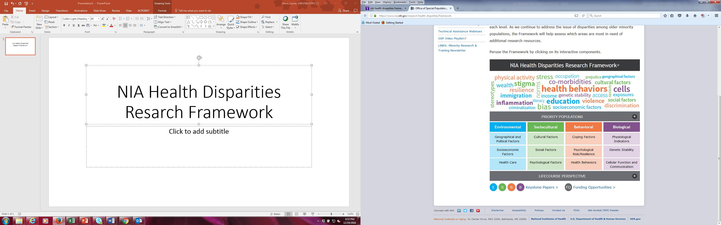
NIA Health Disparities Research Framework www.nia/disparities/framework
Showcases NIA-funded research projects that address health disparities related to aging
Potential applicants are able to peruse NIA priorities and investments in this important area of aging research
This tool also includes links to keystone papers and current related funding opportunities
Carl Hill, "Achieving and Sustaining Behavior Change to Benefit Older Adults" Dec 6-7, 2018

Slide 8
CONTACT
Carl V. Hill, Ph.D., M.P.H.
Director, Office of Special Populations
National Institute on Aging (NIA)
National Institutes of Health (NIH)
hillcv@mail.nih.gov
www.nia.gov/health-disparities
Carl Hill, "Achieving and Sustaining Behavior Change to Benefit Older Adults" Dec 6-7, 2018

