Slide 1


Neuroepidemiology of Decision Making in Old Age
S. Duke Han, PhD, ABPP-CN
Director of Neuropsychology in Family Medicine
Associate Professor of Family Medicine,
Neurology, Psychology, and Gerontology
Keck School of Medicine of USC
University of Southern California
Visiting Associate Professor of Behavioral and Neurological Sciences
Rush Alzheimer’s Disease Center
Rush University Medical Center
@sdukehan
Achieving and Sustaining Behavior Change to Benefit Older Adults
Research Centers Collaborative Network (RCCN) Workshop
December 6, 2018

Slide 2
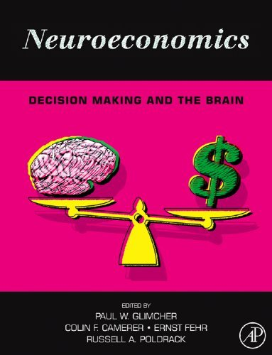
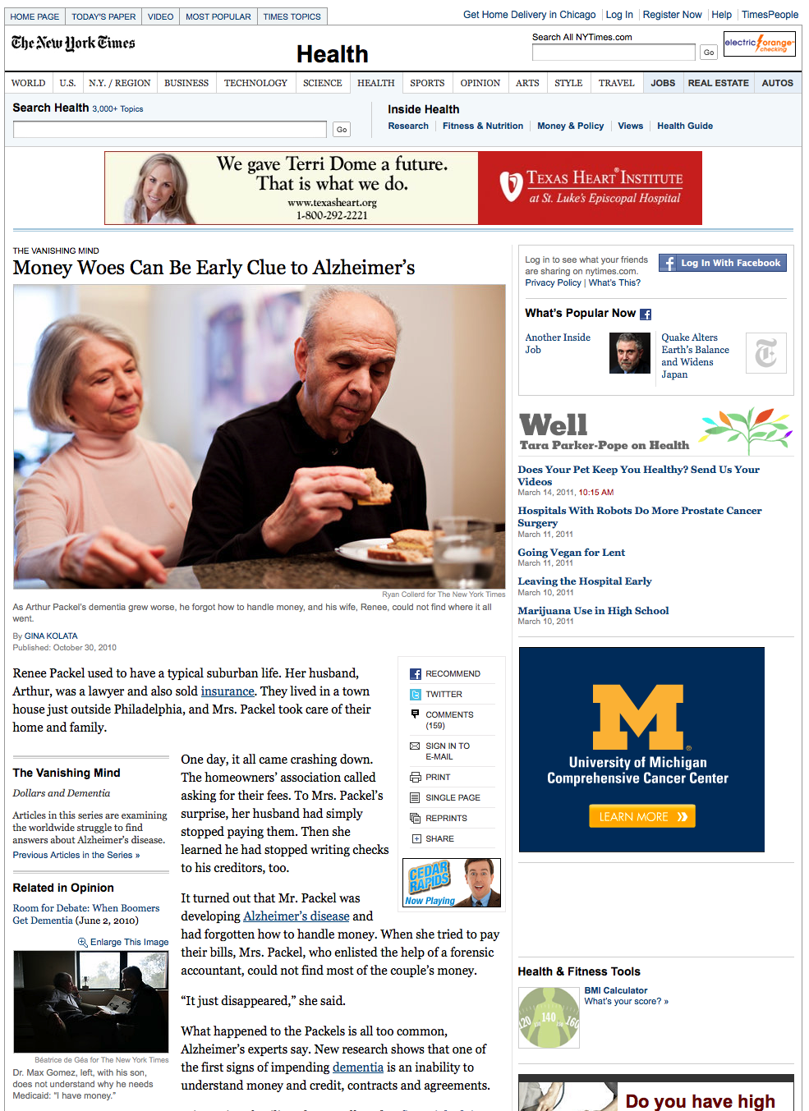
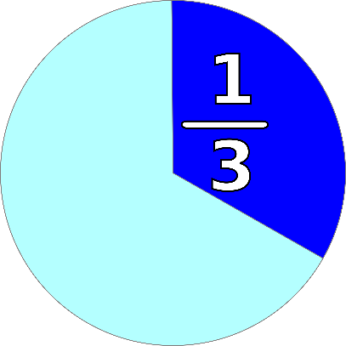
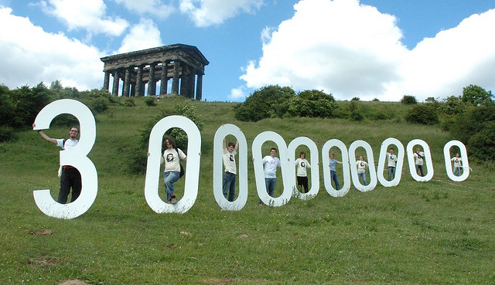
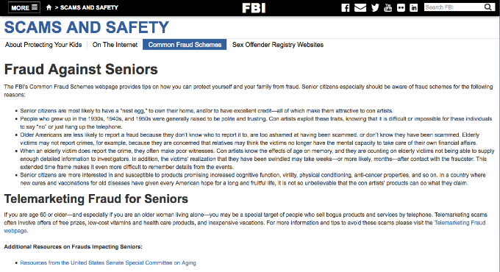
Background
How can we understand this?
Laibson, 2011; Metlife, Inc., 2011;True Link Financial, Inc., 2015; Lachs et al., 1998; Boyle et al., 2013

Slide 3
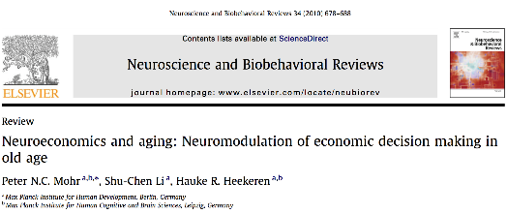
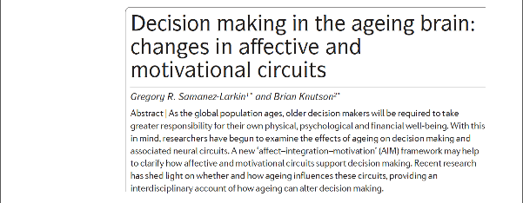
Some Great Examples of Neuroeconomics Work
Also, Brian Knutson, Sam McClure, Joseph Kable, Paul Glimcher, Antonio Rangel, Colin Camerer, Scott Huettel, Mara Mather, Natalie Denburg, Antoine Bechara, and others…
Duke Han, "Achieving and Sustaining Behavior Change to Benefit Older Adults" Dec 6-7, 2018

Slide 4
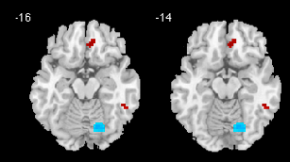
Our Neuroepidemiologic Approach
Decision Making Study (PI: Patricia Boyle) of the Rush Alzheimer’s Disease Center Memory and Aging Project (PI: David Bennett)
Cognitive processing
Affective processing
Personality styles
Behavioral Economics
NIH/NIA Paul B. Beeson Award (PI: Duke Han) to conduct a neuroeconomics substudy
Volumetrics
Diffusion Tensor Imaging
Functional connectivity
R01AG033678; PI: Boyle
R01AG017917; PI: Bennett
K23AG040625; PI: Han

Slide 5
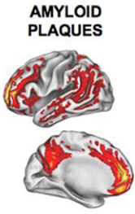
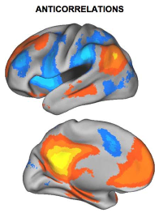
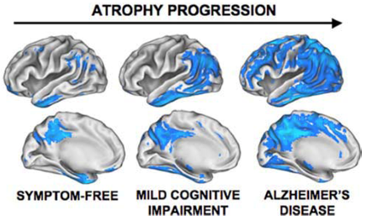
Age-Associated Neuropathology
Buckner et al., 2008; Buckner et al., 2005; Lustig et al., 2003

Slide 6
Age-Associated Neuropathologies May Impact Decision Making Brain Networks
DLPFC
PCC
Superior Long. Fasciculus
Angular Gyrus
ACC
TPJ
insula
striatum
VTA
hippo
OFC
amyg
Uncinate Fasciculus
vmPFC

Slide 7
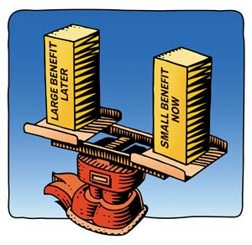
Temporal Discounting

Slide 8
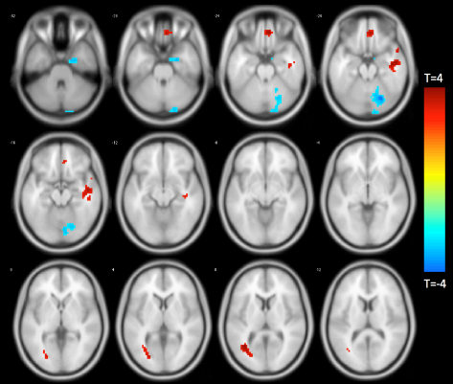
Temporal Discounting
rs-fMRI HIGH->LOW Temporal Discounting
(N=123)
DTI FA
(N=302)
Han et al., Experimental Gerontology, 2013 & Han et al., Brain Structure and Function, 2018

Slide 9
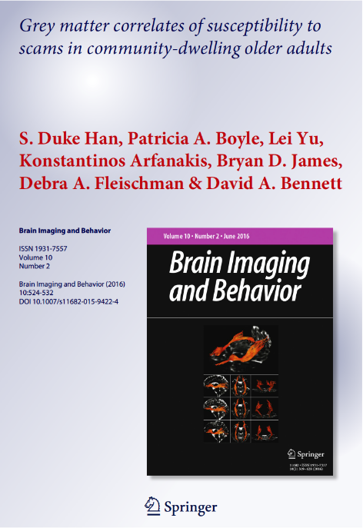
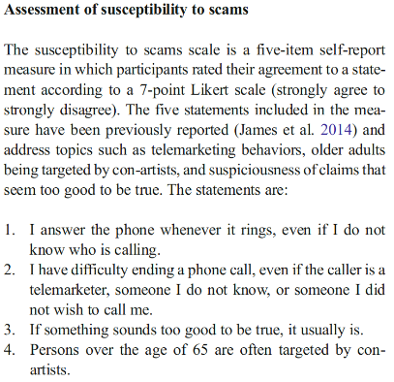
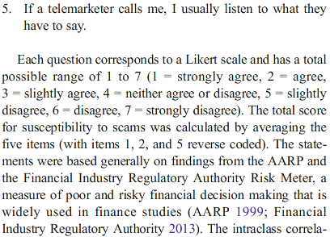

Slide 10
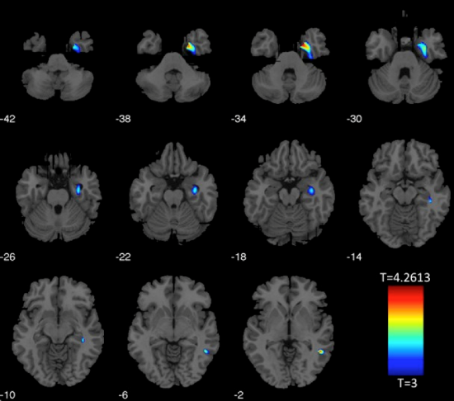
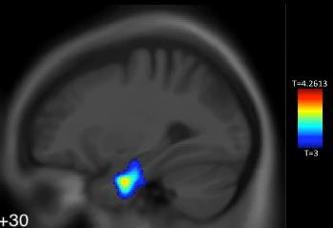
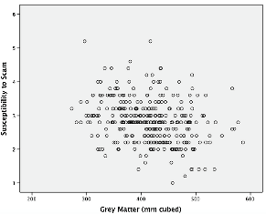
Grey Matter Correlates of Susceptibility to Scams
(N=348)
Han et al., Brain Imaging and Behavior, 2016

Slide 11
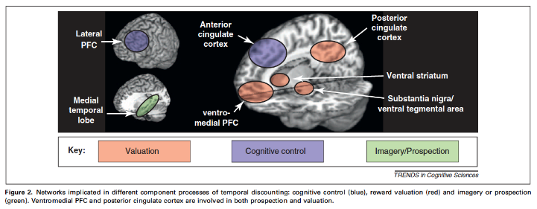
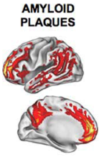
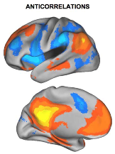

Peters and Buchel, 2011
+ Age-Associated Neuropathology
Buckner et al., 2008; Buckner et al., 2005; Lustig et al., 2003

Slide 12
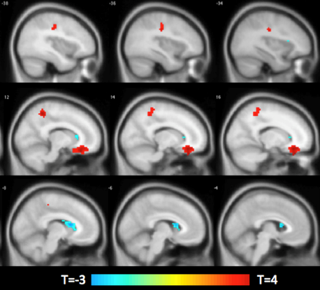
Financial Literacy
rs-fMRI POS to NEG
(N=139)
DTI FA
(N=346)
Han et al., Archives of Gerontology and Geriatrics, 2014 & Han et al., Neuroimage, 2016

Slide 13
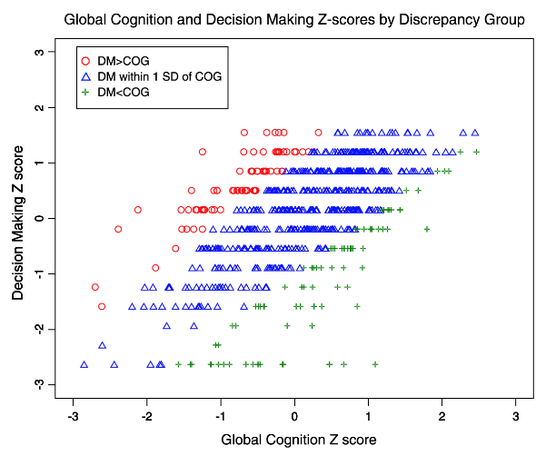
Cognition and Decision Making Discrepancies
Discrepancy=23.9%; 12.9% DM<COG; 11.0% DM>COG
(N=689)
Han et al., Aging, Clinical, and Experimental Research, 2015

Slide 14
Conclusions
Factors that impact the brain in old age (e.g., age-related neuropathologies) may impact decision making in old age by impacting brain network characteristics (e.g., structure, structural and functional connectivity).
There is significant individual variability in neuroimaging findings and cognitive/decision making discrepancies (implications for legal and public policy).
Higher literacy may support better decision making in old age.
Longitudinal and neuromodulatory approaches will shed more light on these issues.
Duke Han, "Achieving and Sustaining Behavior Change to Benefit Older Adults" Dec 6-7, 2018

Slide 15
Future Directions
Racial Differences in Decision Making Among Older Adults (R01AG055430; PI: Han)
Behavioral and neuroimaging substudy in the Minority Aging Research Study (MARS; RF1AG022018 PI: Lisa L. Barnes) of the Rush Alzheimer’s Disease Center
Identify factors that mediate or moderate racial differences in decision making
Finance, Cognition, and Health in Elders Study (FINCHES) (NIH/NIA R01 to be resubmitted; PI: Han)
Pilot funding from the Elder Justice Foundation and Cathay Bank Foundation
Emotional regulation, behavioral economic, health, neuropsychological, neuroimaging, and qualitative longitudinal study of financially exploited, cognitively-intact older adults
In collaboration with the National Center on Elder Abuse (NCEA) at USC

Slide 16
Acknowledgements
RUSH UNIVERSITY
RADC Faculty and Staff
David Bennett, MD
Patricia Boyle, PhD
Lisa Barnes, PhD
Konstantinos Arfanakis, PhD
Debra Fleischman, PhD
Sue Leurgans, PhD
Lei Yu, PhD
UNIVERSITY OF SOUTHERN CALIFORNIA
Laura Mosqueda, MD
Arie Kapteyn, PhD
Mara Mather, PhD
Annie Nguyen, PhD
Anya Samek, PhD
Gali Weissberger, PhD
Caroline Nguyen
Emanuil Parunakian
Jacqueline Chen
FUNDING
NIH/NIA K23AG040625 (Beeson Award)
NIH/NIA R01AG055430
National Institute on Aging
American Federation for Aging Research
John A. Hartford Foundation
National Institute of Justice
Elder Justice Foundation
Cathay Bank Foundation
HARVARD UNIVERSITY
Randy Buckner, PhD
WEILL CORNELL COLLEGE
Mark Lachs, MD
UNIVERSITY OF MICHIGAN
Bob Willis, PhD
Ken Langa, MD, PhD

