Slide 1
Modifying Movement Patterns to Promote Weight Loss in Aging
The mHealth-Supported EMPOWER study
Jason Fanning, PhD
Wake Forest School of Medicine

Slide 2
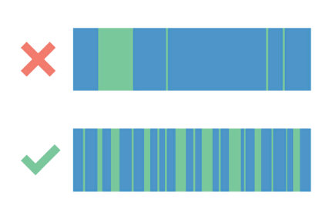
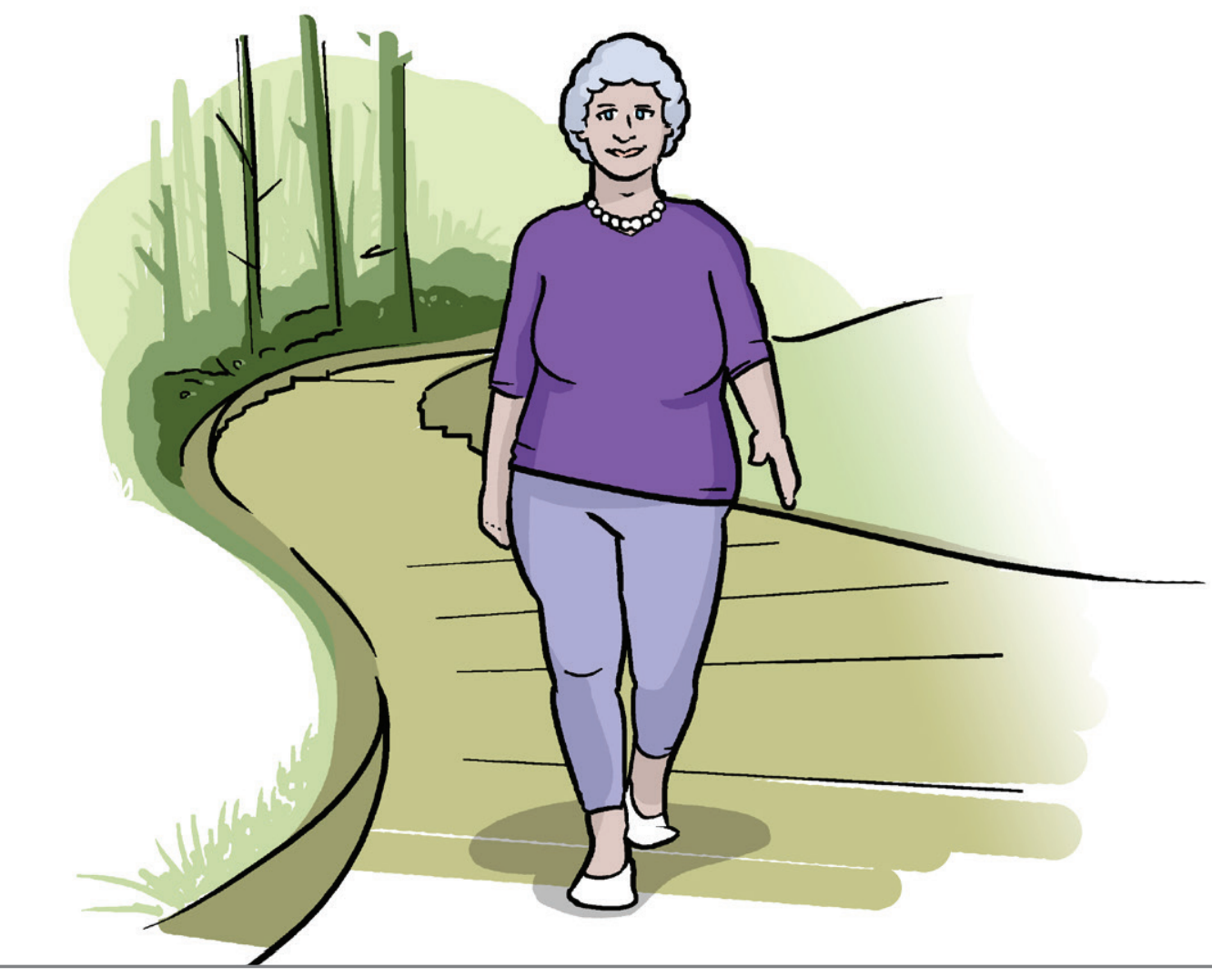
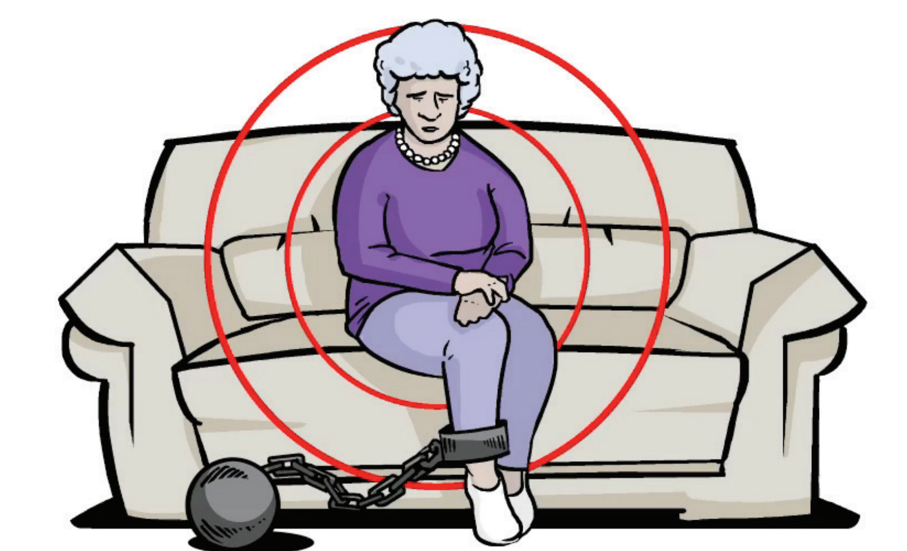

A serial-movement approach
Focuses on patterns of accumulation and provision of tools to build awareness
Emphasizes the importance of exploration of activities across the intensity spectrum
2018 Physical Activity Guidelines
Notes:
KEEP IT SHORT

Slide 3
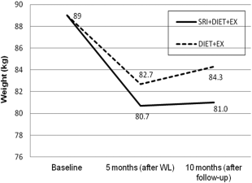
EMPOWER
Based on the SitLess pilot (Nicklas, 2014)
mHealth-supported day-long movement to prevent weight regain
Low-active, obese older adults (N=180)
Ongoing 3 arm randomized controlled trial
Weight Loss + Exercise
Weight Loss + SitLess
Weight Loss + Exercise + SitLess
Three phases
Face-to-face group counseling (6 months)
Transition (3 months)
Maintenance (9 months)
Hypotheses
WL + EX + SitLess will have greatest weight loss at month 18
Fanning et al 2018a; PIs Nicklas & Rejeski
Notes:
BMI = 30–45 kg/m²
No more than 2 days w/ 30 min structured activity

Slide 4

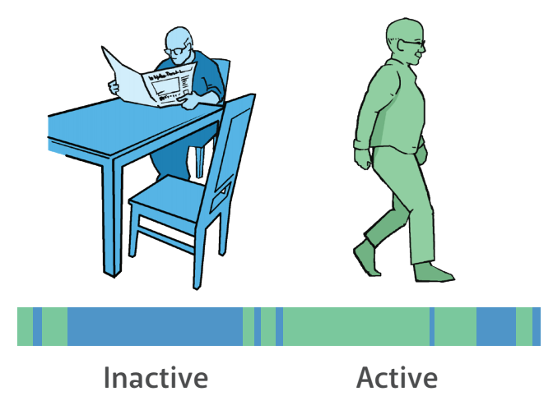

Goals for Technology
Maintain Connection & Support
Build Awareness & Support
Self-Efficacy

Slide 5
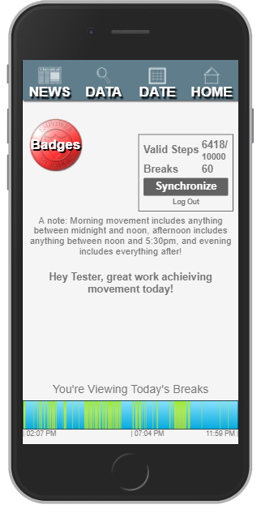
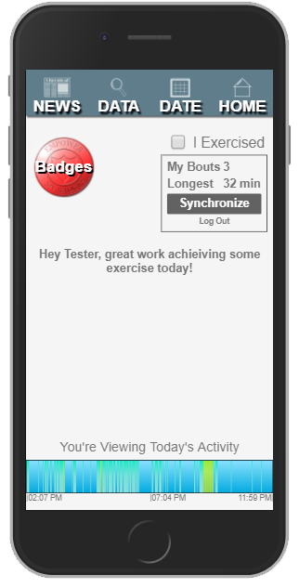

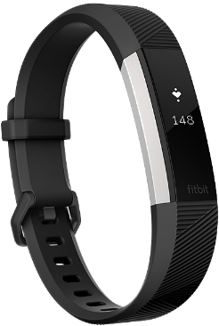
EMPOWER Companion mHealth Suite
Fanning et al 2018a
Notes:
Discuss iterative design
Discuss features available to all groups
Discuss group-specific features, most notably for SitLess

Slide 6
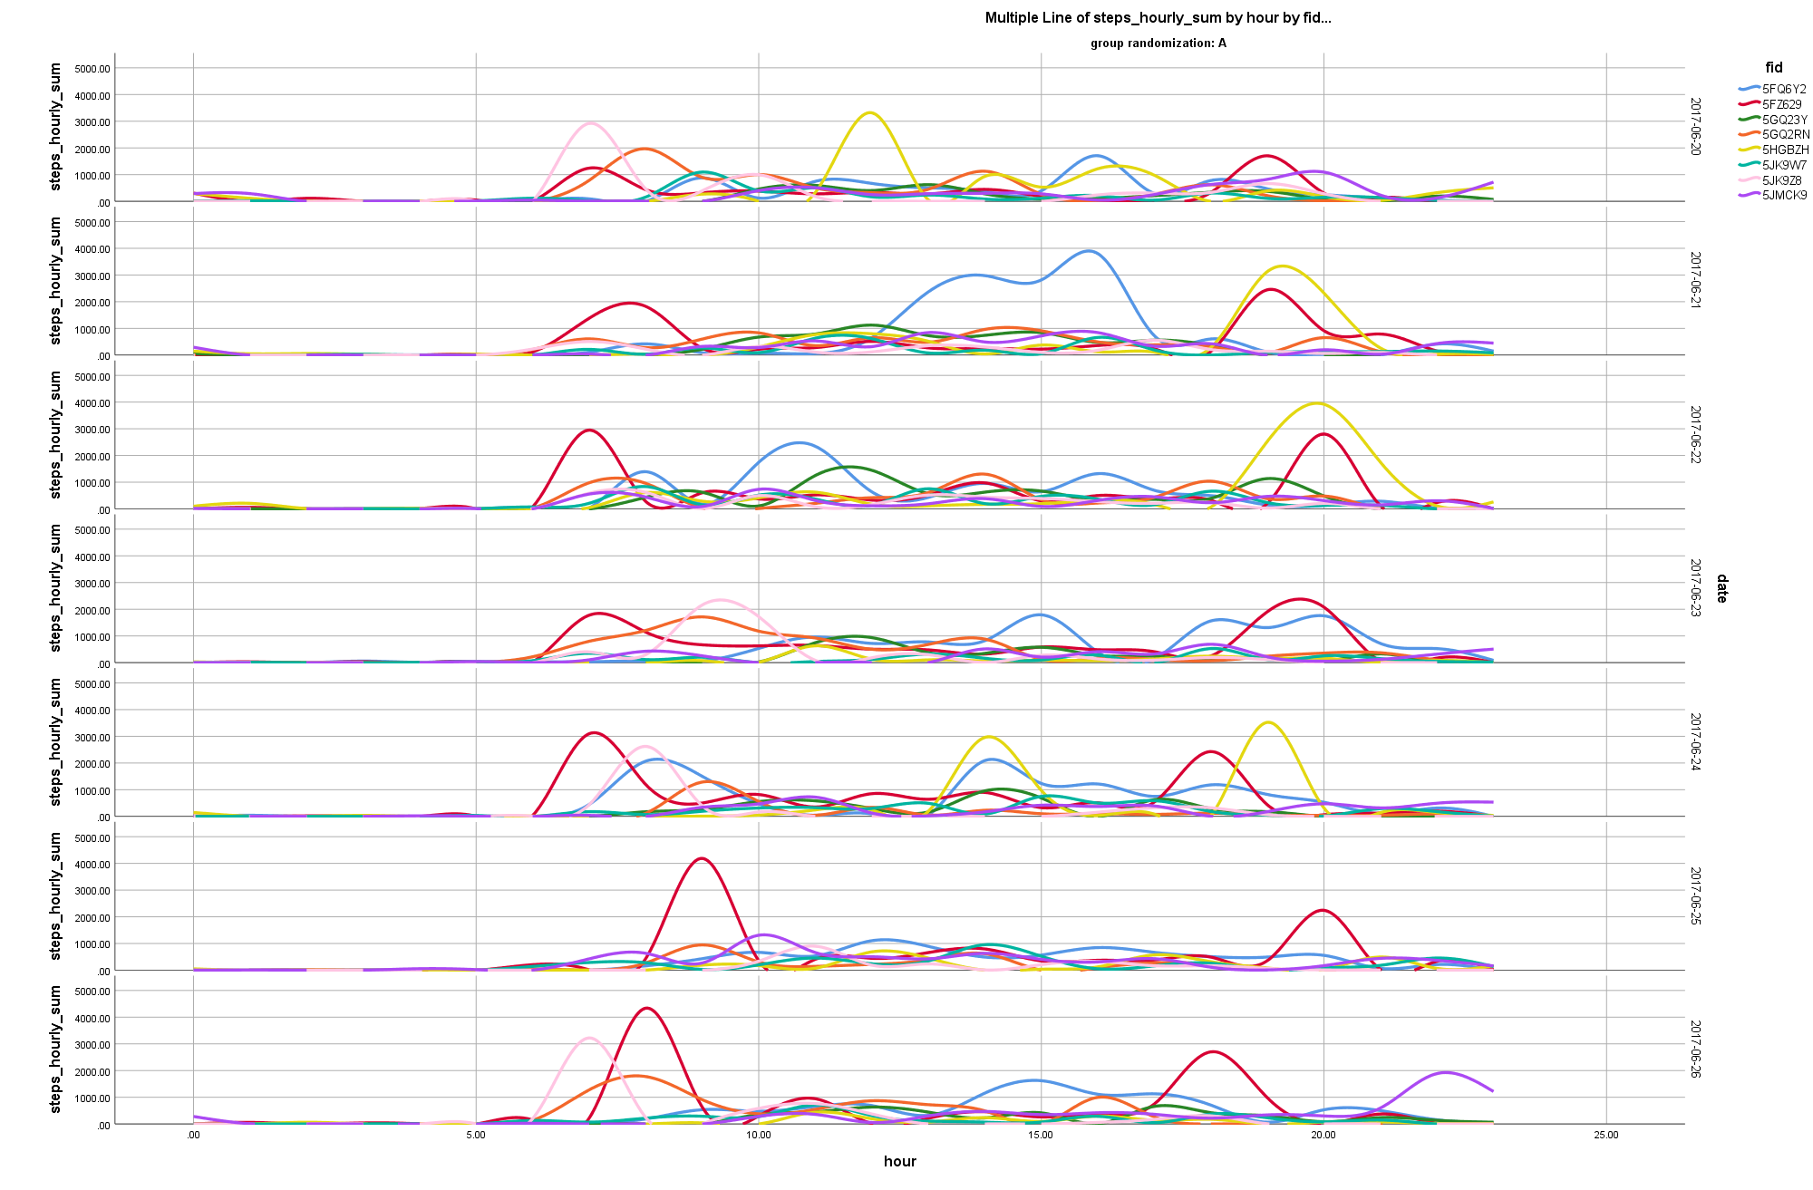
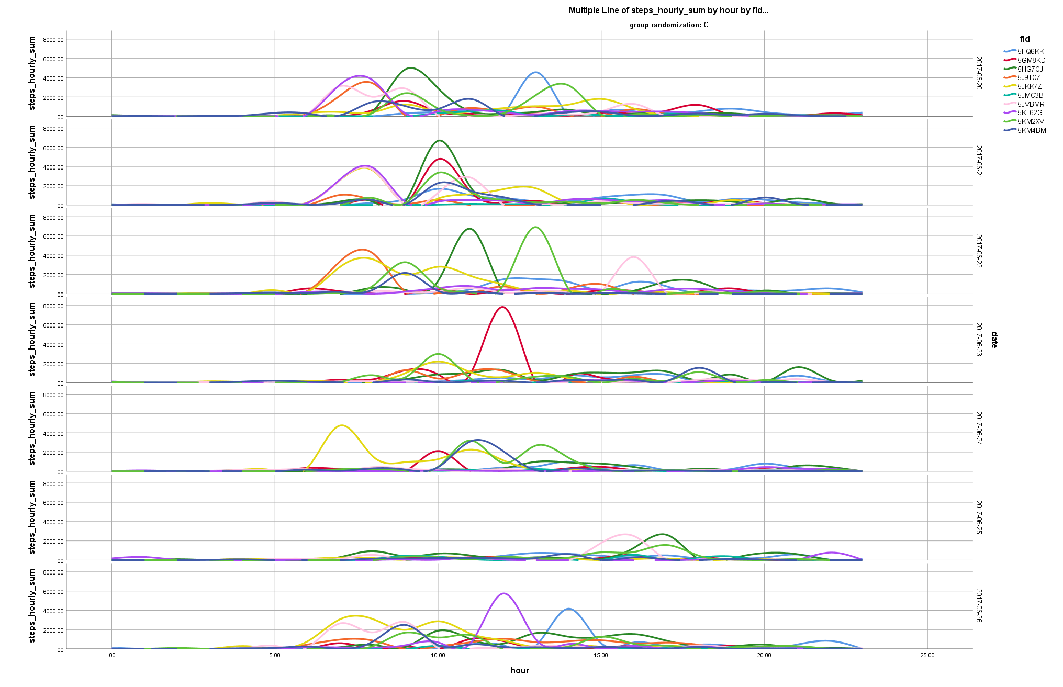
A one-week snapshot
SitLess
Exercise

Slide 7
Thank You
EMPOWER Team
Sherri Ford
Bev Nesbit
Barbara Nicklas (PI), PhD
Jack Rejeski (PI), PhD
Funding
NIA R01 AG051624 (EMPOWER)
Contact
fanninjt@wfu.edu

