Slide 1
Adherence
Current status, and how distress may be key to progress
Don Edmondson, PhD, MPH, with a lot of help from
Ian Kronish, MD, MPH
RCCN Meeting, Bethesda, 2018

Slide 2
Medication
Adherence is Crucial
“Drugs don’t work in patients who don’t take them”
Surgeon General Koop, 1985
26% difference in health outcomes between high and low adherers
DiMatteo, Med Care, 2004
125,000 deaths and $289 billion in costs per year
Viswanathan, Ann Intern Med, 2012
Notes:
Key Point: Explain how to refer to ABPM
BCT: Instruction on how to perform the behavior
Intervention function: training

Slide 3
Lots of Research
Not a Lot of Progress
Cochrane review 2014
  182 RCTs of adherence interventions
  Only 5 interventions reported impact on adherence and outcomes
  “Current methods…are mostly complex and not very effective”
Kronish & Moise. JAMA Intern Med, 2017; Nieuwlatt et al. Cochrane Database Sys Rev 2014

Slide 4
The underappreciated role of distress after life-threatening medical events
  In systematic reviews, 15-25% of CVD patients screen positive for CVD-related PTSD
  Those who screen positive are at twice the risk of secondary CVD events and mortality
  Mechanisms include autonomic, immune, and behavioral pathways
  Adherence is particularly compromised
Edmondson et al., 2011, 2012; Sumner et al., 2017 3

Slide 5
Enduring somatic threat
PTSD due to CVD events is different
It’s about present and future risk (not past)
From a threat in the body
Meli et al, 2017

Slide 6
Distress and non-adherence
Adherence is associated with secondary risk
But patients who are most distressed by the index event are least likely to adhere
Those who screen positive are twice as likely to be nonadherent—not just because of PTSD (PTSD due to other types of events was not associated with adherence)
Taggart Wasson et al., 2018

Slide 7
Patients avoid medications that remind them of risk
We first saw that patients with greater anxiety sensitivity were less adherent
In particular, those who reported interoceptive sensitivity and catastrophizing interpretations of somatic signals
We considered implicit measures, but decided to just ask them
Those with high distress reported skipping medications because they reminded them of risk
Alcantara et al., 2014; Husain et al, 2018; Monane et al., 2018

Slide 8
It’s not just about medications
Patients also report avoiding physical activity for fear of increased HR
We have observed autonomic hyperreactivity to physiological and cognitive threat cues in ACS patients, and interoceptive threat bias increases 24-hr heart rate at 1 month post-ACS
Monane et al., 2018

Slide 9
Conceptual model with candidate mechanisms

Slide 10
Implications
Rather than a “teachable moment,” perhaps a time for reducing risk perceptions
Focus on positive affect/meaning rather than risk reduction to motivate behavior change
Clarify the limitations of interoception for identifying acute exacerbations
Exposure-based interventions paired with health behaviors as stress reduction may be beneficial

Slide 11
Discussion

Slide 12
Thank you.

Slide 13
Is There a “Best” Adherence Measure?
Adherence is a multidimensional behavior
Measures do not assess the same behavior (e.g., refill ≠ electronic adherence)
Different measures may be needed to measure different adherence behaviors

Slide 14
Recommended Self-Report Questionnaires
(N=24; more than 1 per respondent possible)
Name of Scale | Frequency
Voils Adherence Questionnaire (3-items) | 4
Wilson’s HIV Adherence Questionnaire (3-items) | 4
Morisky Scale (unspecified; 8 item; 4-item) “Don’t use” | 4, 2, 1 1
McHorney’s Adherence Estimator (3-items) | 3
Hill-Bone Questionnaire, (8-items) | 2
“Weinman’s Questionnaire”/BMQ (10-items) | 2
Visual Analog Scale (1-item) | 1
“Ability to adhere” Likert Scale with 5-6 options (1-item) | 1
Haynes et al. 1980 Tablets missed per day/wk/mo (3-items) | 1

Slide 15
Reasons for Recommending Top SRQs
Name of Scale | Reasons
Voils Adherence Questionnaire | Assesses behavior and reasons separately
Wilson’s HIV Adherence Questionnaire | Validated with electronic adherence Validated with outcomes (HIV viral load) Rigorous development with cognitive testing Prevents ceiling effects Ease of use Free
Morisky Scale “Don’t use” | Validated Commonly used Allows for variability Combines attitudes and reasons for nonadherence
McHorney’s Adherence Estimator | Validated against claims refill data Face validity Designed for clinical use Ease of use including on-line platform Free

Slide 16
Recommended Electronic Adherence Devices
(N=24; more than 1 per respondent possible)
Name of Device | Frequency | Reasons
MEMS | 6 | long track-record well-validated well-accepted by adherence community
Wisepill | 3 | wireless, enabling just-in-time interventions and remote data collection
AdhereTech | 1 | approved by institution (VA)
eCAPS | 1 | affordable resemble typical pill bottles wireless version
Homemade devices (e.g., Ekstrand’s Tel-Me-Box) | 1
No specific brand | 1 | “choice depends on lots of factors”

Slide 17
Medication Nonadherence is Common
What percent of patients are non-adherent to chronic disease medications?
30%
50%
70%
All of the above
Myth #1: Individuals only adhere to medications 50% of the time
Gellad et al. Pharmacoepidemiol Drug Saf, 2017

Slide 18
Prevalence of Non-adherence
Depends on Specific Adherence Behavior
15-20%
Never initiate
Miss >20% of doses
Discontinue within 1 year
30-70%
30-70%
DiMatteo Med Care 2004; Dunbar-Jacob J Clin Epidemiol 2001; DiMatteo Med Care 2002

Slide 19
Few Studies Use a Mechanistic Approach
Conducted a systematic review of NIH-funded trials with medication adherence as an outcome (inception – June 2016)
Only 3% (2 of 44) of trials incorporated tests of hypothesized mechanisms of behavior change by which interventions improve medication adherence
Edmondson et al. Behav Res Ther. 2017

Slide 20
Late Initiation,
Good Implementation
Good Initiation,
Poor Implementation
Good Initiation,
Good Implementation,
Early Discontinuation
Vrijens et al. Br J Clin Pharmacol. 2012

Slide 21
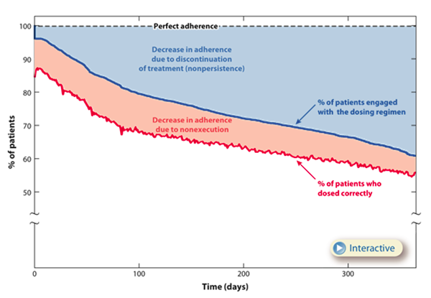
Decrease in adherence due to discontinuation
Blaschke et al. Annu Rev Pharmacol Toxicol. 2012

Slide 22
Focus of many behavioral interventions
Decrease in adherence due to discontinuation
Blaschke et al. Annu Rev Pharmacol Toxicol. 2012

