Slide 1

Gender Differences in Cognitive Aging
Dena B. Dubal, M.D., Ph.D.
David Coulter Endowed Chair in Aging
and Neurodegenerative Disease
Laboratory of Neuroscience and Aging
Dept of Neurology and Weill Institute, UCSF

Slide 2
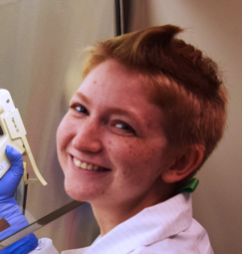
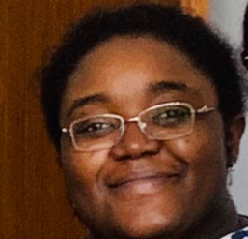

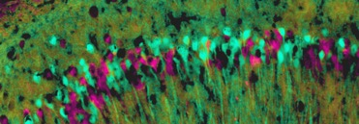
Goal: Improve Healthspan
My lab studies basic sex-based mechanisms of aging and cognitive resilience
Emily Davis,
Graduate Student
Samira Abdulai-Saiku, PhD,
Postdoctoral Fellow, *RCCN Early Career Awardee
Parent of Origin of Active X

Slide 3
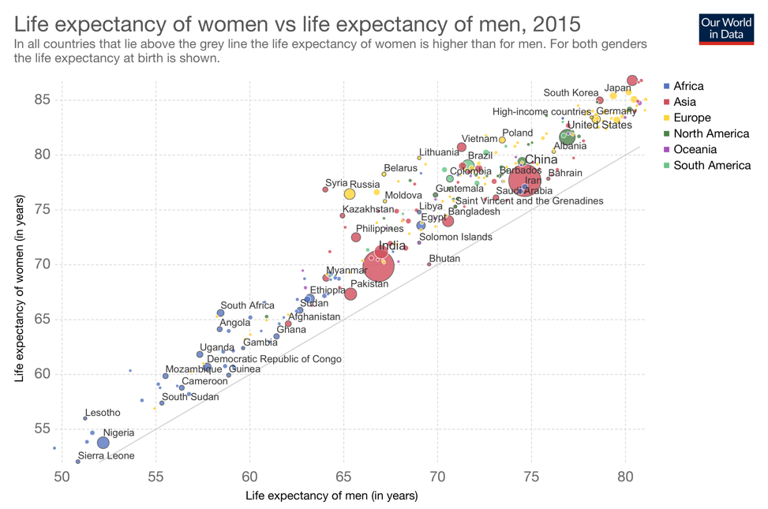
Goal: Improve Healthspan
Women live longer than men – across the world
Source: UN Population Division (2017 Revision)

Slide 4
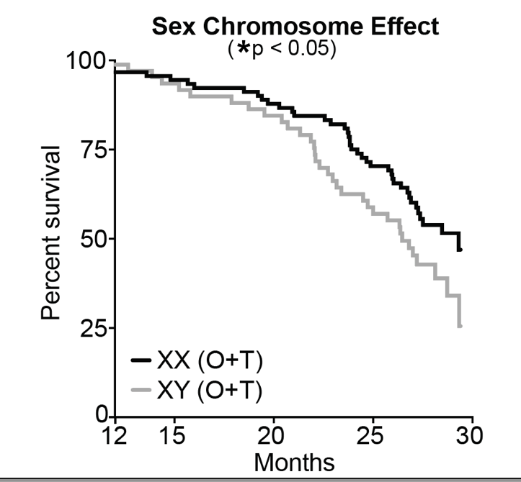

Goal: Improve Healthspan
FCG model mice: Sex chromosomes contribute to female longevity
Davis et al Aging Cell 2019

Slide 5
Goal: Improve Healthspan
Aging and Disease cause cognitive decline
*
*
*
Adapted from “Live Longer, Live Well” AFAR, Glenn Foundation, British Society for Research on Aging

Slide 6
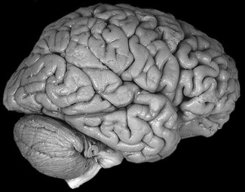
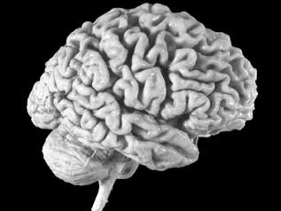
Goal: Improve Healthspan
Why study sex and gender differences in cognitive decline?
The things that help us live longer tend to confer resilience.
Does female longevity link to female advantage in cognitive aging and disease?
There are no effective medical treatments for cognitive impairments.
Understanding what confers resilience in one sex can reveal new targets for treating both/all sexes.
Sex-derived
treatments

Slide 7
Is there biologic and molecular evidence for slower brain aging in women?

Slide 8
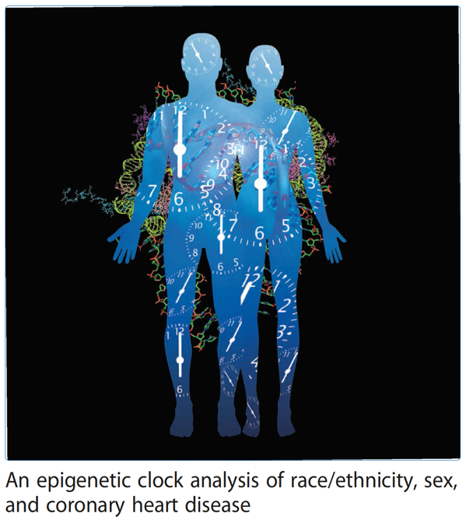
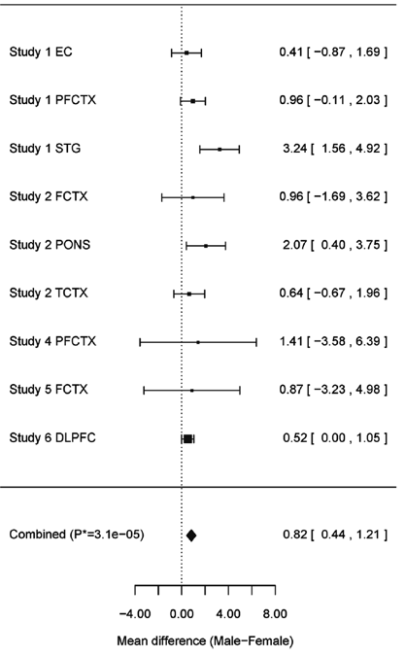
Goal: Improve Healthspan
Epigenetic Clock: Women show slower “molecular” brain aging
Horvath et al Genome Biology 2016

Slide 9
Goal: Improve Healthspan
The aging female brain is metabolically younger
Men
Women
Goyal et al PNAS 2019

Slide 10
Do women show less cognitive decline with typical aging, in recent studies?

Slide 11
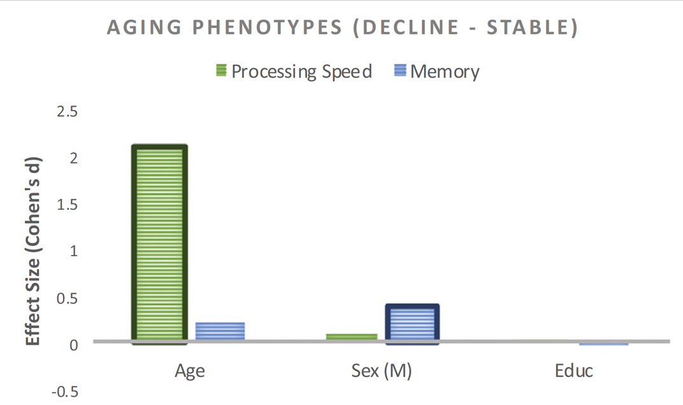
Goal: Improve Healthspan
Women show less cognitive decline in typical aging (MAC, UCSF)
Worse Memory in “Decliners”
Casaletto et al Neurobiology of Aging 2019

Slide 12
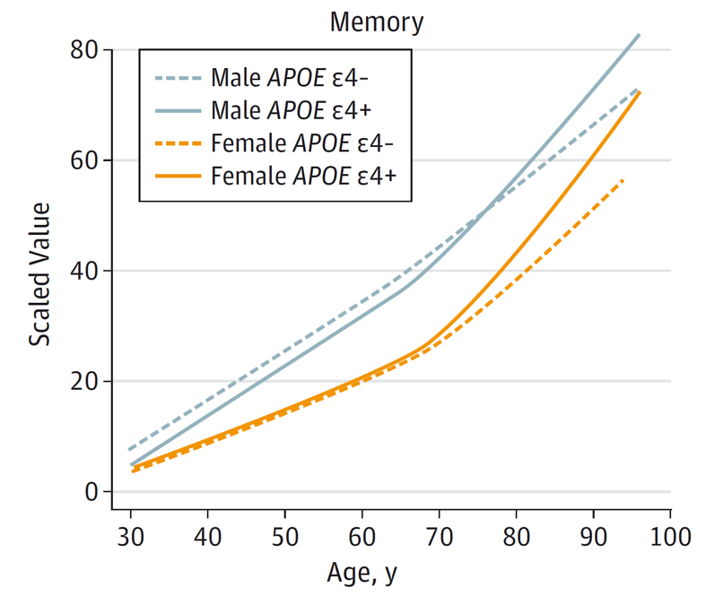
Goal: Improve Healthspan
Women show less cognitive decline in typical aging (MCSA, Mayo)
Worse Memory
Jack et al JAMA Neurology 2015

Slide 13
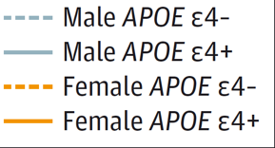
Goal: Improve Healthspan
Women show less hippocampal atrophy with typical aging (MCSA)
Hippocampal Atrophy
Amyloid PET
Jack et al JAMA Neurology 2015

Slide 14
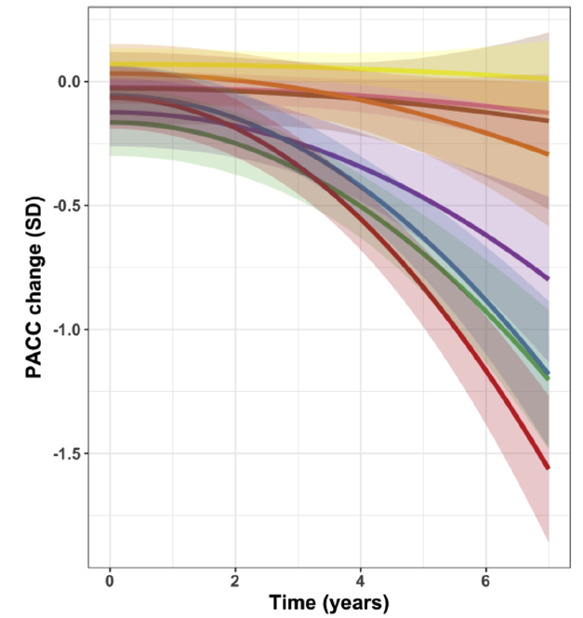
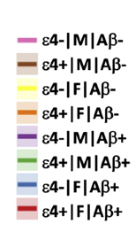
Goal: Improve Healthspan
Women -Aβ show less cognitive impairment,
but +Aβ show steeper cognitive decline in old age
(ADNI, AIBL, HABS)
F
(– Aβ)
M
Worse Memory
M
(+ Aβ)
sex difference driven by age >80yrs
F
Buckley et al Neurobiology of Aging 2018

Slide 15
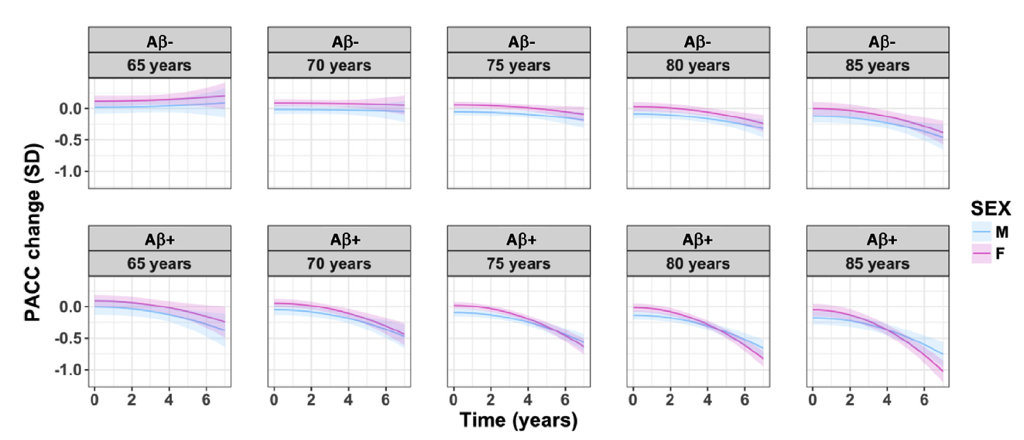
Goal: Improve Healthspan
Elderly women (specifically >80yrs) with +Aβ show steeper cognitive decline (ADNI, AIBL, HABS)
Worse Memory
Buckley et al Neurobiology of Aging 2018

Slide 16
Goal: Improve Healthspan
What can we learn from these studies?
Women live longer – and this tends to associate with female cognitive resilience in typical aging and preclinical AD in recent studies.
Female advantage in molecular processes could set the stage for female resilience against cognitive decline in aging and disease.
In some populations high amyloid in elderly (>80yrs) women may contribute to higher female AD risk in advanced age.
When studying sex difference in >80yrs, there is a strong survival bias favoring robust men that lived beyond their typical lifespan.

Slide 17
Goal: Improve Healthspan
What are incredible opportunities to study gender and sex difference in cognitive decline?
Rigorous gender-specific delineation of how amyloid, tau, synaptic decline, α-synuclein, TDP-32, CSF/ blood/other biomarkers, network dysfunction, imaging changes, contribute – over time – to cognitive decline.
Apply this approach to investigate typical aging and neurodegenerative diseases of aging including AD, PD, FTD, PSP, MSA, ALS, CJD, and more.
Determination of how sex-based mechanisms of longevity intersect with brain resilience or vulnerability to cognitive decline in aging and disease.
Expand studies to include diverse socioeconomic status, geography, ancestry, and ethnic groups – to increase equity in research and relevance to all.
Using animal and other models, dissect causal mechanisms of sex-based cognitive resilience . This will reveal new molecular targets and pathways for novel treatments!

Slide 18

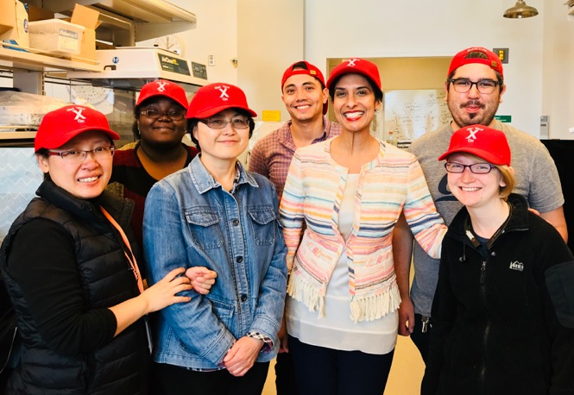
Dubal Lab
  Emily Davis
  Samira Abdulai-Saiku
  Gina Williams
  Dan Wang
  Arturo Moreno
  Chen Chen
  Lauren Broestl
  Kurtresha Worden
  Bayardo Garay, Kevin Chang
Acknowledgments
UCLA
Art Arnold
Rush University
David Bennett
Columbia University
Philip De Jager
U Wash
Mike MacCoss
Gennifer Merrihew
Allen Brain Institute
Julie Harris
UT San Antonio
Nicholas Musi
Yuji Ikeno
UCSF
Barbara Panning
Lennart Mucke
Bruce Miller
Kaitlin Casaletto
Jennifer Yokoyama
Luke Bonham
Support and Funding
R01 (NINDS), K08 (NIA/AFAR) Paul Beeson Award in Aging, Weeks-Coulter Foundation, Bakar Foundation, Glenn Medical Foundation, AFAR Junior Faculty Grant, Nathan Shock Center Pilot Grants

