Slide 1


SEX AND GENDER
DIFFERENCES IN AGING
Gender and Innate and Adaptive Immunity in Aging
Margaret F. Doyle, PhD
Department of Pathology and Laboratory Medicine
University of Vermont

Slide 2
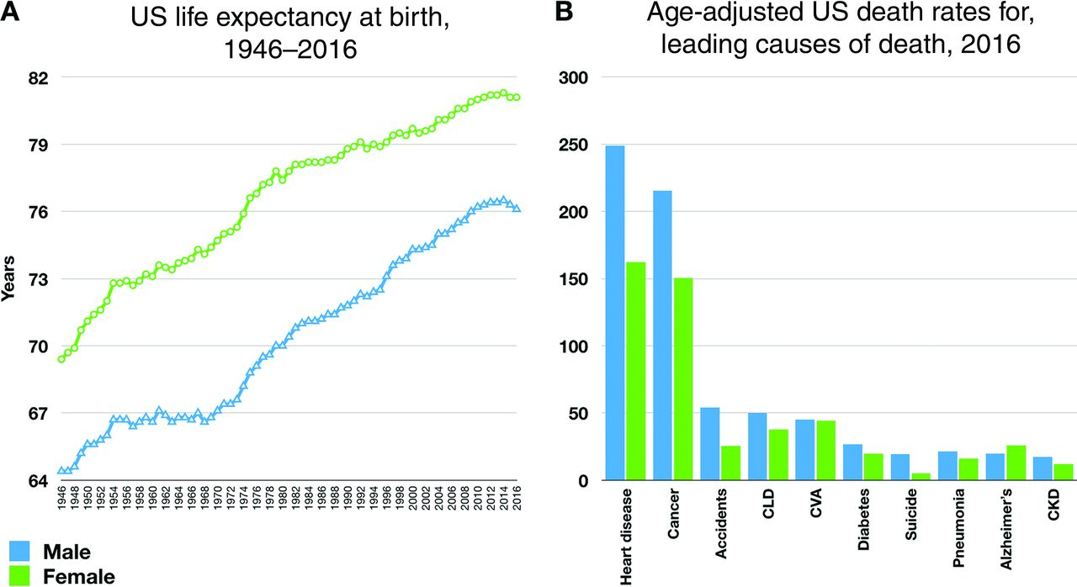
Warraich, HJ and Califf, RM, Clinical Chemistry (2019) 65, 19-23.

Slide 3

Excerpt from Johns Hopkins Health Review Spring/Summer 2016 Volume 3 Issue 1
Understanding Inflammation
By Michael Anft
Inflammation has been found to be an underlying cause in many diseases, making it a hot topic in the health media. But what do we really know about chronic inflammation and its effects on the body?
As scientists have searched for the mysteries behind the diseases most likely to afflict us, they have alighted on one factor common to virtually all of them: inflammation. Chronic inflammation, headlines now regularly state, has a role in a host of common and often deadly diseases, including Alzheimer’s, arthritis, cancer, diabetes, heart disease, and possibly even depression.
Unsurprisingly, this news brings with it a raft of self-proclaimed remedies purporting to fight inflammation. Diets, herbs, supplements, and exercise regimens have flooded the market with promises to keep inflammation in check and improve overall health.
But is there evidence that over-the-counter products or sweeping lifestyle changes will reduce inflammation’s damaging effects? Scientists caution that despite its current high profile, inflammation remains a mystery. “Basic science hasn’t yet answered the major questions about inflammation,” says Michelle Petri, a rheumatologist and a director of the Johns Hopkins Lupus Center. Researchers like Petri have been studying low-level inflammation as a culprit in a number of diseases for decades. What they have discovered has led to an emerging understanding of how lifestyle choices—like diet, dental health, and exercise—may influence inflammation and its potentially damaging downsides. Despite its current high profile, Petri says, inflammation remains a mystery.
Inflammation is a vital part of the human immune system. When harmful bacteria or viruses enter your body, when you scrape or twist your knee, the body’s defense system kicks into high gear. Chemicals ramp up the body to fight, bathing the damaged area with blood, fluid, and proteins; creating swelling and heat to protect and repair damaged tissue; and setting the stage for healing.
Illustration by Anna & Elena Balbusso
When our body’s powers of correction go wrong, they can work against us. Unlike the inflammation that follows a sudden infection or injury, the chronic kind produces a steady, low level of inflammation within the body that can contribute to the development of disease.

Slide 4
Exerpt from Johns Hopkins Health Review Spring/Summer 2016 Volume 3 Issue 1
Understanding Inflammation
By Michael Anft
Inflammation has been found to be an underlying cause in many diseases, making it a hot topic in the health media. But what do we really know about chronic inflammation and its effects on the body?
As scientists have searched for the mysteries behind the diseases most likely to afflict us, they have alighted on one factor common to virtually all of them: inflammation. Chronic inflammation, headlines now regularly state, has a role in a host of common and often deadly diseases, including Alzheimer’s, arthritis, cancer, diabetes, heart disease, and possibly even depression.
Unsurprisingly, this news brings with it a raft of self-proclaimed remedies purporting to fight inflammation. Diets, herbs, supplements, and exercise regimens have flooded the market with promises to keep inflammation in check and improve overall health.
But is there evidence that over-the-counter products or sweeping lifestyle changes will reduce inflammation’s damaging effects? Scientists caution that despite its current high profile, inflammation remains a mystery. “Basic science hasn’t yet answered the major questions about inflammation,” says Michelle Petri, a rheumatologist and a director of the Johns Hopkins Lupus Center. Researchers like Petri have been studying low-level inflammation as a culprit in a number of diseases for decades. What they have discovered has led to an emerging understanding of how lifestyle choices—like diet, dental health, and exercise—may influence inflammation and its potentially damaging downsides. Despite its current high profile, Petri says, inflammation remains a mystery.
Inflammation is a vital part of the human immune system. When harmful bacteria or viruses enter your body, when you scrape or twist your knee, the body’s defense system kicks into high gear. Chemicals ramp up the body to fight, bathing the damaged area with blood, fluid, and proteins; creating swelling and heat to protect and repair damaged tissue; and setting the stage for healing.
Illustration by Anna & Elena Balbusso
When our body’s powers of correction go wrong, they can work against us. Unlike the inflammation that follows a sudden infection or injury, the chronic kind produces a steady, low level of inflammation within the body that can contribute to the development of disease.

Slide 5

Immune Stimulus
Indirect:
Dyslipidemia
Wound Healing
Microbial Translocation/ Endotoxemia
Alcoholic Liver Damage
Smoke-related Lung Damage
Direct:
Viruses (HIV, CMV,etc)
Bacteria
Autoimmune Disorders (RA, SLE)

Slide 6
Immune Stimulus
Indirect:
Dyslipidemia
Wound Healing
Microbial Translocation/ Endotoxemia
Alcoholic Liver Damage
Smoke-related Lung Damage
Direct:
Viruses (HIV, CMV,etc)
Bacteria
Autoimmune Disorders (RA, SLE)
Immune Response
Innate:
Neutrophils
Monocytes
Dendritic Cells
Innate/Adaptive:
Natural Killer Cells
Gamma Delta T Cells
Adaptive:
B-Cells
T-Cells
CD4 Helper T Cells
CD8 Cytotoxic T Cells

Slide 7
Immune Stimulus
Indirect:
Dyslipidemia
Wound Healing
Microbial Translocation/ Endotoxemia
Alcoholic Liver Damage
Smoke-related Lung Damage
Direct:
Viruses (HIV, CMV,etc)
Bacteria
Autoimmune Disorders (RA, SLE)
Immune Response
Innate:
Neutrophils
Monocytes
Dendritic Cells
Innate/Adaptive:
Natural Killer Cells
Gamma Delta T Cells
Adaptive:
B-Cells
T-Cells
CD4 Helper T Cells
CD8 Cytotoxic T Cells
Immune Action
Inflammation- release of cytokines, chemokines, proteases
Migration/Infiltration-cells migrate to site of injury/infection
Coagulation-activated monocytes express Tissue factor which increases coagulation
T Cell Response-
Th1-produces IFNg, effective against intracellular pathogens
Th2-produces IL4, effective against extracellular pathogens
CD8 Cells- produce cytotoxins to kill infected cells
T-regs- suppress the immune system
B Cell Response-Antibody Production

Slide 8
Immune Stimulus
Indirect:
Dyslipidemia
Wound Healing
Microbial Translocation/ Endotoxemia
Alcoholic Liver Damage
Smoke-related Lung Damage
Direct:
Viruses (HIV, CMV,etc)
Bacteria
Autoimmune Disorders (RA, SLE)
Immune Response
Innate:
Neutrophils
Monocytes
Dendritic Cells
Innate/Adaptive:
Natural Killer Cells
Gamma Delta T Cells
Adaptive:
B-Cells
T-Cells
CD4 Helper T Cells
CD8 Cytotoxic T Cells
Immune Action
Inflammation- release of cytokines, chemokines, proteases
Migration/Infiltration-cells migrate to site of injury/infection
Coagulation-activated monocytes express Tissue factor which increases coagulation
T Cell Response-
Th1-produces IFNg, effective against intracellular pathogens
Th2-produces IL4, effective against extracellular pathogens
CD8 Cells- produce cytotoxins to kill infected cells
T-regs- suppress the immune system
B Cell Response-Antibody Production
Immune Memory – Pathogen specific adaptive cells remain after infection has cleared to surveil for future infection by those pathogens.

Slide 9
The immune system is in place to help keep us healthy and protect us from disease.
How do the immune cells relate to diseases such as atherosclerosis, heart disease, stroke, dementia, frailty?
But what happens when the system is over-utilized?
Do we have a finite number of cells and what happens when they are gone?
Is there anything we can do to stop the utilization or slow the progress?
Can the process be reversed?
Are they in the causal pathway or just indicators of what is happening?
Are there gender and/or race differences in the aging immune system?
Are there genetic factors that determine our immune landscape?
Are there environmental factors that alter the immune landscape?
What happens when “good cells” go “bad”?

Slide 10
The immune system is in place to help keep us healthy and protect us from disease.
How do the immune cells relate to diseases such as atherosclerosis, heart disease, stroke, dementia, frailty?
But what happens when the system is over-utilized?
Do we have a finite number of cells and what happens when they are gone?
Is there anything we can do to stop the utilization or slow the progress?
Can the process be reversed?
Are they in the causal pathway or just indicators of what is happening?
Are there gender and/or race differences in the aging immune system?
Are there genetic factors that determine our immune landscape?
Are there environmental factors that alter the immune landscape?
What happens when “good cells” go “bad”?

Slide 11
The immune system is in place to help keep us healthy and protect us from disease.
How do the immune cells relate to diseases such as atherosclerosis, heart disease, stroke, dementia, frailty?
But what happens when the system is over-utilized?
Do we have a finite number of cells and what happens when they are gone?
Is there anything we can do to stop the utilization or slow the progress?
Can the process be reversed?
Are they in the causal pathway or just indicators of what is happening?
Are there gender and/or race differences in the aging immune system?
Are there genetic factors that determine our immune landscape?
Are there environmental factors that alter the immune landscape?
What happens when “good cells” go “bad”?

Slide 12
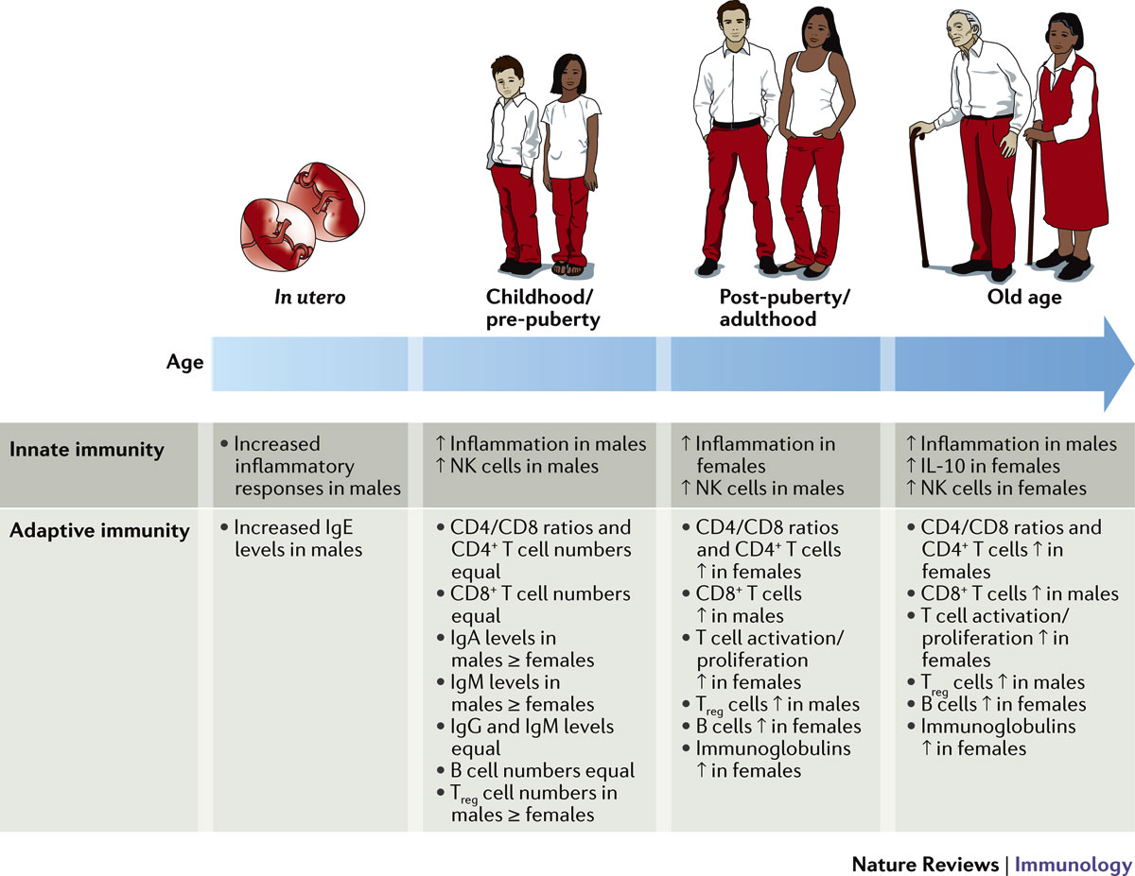
Klein and Flanagan. (2016) Nature Reviews Immunology, 16, 626-638.

Slide 13
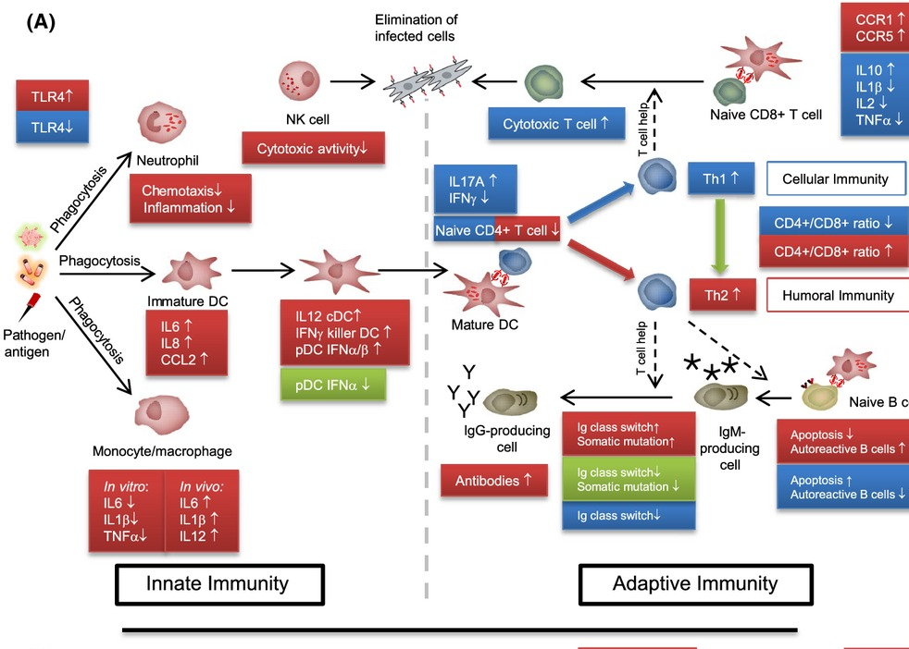
Effects of sex steroid hormones on the immune system.
Effects of estrogens at ovulatory to pregnancy levels (during the reproductive phase of life) are shown in red, effects of testosterone in blue, and effects of progesterone in green.
Aging Cell, Volume: 14, Issue: 3, Pages: 309-321, First published: 26 February 2015, DOI: (10.1111/acel.12326)

Slide 14
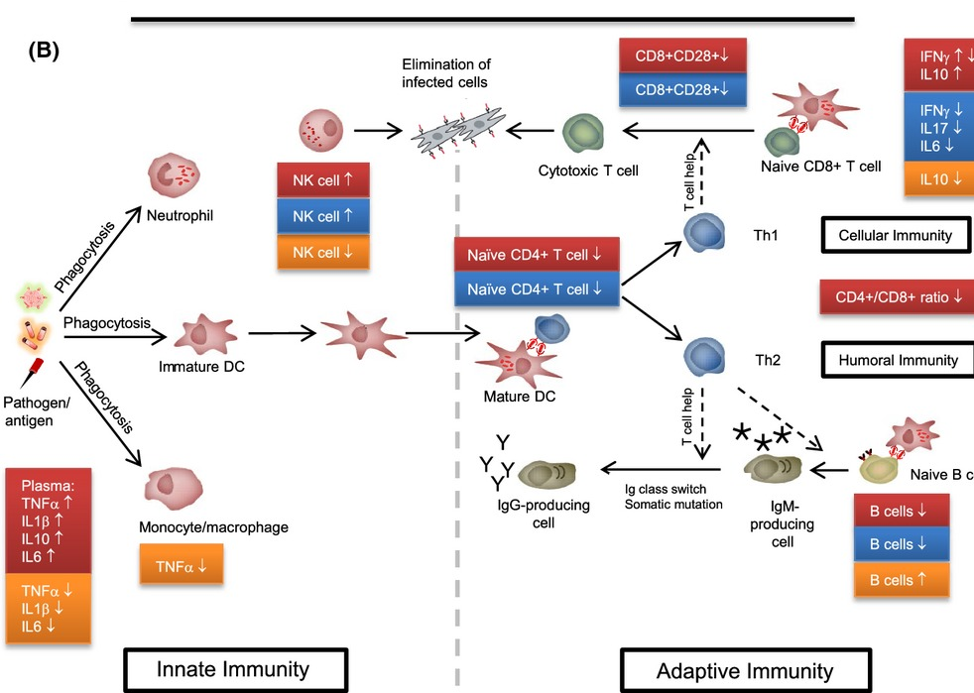
Sex and aging affect the immune system
Age‐related changes in elderly women (postmenopause) are shown in red, in elderly men in blue, and effects of HRT on the female immune system in orange.
Aging Cell, Volume: 14, Issue: 3, Pages: 309-321, First published: 26 February 2015, DOI: (10.1111/acel.12326)

Slide 15
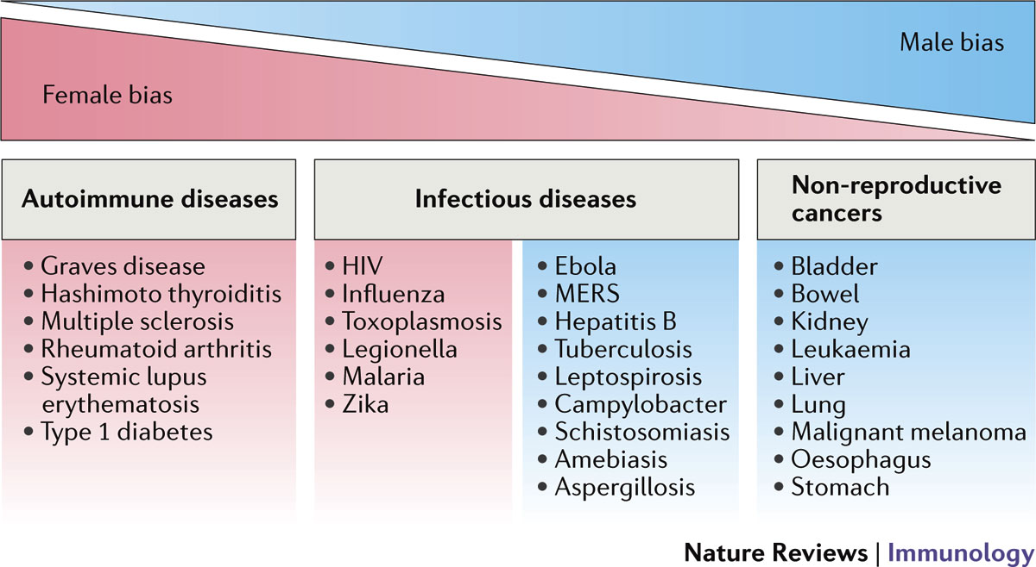
Klein and Flanagan. (2016) Nature Reviews Immunology, 16, 626-638.

Slide 16

Aging (Albany NY). 2016 Sep; 8(9): 1844–1859.
Published online 2016 Sep 28. doi: 10.18632/aging.101020
PMCID: PMC5076441
PMID: 27690265
DNA methylation-based measures of biological age: meta-analysis predicting time to death

Slide 17
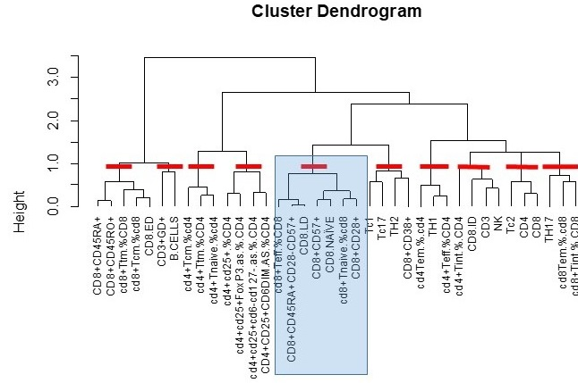
Figure 3. Cluster dendogram of cell types in pilot samples
 | IEAA Status |  |  | Age
Cluster | Estimate | SE | p-value | Estimate | SE | p-value
1 | 0.43 | 0.23 | 0.06 | -0.41 | 0.77 | 0.60
2 | 0.04 | 0.21 | 0.83 | 0.50 | 0.79 | 0.53
3 | 0.28 | 0.22 | 0.20 | -1.13 | 0.78 | 0.15
4 | 0.03 | 0.22 | 0.88 | 0.50 | 0.85 | 0.56
5 | 0.25 | 0.22 | 0.25 | 0.48 | 0.78 | 0.54
6 | 0.82 | 0.39 | 0.03 | 0.00 | 1.03 | 1.00
7 | 0.02 | 0.20 | 0.94 | 0.57 | 0.76 | 0.45
8 | -0.03 | 0.15 | 0.82 | -0.08 | 0.59 | 0.89
9 | 0.14 | 0.14 | 0.31 | -1.15 | 0.45 | 0.01
10 | -0.13 | 0.19 | 0.49 | -1.47 | 0.65 | 0.03
Epigenetic age associated with gamma delta T cells and B cells
Chronological age associated with markers of CD8 cell immunosenescence.

Slide 18
Opportunities
Immune cell profiling exists to some extent in multiple large population studies, including MESA, CHS, VACS (HIV), HRS.
Methods for examining immune cells are improving.
Costs of basic flow cytometers has dropped.
Allow for 96 well plate, walkaway analysis
CyTOF (using heavy metals and mass cytometry) allows for ~42 different Abs to be examined simultaneously.
Machine learning for analysis of the immune system as a whole is blossoming
In the TOPMed era, the opportunity to examine sex/gender differences in immune cell senescence, epigenetic aging, chronologic aging exists.
Pitfalls
Tend to adjust for age and sex/gender rather than stratify and explore differences
Tend to analyze age as a linear trajectory
Generally looking at age and not aging.
While most population studies have vast repositories of plasma/serum samples for longitudinal studies of aging, few have longitudinal samples of properly stored cells.

Slide 19
Thank You
Questions?

