Slide 1
Incentives as a Policy Tool to Shape System Behavior
Cheryl L. Damberg
“The Health System’s Role in Improving the Health of Older Adults”
Research Centers Collaborative Network of the NIA
Achieving and Sustaining Behavior Change to Benefit Older Adults
December 7, 2018

Slide 2




What are We Paying for When We Pay Providers?
A physician’s time?
A unit of treatment delivered?
Measurable improvement in our health?
Something else?
Notes:
To put it another way:
What actions are we incentivizing by the design of our payment systems?
And, as my presentation will cover, “how are payment systems being redesigned to encourage the behaviors we desire?”
When I use the term “providers”—I am referring to doctors and hospitals

Slide 3

Health Care Payment Models have been Evolving
Fee for service
Pay for performance
Pay for value
3
Cheryl Damberg, "Achieving and Sustaining Behavior Change to Benefit Older Adults" Dec 6-7, 2018
Notes:
How we pay providers has been a moving target for decades
Decades in which RAND has been pivotal in shaping the conversation as well as policies---regarding how provider payments are designed
Let me start by orienting you to these 3 types of payment models.

Slide 4
How are Incentives Shaping Health System Behaviors?
Actions to reduce total costs of care
Improve hand-off at discharge (transition clinics)
Tighter management of complex patients in the community
Use multi-disciplinary care teams in ambulatory setting
Shift management of complex patients from PCP to central team
Reduce the number of specialists and capitate specialists
Actions to redesign primary care:
Case management of high risk patients
Team-based care
Using data analytics to identify high risk patients
Telehealth
Task shifting (working to highest level of licensure)
Open access appointments

Slide 5
Do Pay-for-Performance Incentives Work?
Evaluations—mostly observational studies with numerous issues
Lack of good control group, short term interventions, few measures examined, different implementation contexts and design approaches
Bottom line: P4P did not transform care delivery as hoped!
Ambulatory setting: Evidence on impacts is mixed. Modest improvements on process measures. No consistent effect on intermediate health outcomes.
Hospital setting: Public reporting had larger effect than financial payments. Process measures quickly topped out due to hospital’s ability to “control the patient.” Little evidence of effects on health outcomes, save for hospital readmissions.
Incentives mostly small, raising questions about whether larger incentives would create more engagement and greater improvement
Source: A. Mendelson, K Kondo, C Damberg et al. The effects of Pay-for-Performance Programs on Health, Health Care Use, and Processes of Care: A Systematic Review. Annals of Internal Medicine, 2017.

Slide 6
Why Don’t Incentives Work as Desired?
Incentives seek to influence human/organizational motivation
Typically structured as “contingent rewards” --work best in situations with simple rules
For conceptual problems that require cognitive skills, incentives lead to poorer performance
Hierarchical principal-agent incentive structure:
At the system level, may encourage investments in infrastructure and quality improvement
At provider level, may not motivate people and may decrease intrinsic motivation (Irlenbusch, 2009; Pink, 2009)
Incentives mostly built on a fee-for-service (FFS) payment structure
Doesn’t give providers the flexibility to deliver the highest value services that would improve the health of patients (e.g., community services)
Sources: B Irlenbusch, London School of Economic’s Department of Management, 2009. Daniel Pink, Drive, 2009.
Notes:
Contingent rewards/incentives tend to work with tasks that have simple rules—the reward narrows focus and provider can see goal right there (routine, mechanical work)
Where solutions are on the periphery, incentives are bad, as you don’t want to narrow the focus, rather you want providers to be thinking in the larger/broader space
Contingent rewards block creativity---which can hinder care redesign and alternative ways of managing patients.

Slide 7
Areas of Controversy
If you make incentives larger, that will lead providers to make changes
Introduces undesirable incentives for providers that could harm patients
Doesn’t fix the underlying “base payment” problem, which remains mostly FFS
Lack of accountability for appropriateness of services and health outcomes—measuring the wrong things
Incentives may discourage providers for caring for certain types of patients
Held accountable for things they can’t control
Could lead to undesired effects unless risk-adjust measures for greater complexity and social determinants
Performance measures don’t account for important exclusions, namely patient preferences given treatment and side-effect tradeoffs—particularly important among the older population
Other strategies may be more effective in driving desired changes among frontline physicians—this area requires more exploration!
Notes:
Contingent rewards “block creativity”---which can hinder care redesign and alternative ways of managing patients.

Slide 8
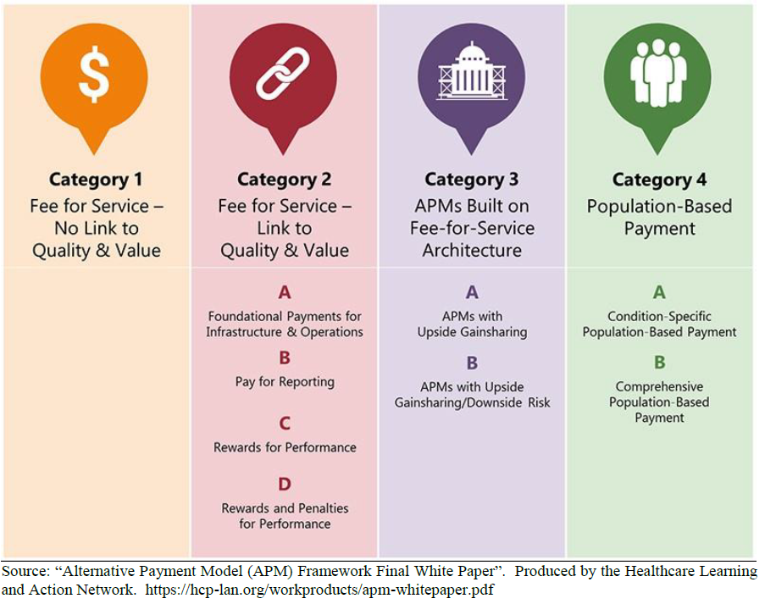
Alternative Approaches that Shift Towards Paying for Value
Cheryl Damberg, "Achieving and Sustaining Behavior Change to Benefit Older Adults" Dec 6-7, 2018

Slide 9
What are the Concerns with Alternative Payment Models that Pay for Quality or Value?
Source: Harold Miller. “Why Value-based Payment Isn’t Working and How to Fix it.” Center for Healthcare Quality and Payment Reform
Cheryl Damberg, "Achieving and Sustaining Behavior Change to Benefit Older Adults" Dec 6-7, 2018

Slide 10
Reconsidering what we Pay for and Incentivize
Current State:
Focus on delivering more services
Future State:
Measure and pay for preserving health
Medical Treatment
“Sick” Care
Prevention & Management
“Health” care
Cheryl Damberg, "Achieving and Sustaining Behavior Change to Benefit Older Adults" Dec 6-7, 2018
Notes:
Need a new paradigm
Little in today’s health system architecture to incentivize providers to actively prevent the occurrence of disease in 1st place and to limit procedures supplied to patients that are the most effective options
Need to reimburse providers for keeping their customers healthy instead of only paying for services when people are sick.
Goal is to preserve health
Don’t reimburse for procedures; pay for each day a person is kept healthy (insurance company cannot receive reimbursement for any day you are sick; start paying once you are restored to health
Reducing the # of people who are sick---has higher economic value to society.
To effectively preserve health, people will need to share their data to allow early intervention on a constant basis (physical exam, monitoring lifetime data, genetic information) + optimal science guided decisions.

Slide 11
Areas of Opportunity for Multidisciplinary Collaboration
Identify important patient health outcomes and systematically measure those
Develop patient-centered measures of health outcomes tailored to individual preferences for treatment
Conduct research applying behavioral economics/behavioral science to identify other effective approaches to driving desired behaviors (e.g., changing the choice architecture, structuring information)
Map out a road map to revamp payments to health systems and providers to pay for health
Engage patients in maintaining health---this requires active communication and applying what we know about how to communicate
Cheryl Damberg, "Achieving and Sustaining Behavior Change to Benefit Older Adults" Dec 6-7, 2018
Notes:
To change, we have to change our priorities
Political willingness—to change budgets and priorities to support prevention and health education
Regulatory framework changes to enable gathering and using of personal health information
Reframe the payment approach with docs, hospitals, insurers, medical companies
Individuals—need them as willing partners to change lifestyle and prioritize staying healthy.
Question of vision and will!

Slide 12
damberg@rand.org
Cheryl Damberg, "Achieving and Sustaining Behavior Change to Benefit Older Adults" Dec 6-7, 2018

