Slide 1
Sex/Gender Differences in the Demography of Aging
20Eileen Crimmins
USC/UCLA Center for Biodemography and Population Health
Marina Del Rey
June 6,2019

Slide 2




Broad Perspective
What health differences between men and women appear universal and time invariant?

Slide 3
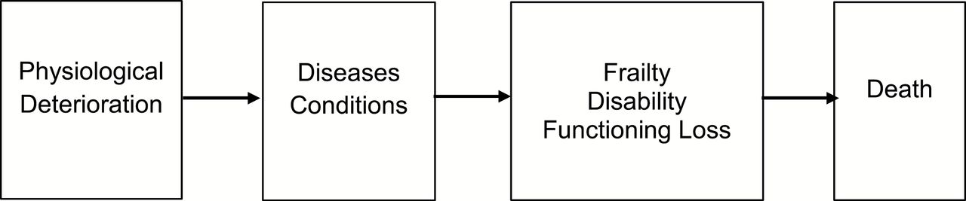
Dimensions of health - The morbidity process.
Molecular
Cellular Aging
Eileen M. Crimmins The Gerontologist 2015;55:901-911
Notes:
Dimensions of the morbidity process. Source: Crimmins et al. (2010)

Slide 4
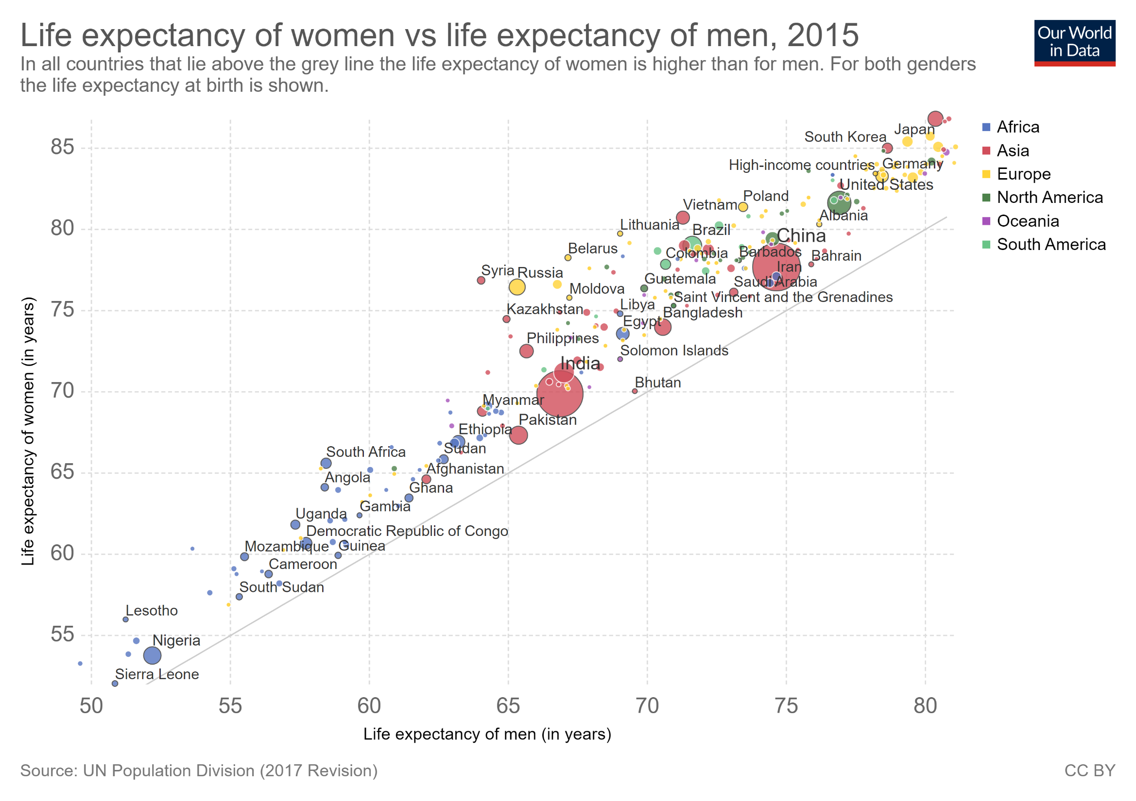
Life Expectancy of Women exceeds that of men in every country – after 2000

Slide 5
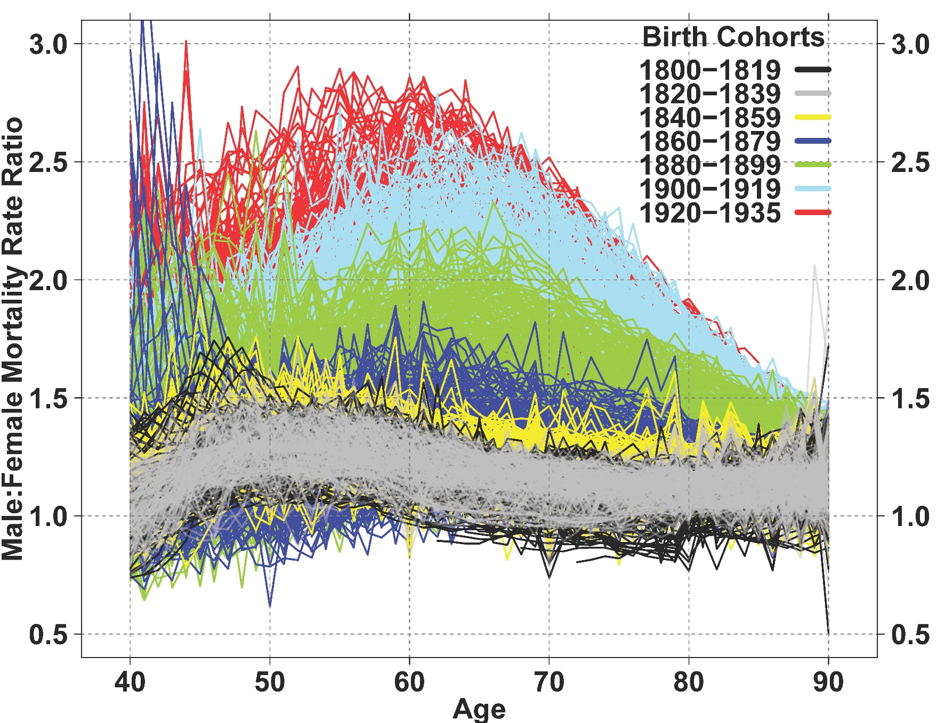
Sex differences in mortality after middle age vary markedly over time - M:F mortality ratios for single-year birth cohorts for 13 countries: 1800–1935.
Source: “The 20th Century Surge of Excess Adult Male Mortality.” 2015. Beltrán˗Sánchez, Finch, Crimmins. PNAS. 112(29):8993-8.

Slide 6
Females have worse physical functioning in most countries
Odds Ratios Indicating Effect of Being Female on Functioning, ADL and IADL Difficulties
“Gender Differences in Health: Results from SHARE, ELSA, and HRS.” 2011. E. M. Crimmins,
A. Sole-Auro, Jung Ki Kim. European Journal of Public Health, 21(1):81-91.

Slide 7
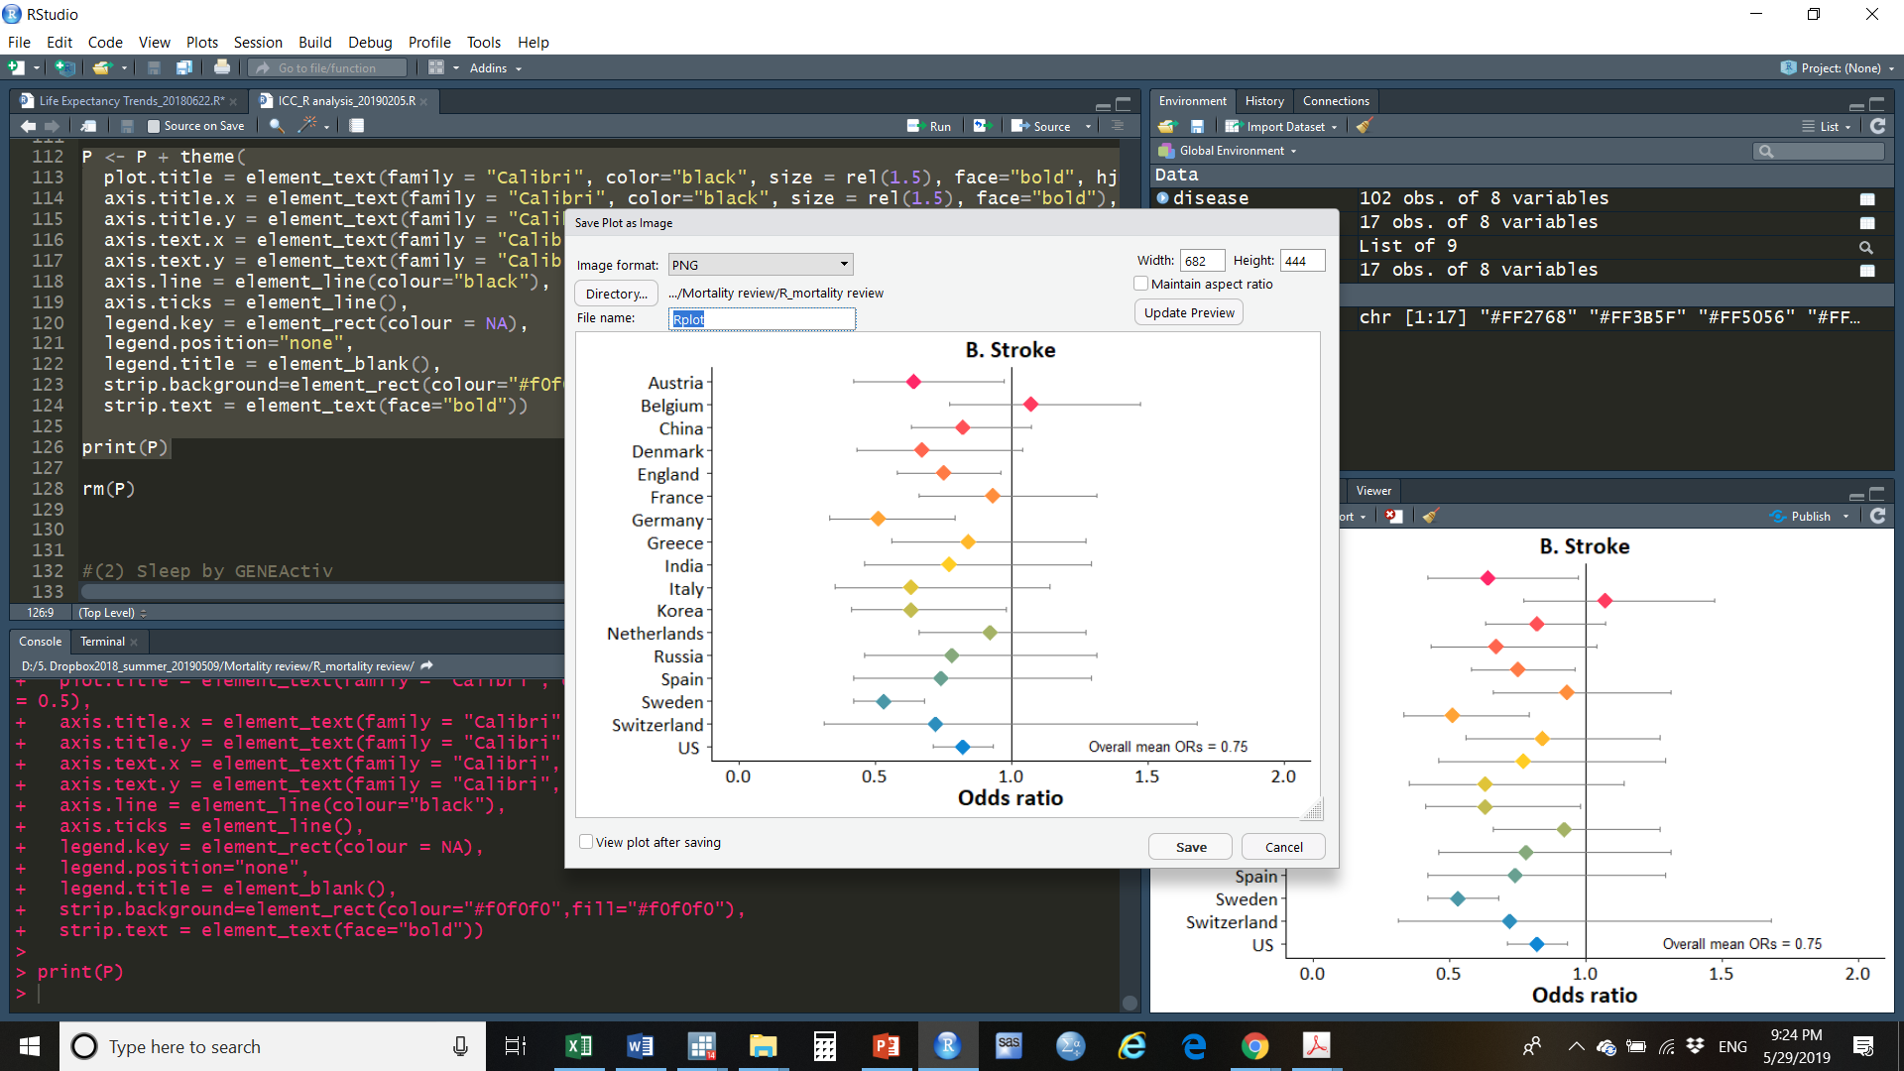
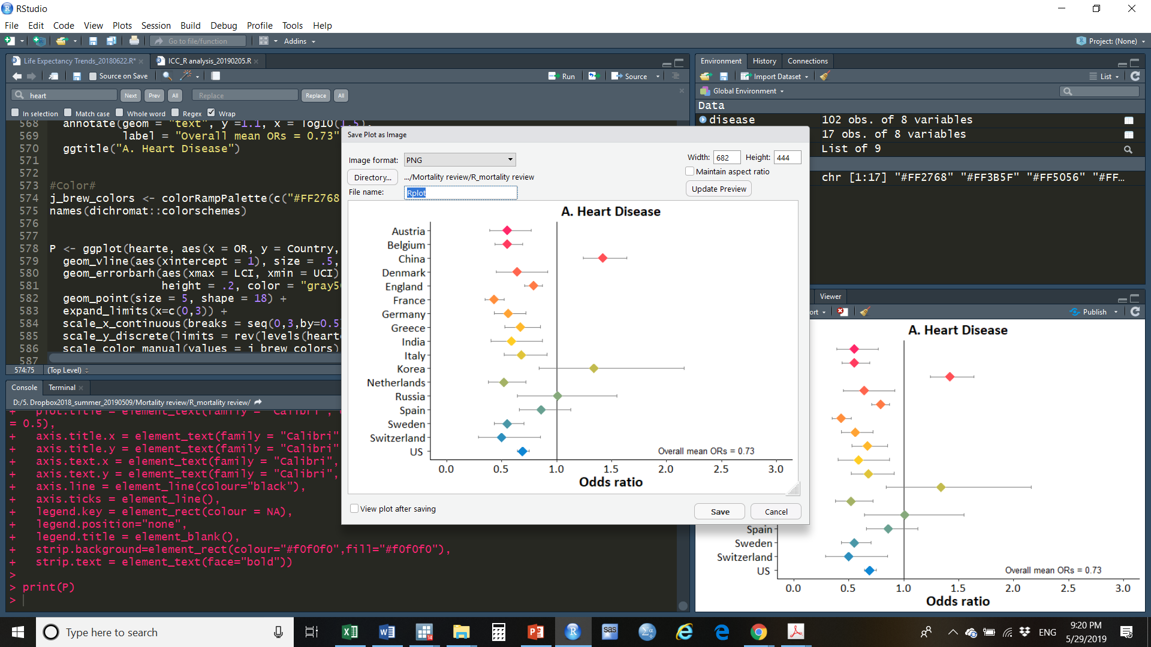
Females less likely to have heart disease and have had a stroke
Odds Ratios indicating Effect of being Female on Presence of Disease or Condition (Population Age 50+)
Source: “Differences Between Men and Women in the Morbidity Process.” 2018. E. M. Crimmins, H. Shim, Y. S. Zhang, J. K. Kim. Clinical Chemistry. 65(1):135-145.
Notes:
Note: Odds ratios from logistic regressions of sex and age on presence of condition; vertical line indicates equality for men and women.
Data: China: CHARLS (2011); Korea: KLoSA (2010); India & Russia: WHO SAGE (2007-2010); Results for SHARE (2004), HRS (2004), and ELSA (2004) from Crimmins, E. M., Kim, J. K., & Solé-Auró, A. (2010). Gender differences in health: results from European Countries (SHARE), England (ELSA) and the U.S. (HRS). European Journal of Public Health, 21(1), 81-91. (25)

Slide 8
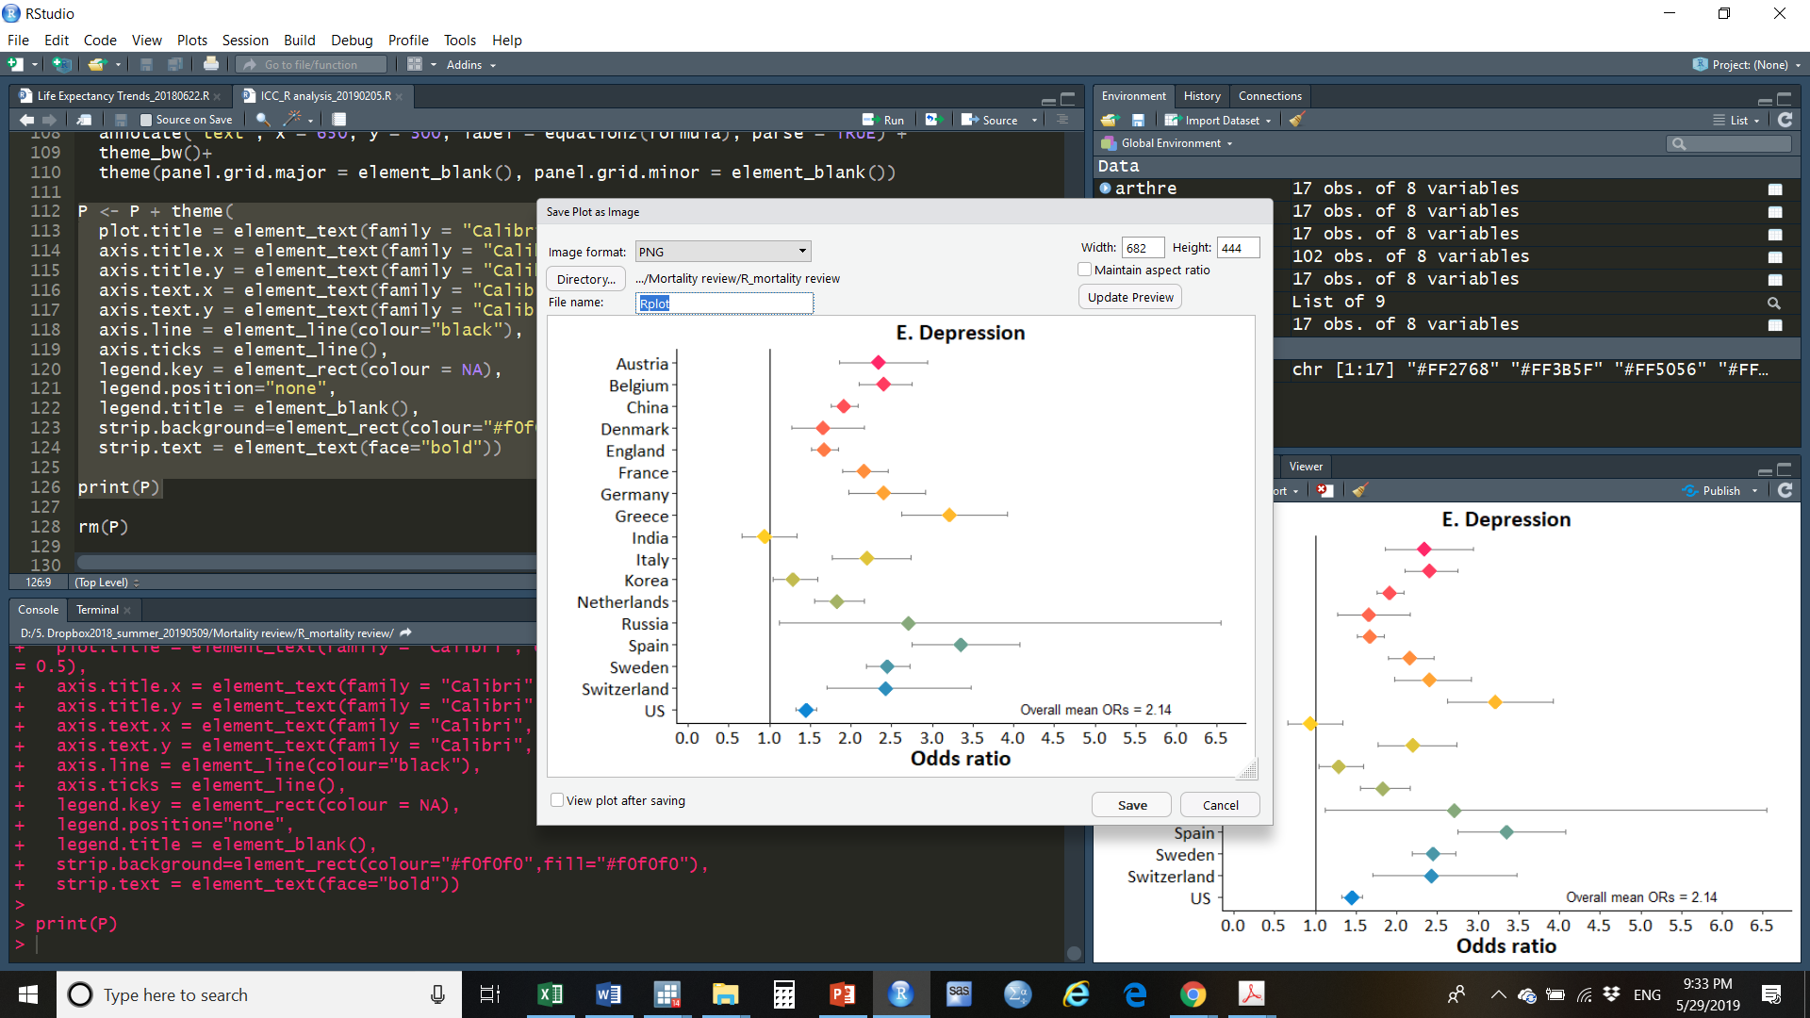

Females more likely to have Arthritis and Depression
Odds Ratios indicating Effect of being Female on Presence of Disease or Condition (Population Age 50+)
Source: “Differences Between Men and Women in the Morbidity Process.” 2018. E. M. Crimmins, H. Shim, Y. S. Zhang, J. K. Kim. Clinical Chemistry. 65(1):135-145.
Notes:
Note: Odds ratios from logistic regressions of sex and age on presence of condition; vertical line indicates equality for men and women.
Data: China: CHARLS (2011); Korea: KLoSA (2010); India & Russia: WHO SAGE (2007-2010); Results for SHARE (2004), HRS (2004), and ELSA (2004) from Crimmins, E. M., Kim, J. K., & Solé-Auró, A. (2010). Gender differences in health: results from European Countries (SHARE), England (ELSA) and the U.S. (HRS). European Journal of Public Health, 21(1), 81-91. (25)

Slide 9

Diabetes - Inconsistent Male – Female Differences: Effect of Being Female
Source: “Differences Between Men and Women in the Morbidity Process.” 2018. E. M. Crimmins, H. Shim, Y. S. Zhang, J. K. Kim. Clinical Chemistry. 65(1):135-145

Slide 10
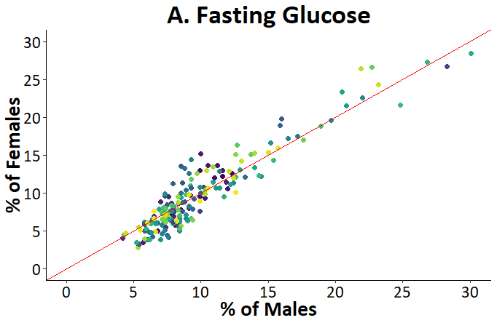
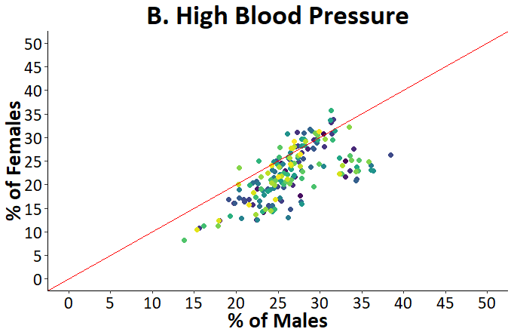
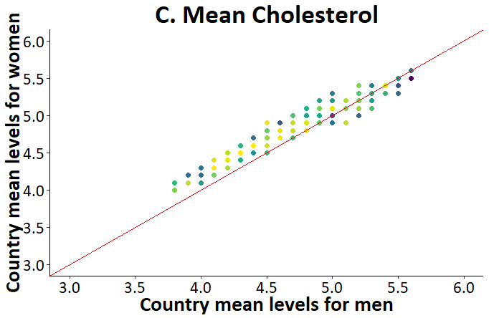
Percent of Men and Women with High Risk Levels of Fasting Glucose and High Blood Pressure and Mean Total Cholesterol in 191 Countries
Source: “Differences Between Men and Women in the Morbidity Process.” 2018. E. M. Crimmins, H. Shim, Y. S. Zhang, J. K. Kim. Clinical Chemistry. 65(1):135-145.
Notes:
Note. Each dot represents the percentage or average level for men and women in an individual country. The number of countries is 191 for blood glucose and blood pressure (Age 18⁺ years), and 189 countries for cholesterol (Age 25⁺ years). All numbers are age-standardized.
Source: WHO Global Health Observatory Data Repository (Available from http://apps.who.int/gho/data/node.main.A867?lang=en)

Slide 11
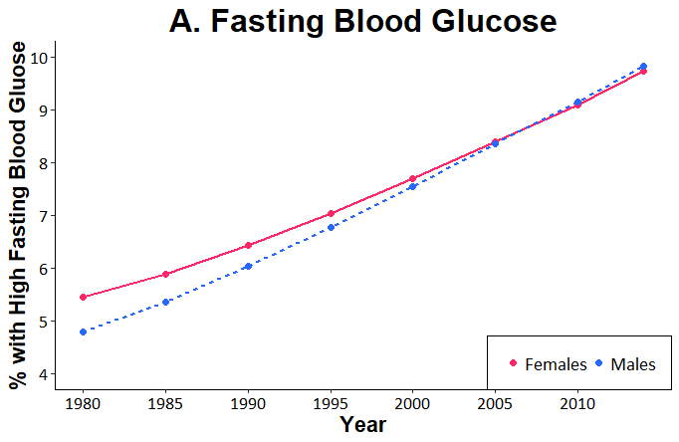
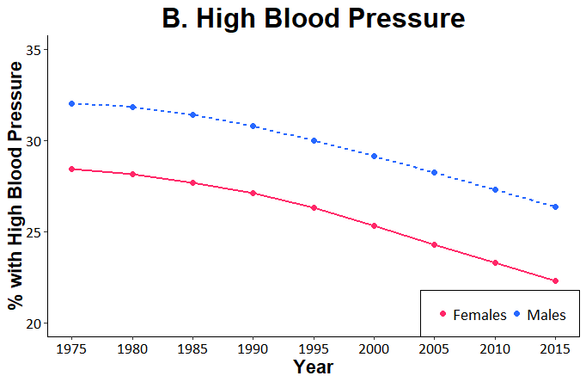
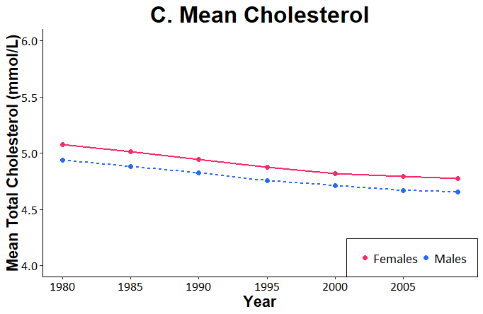
Changes from 1975 to 2015 in Average Percent of Men and Women with High Glucose, High Blood Pressure, and Average Cholesterol Level (mmol/L) in 191 Countries
Source: “Differences Between Men and Women in the Morbidity Process.” 2018. E. M. Crimmins, H. Shim, Y. S. Zhang, J. K. Kim. Clinical Chemistry. 65(1):135-145.
Notes:
Note. Each dot is the average across all countries at a point in time for either men and for women. The number of countries is 191 for blood glucose and blood pressure (Age 18⁺ years), and 189 countries for cholesterol (Age 25⁺ years). Values in each country are age-standardized. Trends from 1980 to 2014 for blood glucose and blood pressure, 1980 to 2009 for cholesterol.
Source: WHO Global Health Observatory Data Repository

Slide 12
Pattern of Sex Differences in Cardiovascular Risk Changes over Time in U.S.
The Old Pattern of Sex Differences in Cardiovascular Risk: 1990
Mean Number of High Risk Cardiovascular Risk Factors for Men and Women by Age
United States: NHANES
Kim, J. Ailshire, E. M. Crimmins. Aging Clinical and Experimental Research. 2019 Jan;31(1):135-143.
Notes:
Cardiovascular risk indicators include systolic and diastolic blood pressure, body mass index (BMI), total cholesterol, high-density lipoprotein (HDL) cholesterol, lowdensity lipoprotein (LDL) cholesterol, triglycerides, and glycated hemoglobin (HbA1c). 8 in total

Slide 13
Sex Differences in Cardiovascular Risk: 2000
Mean Number of High Risk Cardiovascular Risk Factors by Sex and Age

Slide 14
Cardiovascular Risk – Almost the same by sex and age
Mean Number of High Risk Cardiovascular Risk Factors by Sex and Age
United States: NHANES
Kim, J. Ailshire, E. M. Crimmins. Aging Clinical and Experimental Research. 2019 Jan;31(1):135-143.

Slide 15




Future: Sex/gender differences in the hallmarks of aging
Inflammaging
Epigenetics
Telomere Length
Cell Senescence
Mitochondrial Function

Slide 16
Thank you!

Slide 17
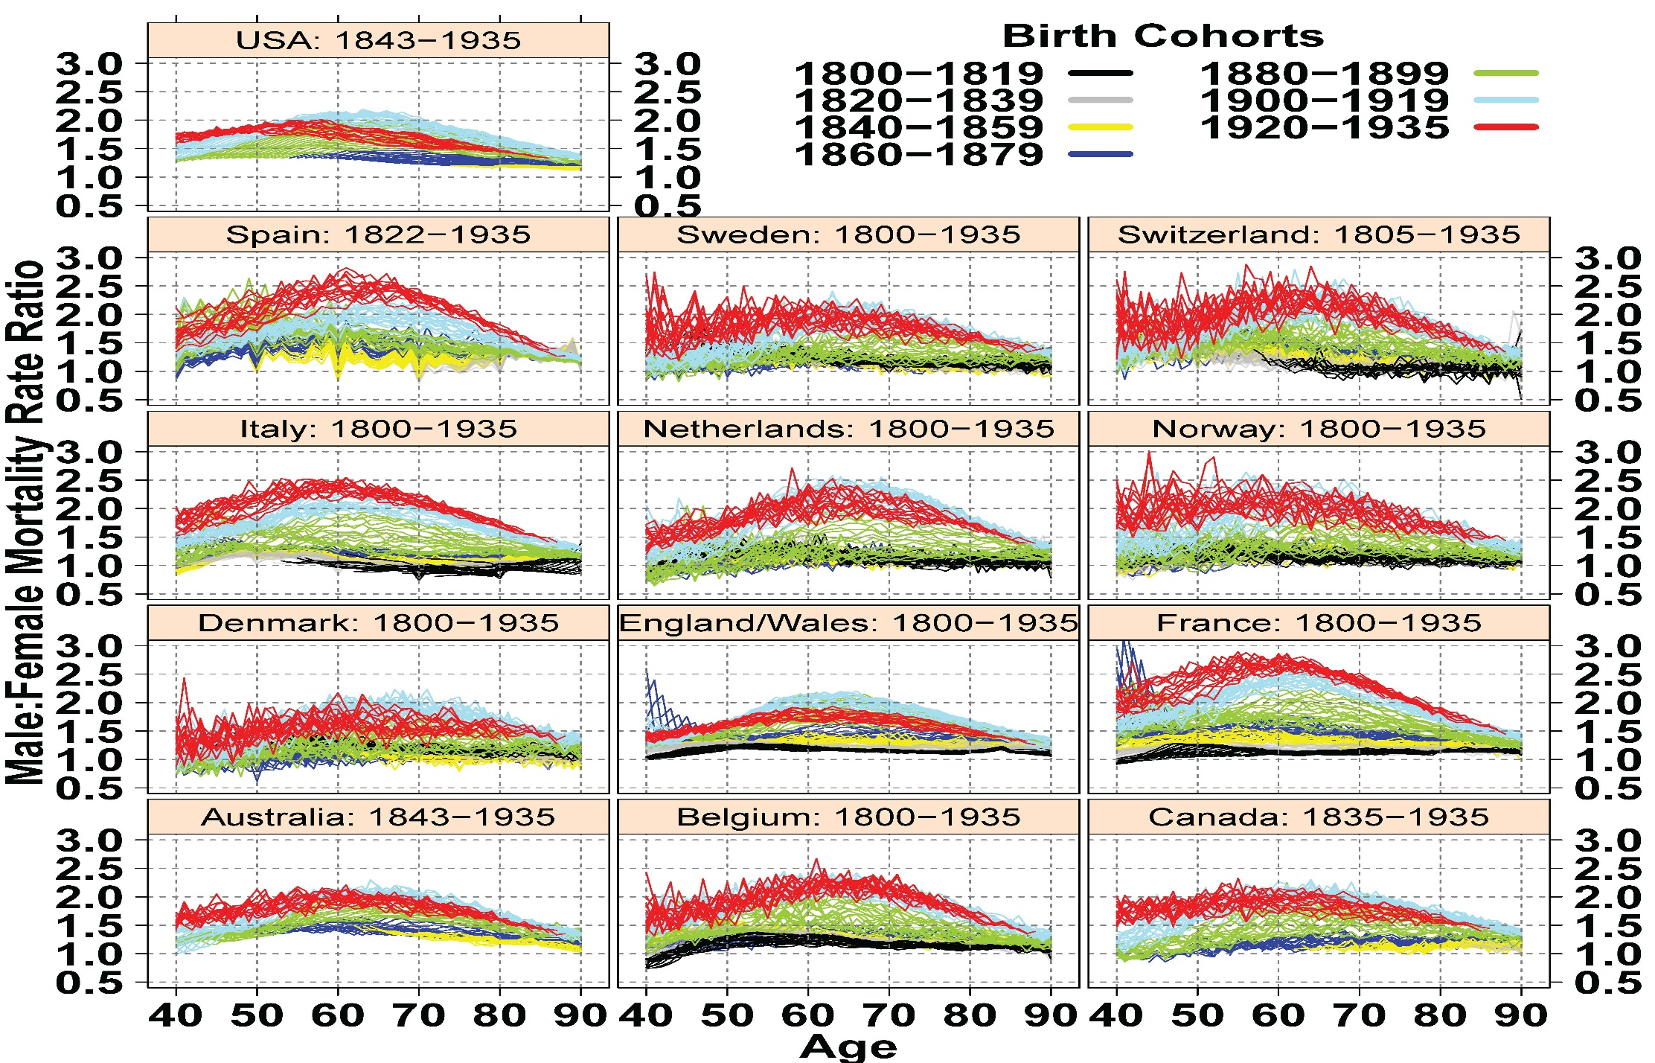
Change in Male: Female ratio remarkably similar across 13 countries
M:F cohort mortality rate ratios for single-year birth cohorts including
“incomplete” cohorts by country: 1800–1935.
Source: Human Mortality Database(www.mortality.org)

