Slide 1



Physiological responses to extreme heat exposure in older individuals
Craig Crandall PhD, Zachary McKenna PhD, Whitley Atkins PhD, Josh Foster PhD
Thermal and Vascular Physiology Laboratory
Institute for Exercise and Environmental Medicine; University of Texas Southwestern Medical Center
Notes:
Today I will share with you some of our preliminary data looking at the impact of air temperature on core temperature regulation during exercise using a simulated burn model

Slide 2
3 FACTS
The Earth’s temperature is increasing, which is accompanied by an increased frequency and intensity of heat waves (World Meteorological Organization, 2023).
The US population is aging, with the number of adults 65+ years projected to increase by 47% between 2022 and 2050 (US Census Bureau, 2023).
Individuals aged 65+ years have the greatest morbidity and mortality risk during extreme heat events (host of citations).

Slide 3
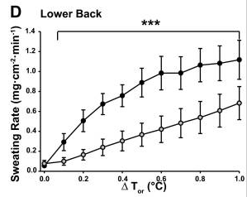

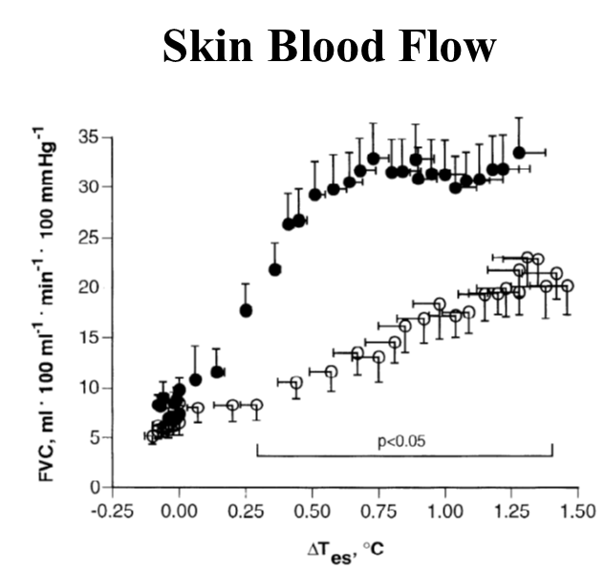
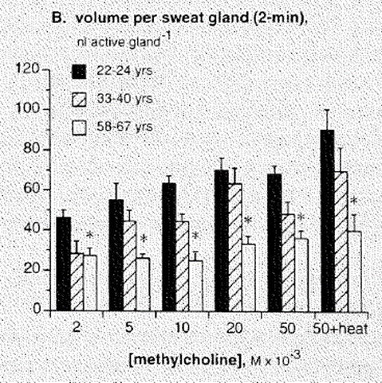
AGING & HEAT STRESS
Aging
↓ Sweating
↓ Skin blood flow
↑ Core temperature
↑ Cardiovascular stress
↑ Renal stress
↑ GI stress
Younger
Older
Smith et al. 2013; Kenney et al. 1997; Kenney & Fowler 1988

Slide 4
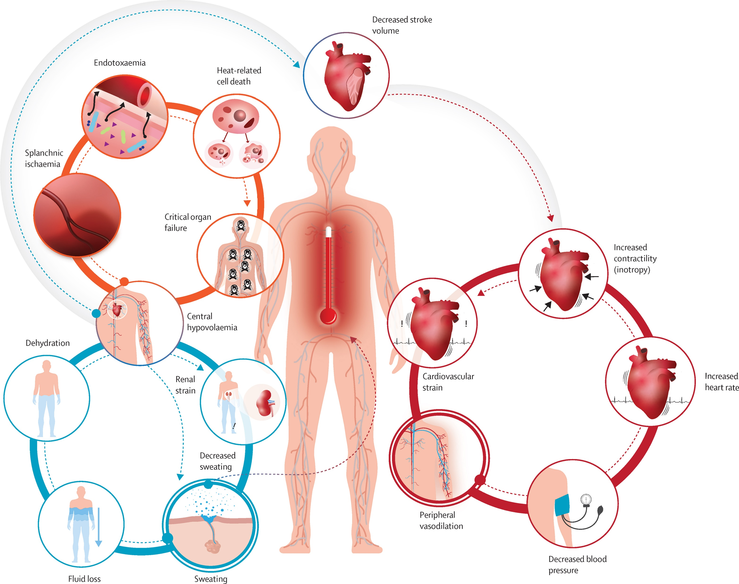
HEAT EXTREMES & HEALTH RISKS
Causes of excess hospital admissions during heat waves (1999-2010; Medicare enrollees across 1900+ counties.
Ebi et al. 2021; Bobb et al 2014

Slide 5


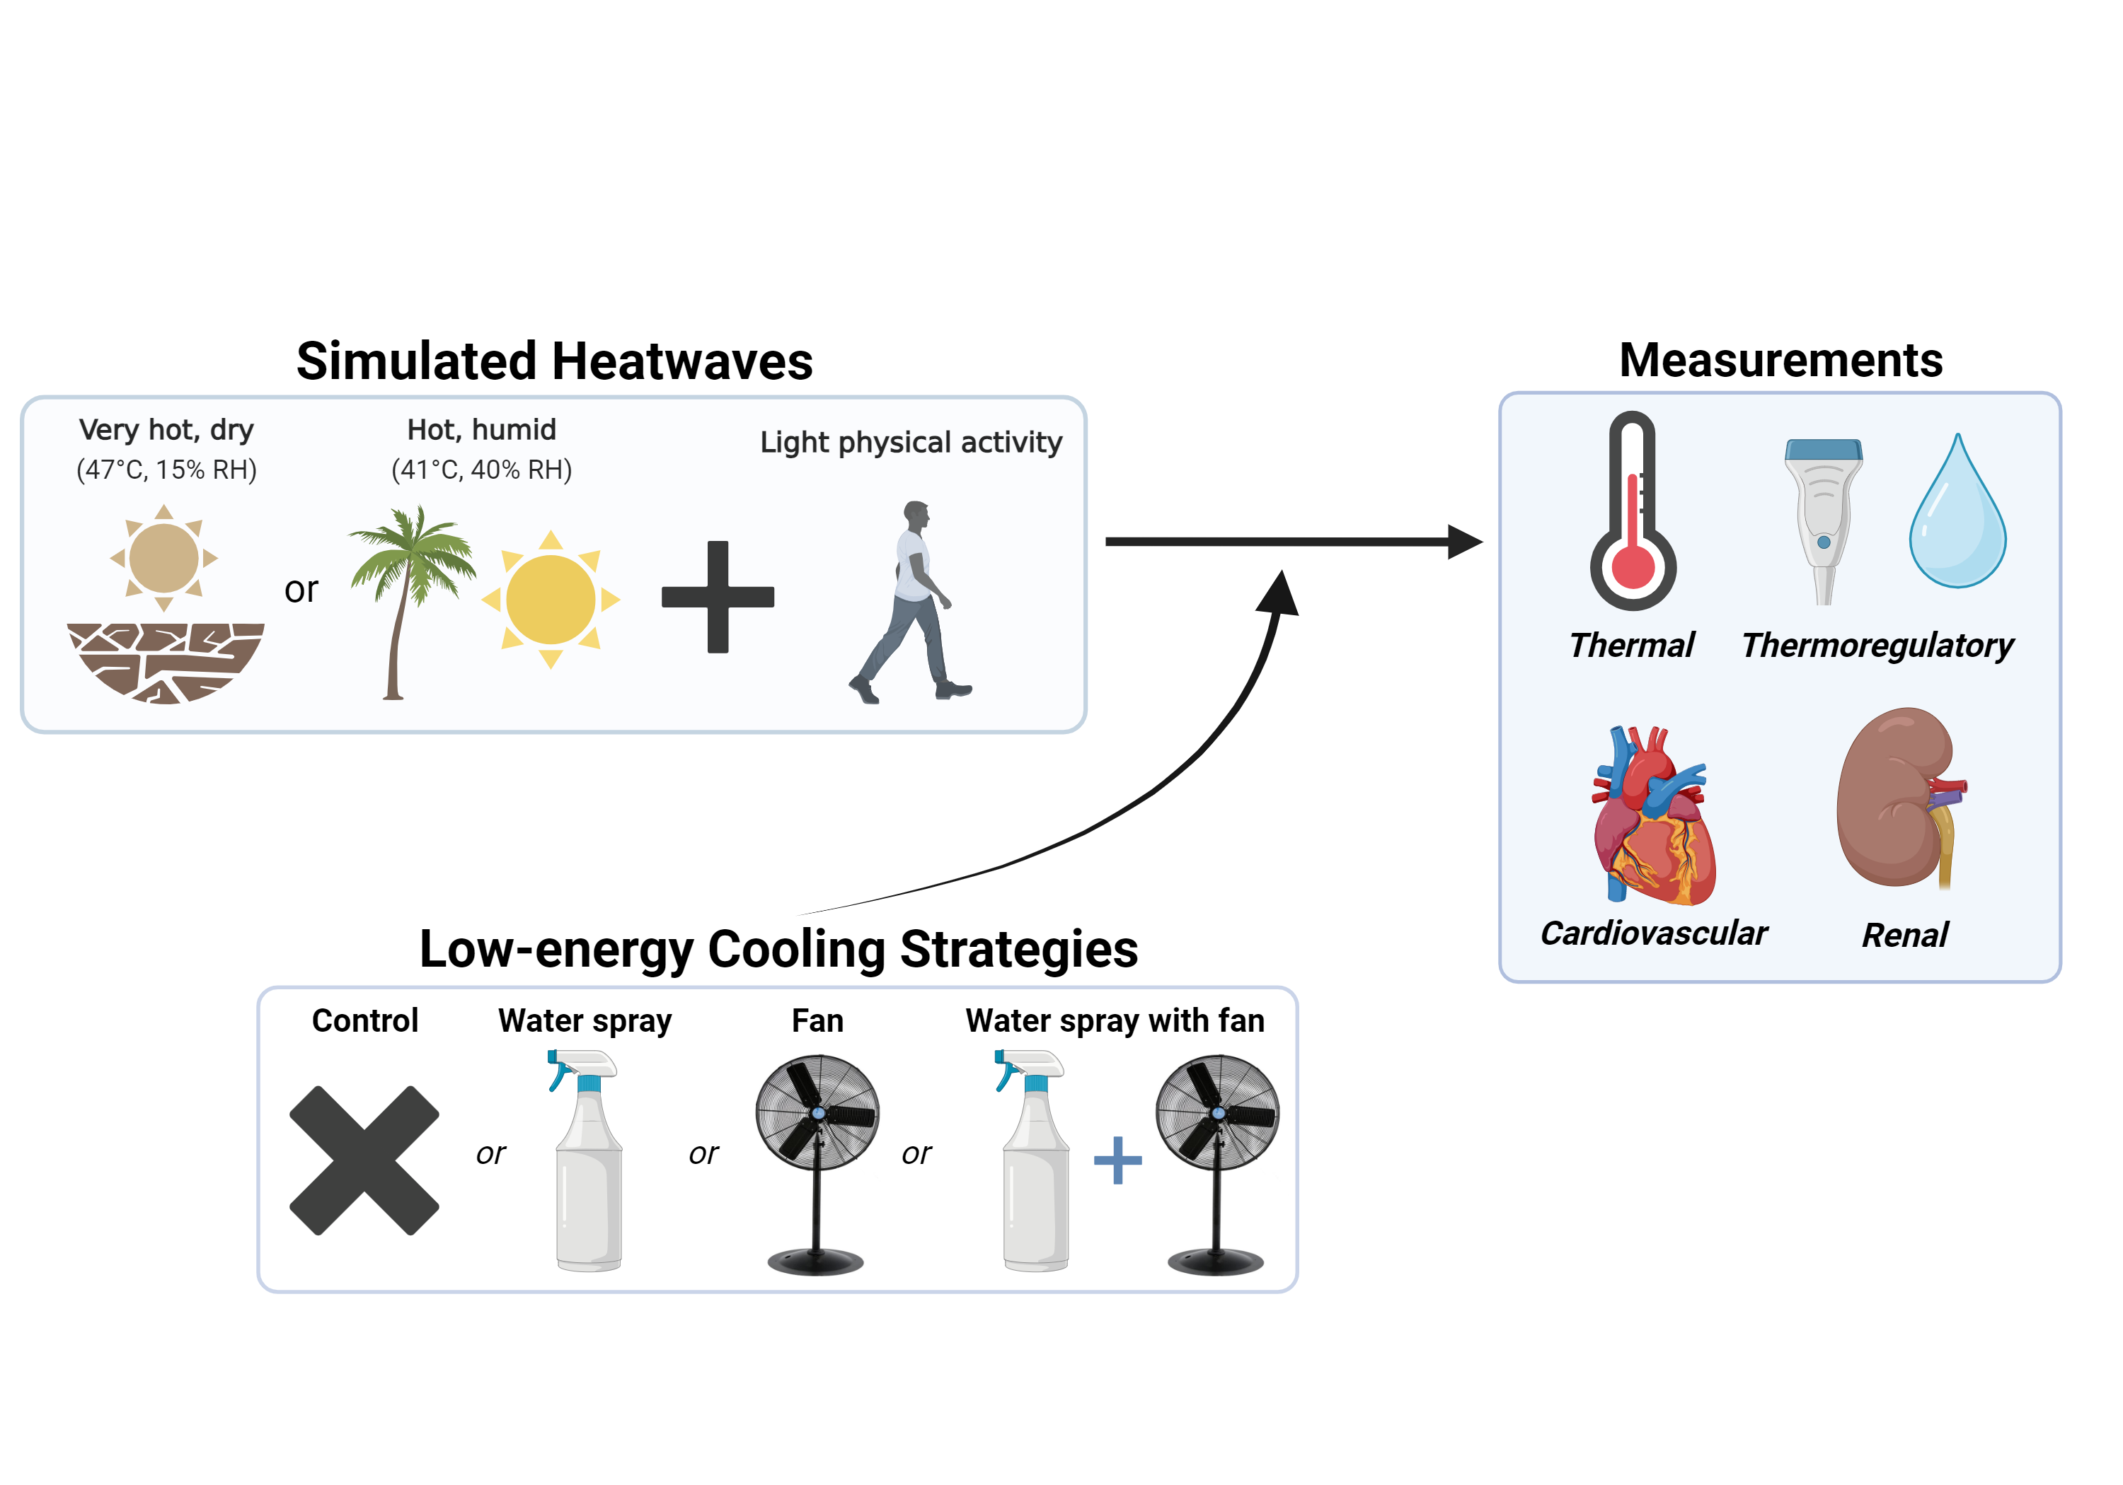
APPROACH
Simulated Heat Waves
Water intake 3 mL/kg/hour (24°C)
Baseline
3 hours – DRY (47°C, 15% RH) or HUMID (41°C, 40% RH)
Recovery
Echocardiogram
Forearm Blood Flow
Blood & Urine Sample
Nude Body Mass
Echocardiogram
Forearm Blood Flow
Echocardiogram
Forearm Blood Flow
Blood & Urine Sample
Nude Body Mass
Continuous: Core and skin temperatures, heart rate, local sweat rate monitoring
Every 15-minutes: Blood pressure, thermal sensation, thermal comfort, RPE
3 METs for 5-minutes
Younger: 18-35 years
Older: 65+ years
2018 Los Angeles heat wave
1995 Chicago heat wave
Notes:
Rationale for 3 hours. Show Rob

Slide 6
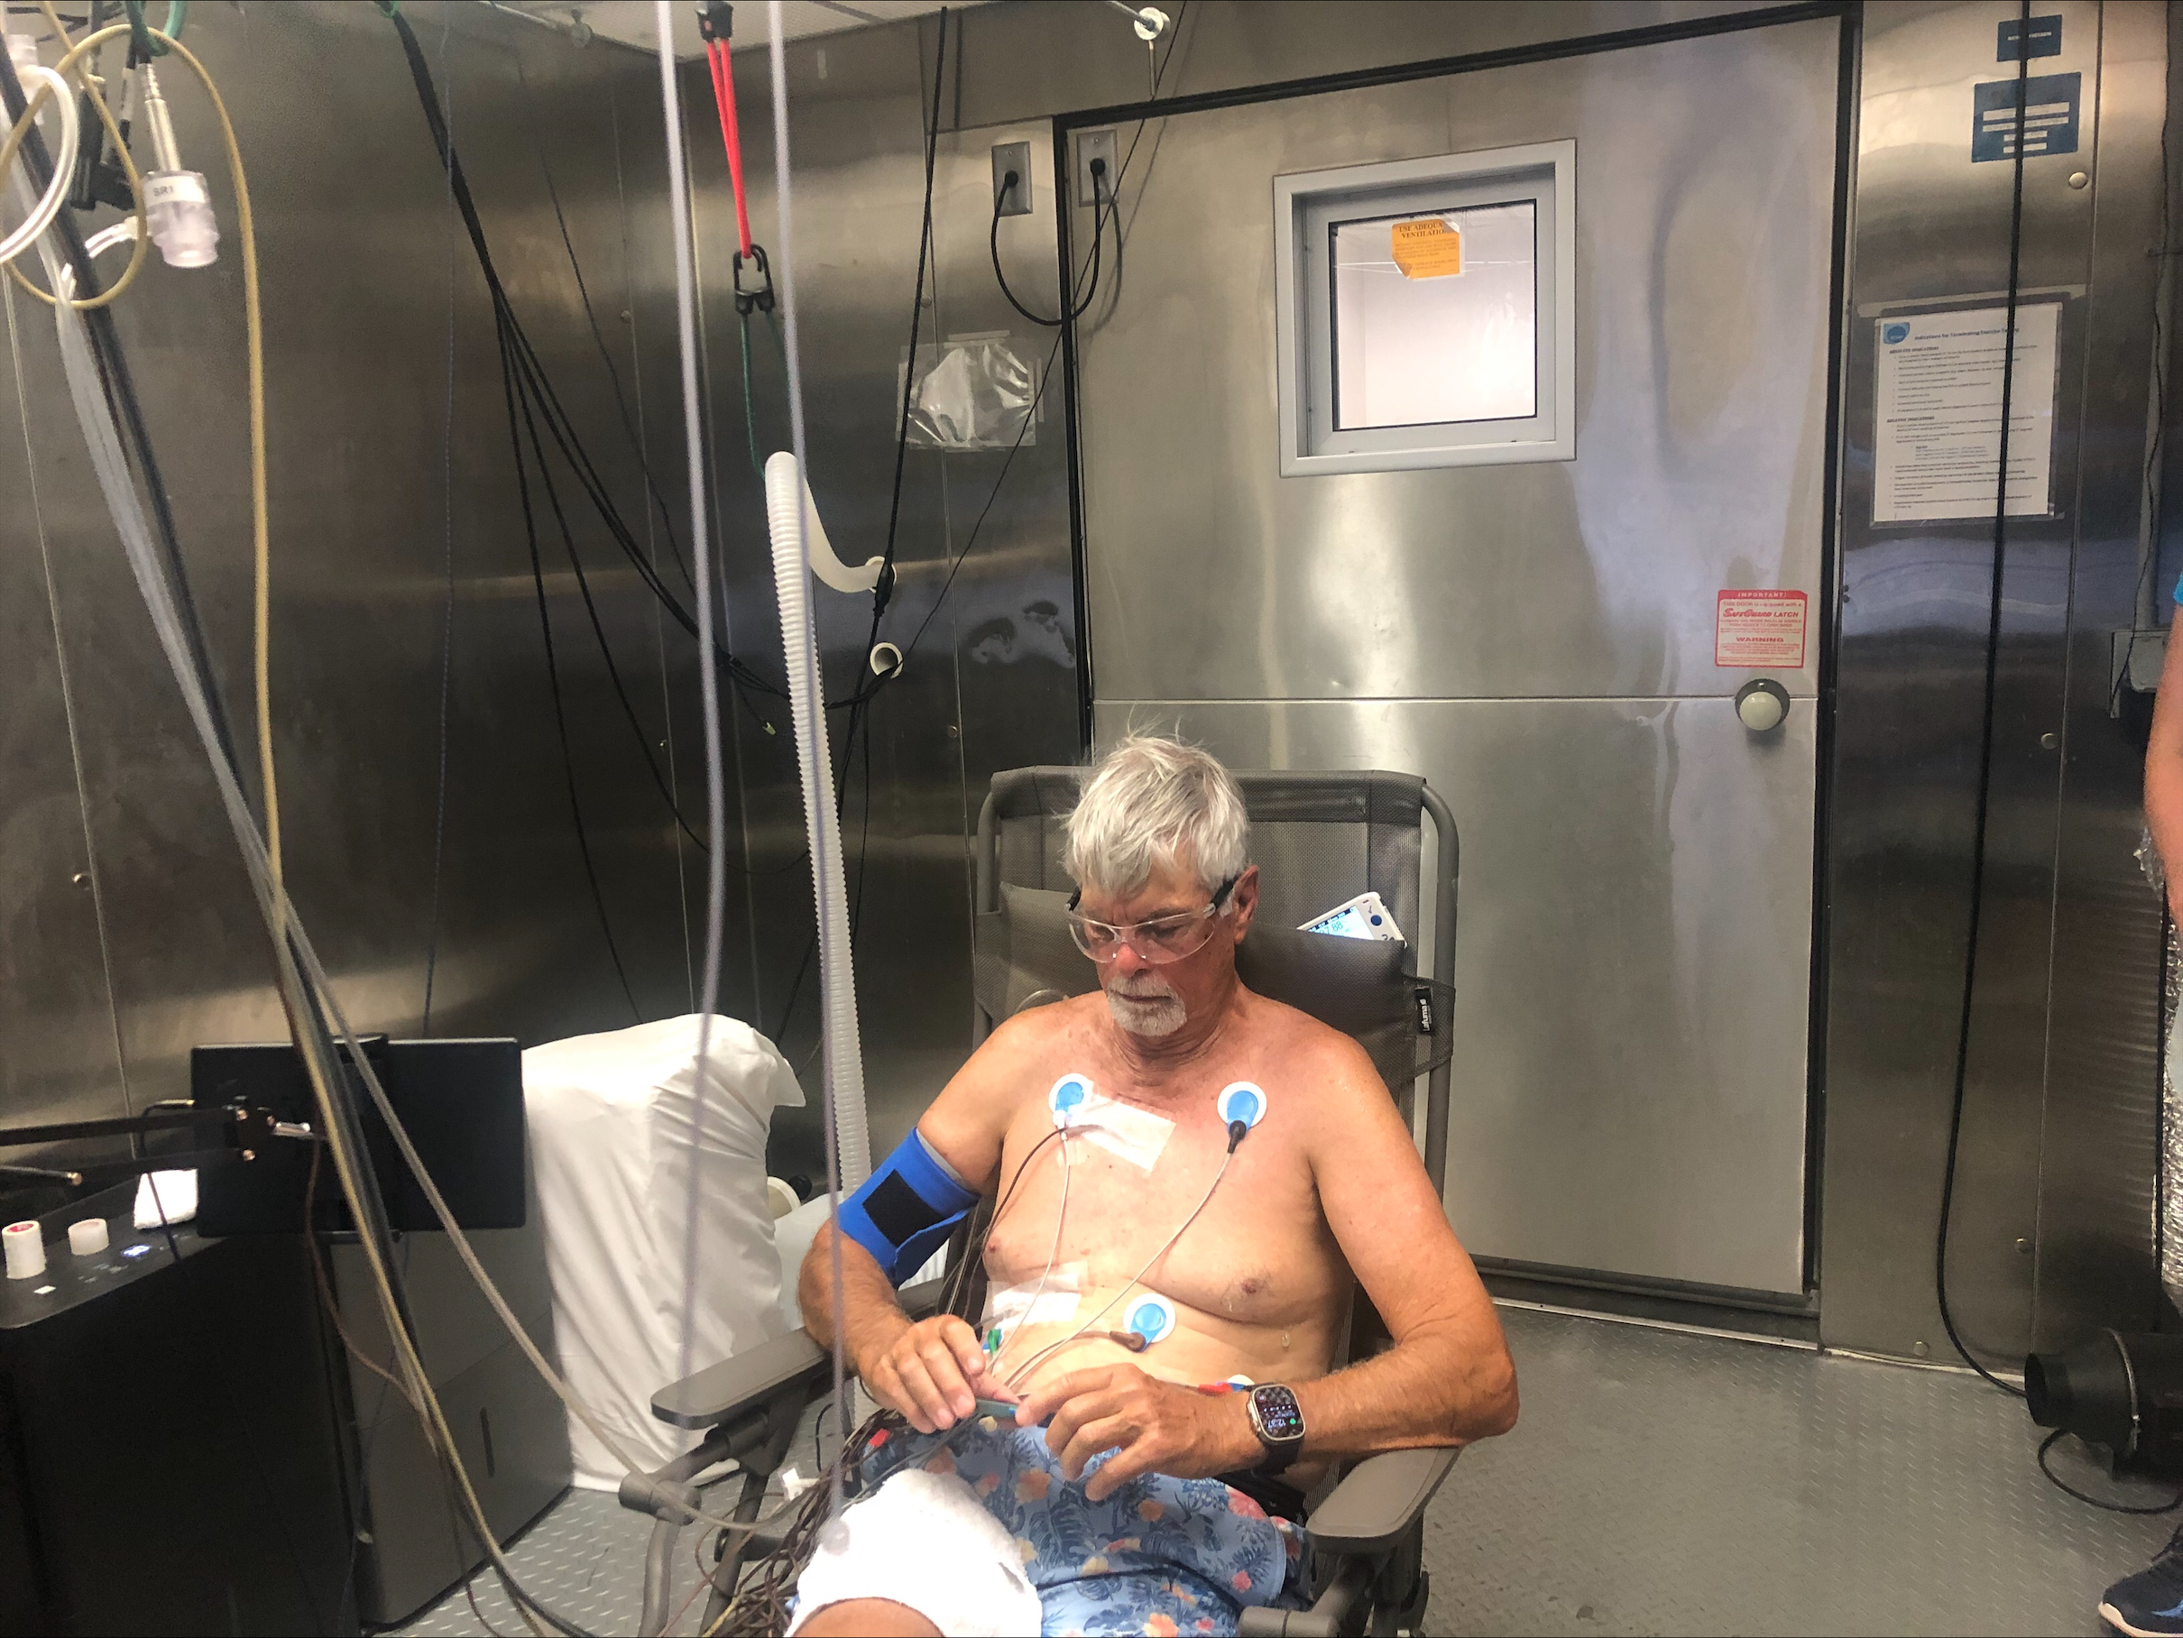
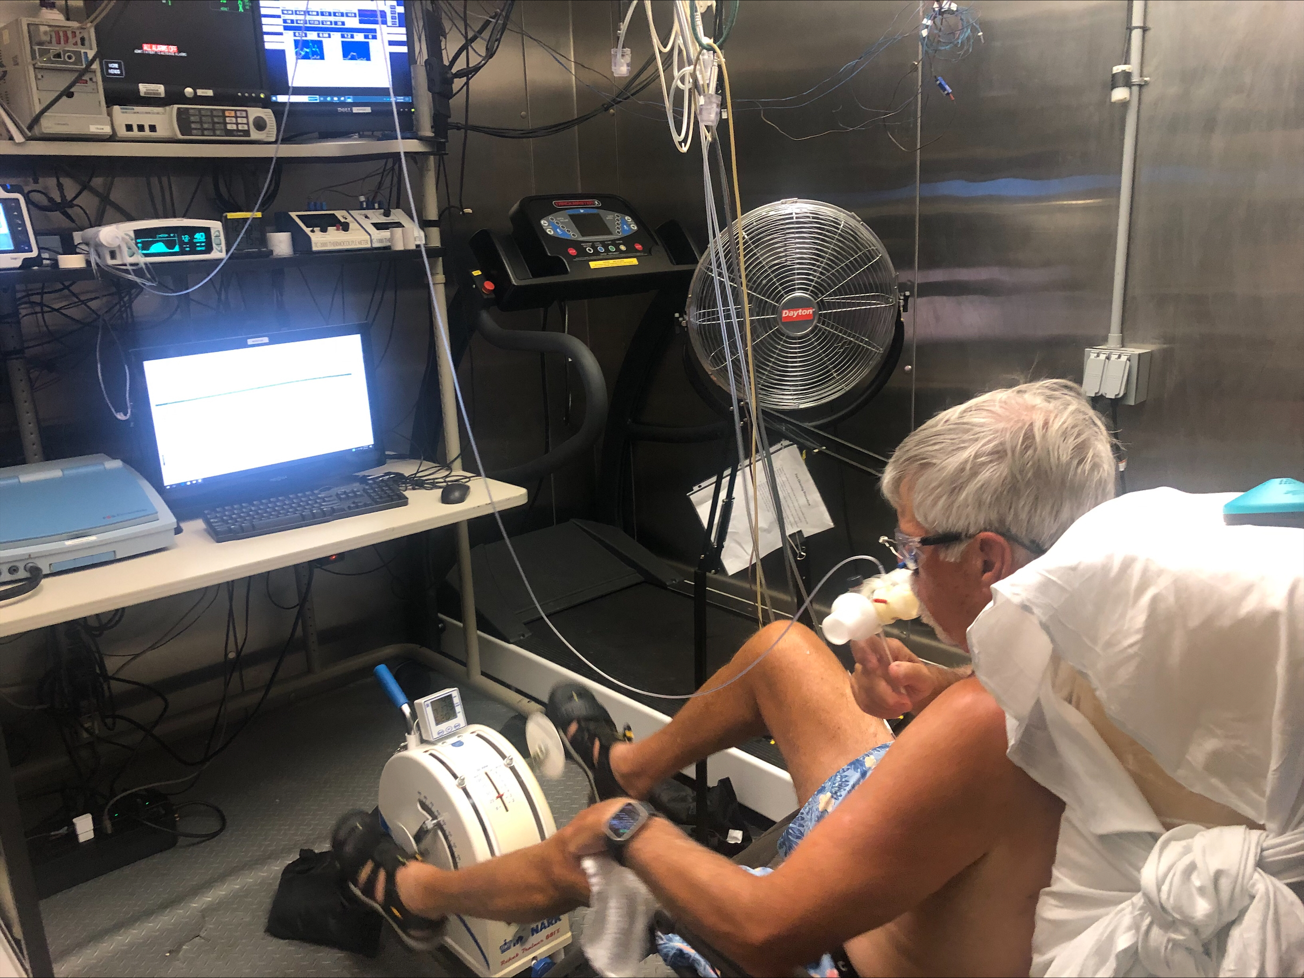
APPROACH
Simulated Heat Waves
Water intake 3 mL/kg/hour (24°C)
Baseline
3 hours – DRY (47°C, 15% RH) or HUMID (41°C, 40% RH)
Recovery
Echocardiogram
Forearm Blood Flow
Blood & Urine Sample
Nude Body Mass
Echocardiogram
Forearm Blood Flow
Echocardiogram
Forearm Blood Flow
Blood & Urine Sample
Nude Body Mass
Continuous: Core and skin temperatures, heart rate, local sweat rate monitoring
Every 15-minutes: Blood pressure, thermal sensation, thermal comfort, RPE
3 METs for 5-minutes
Younger: 18-35 years
Older: 65+ years
2018 Los Angeles heat wave
1995 Chicago heat wave
Notes:
Rationale for 3 hours. Show Rob

Slide 7

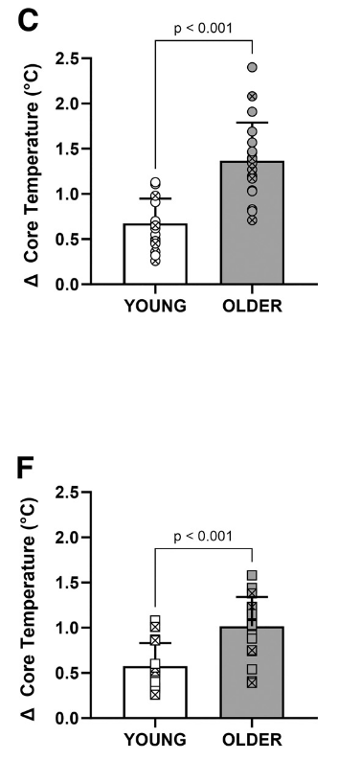
HEAT WAVES & THE ELDERLY
DRY (47°C, 15% RH)
Los Angeles 2018
HUMID (41°C, 40% RH)
Chicago 1995
↑ Core temperature
McKenna et al. 2023

Slide 8
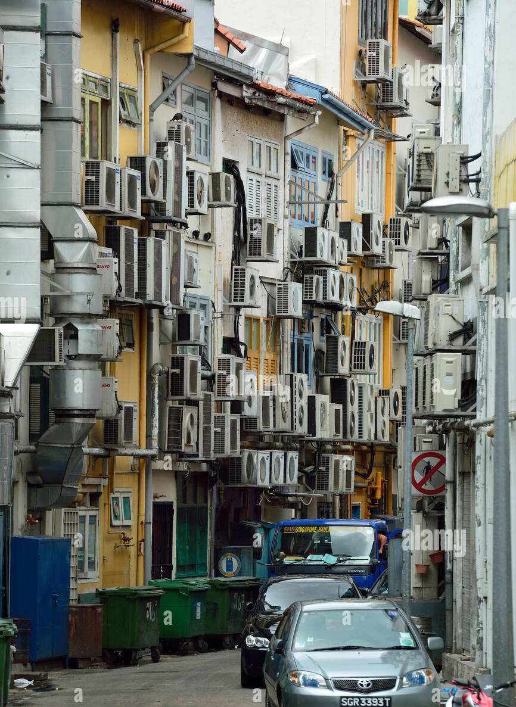
COOLING STRATEGIES- AIR CONDITIONING??
A working A/C is the strongest protective factor against heat-related fatalities.
1 in 10 Americans in do not have A/C
(US Energy Administration, 2020 Residential Energy Consumption Survey)
In many countries with warm/hot climates, A/C availability is even lower (e.g., in 2023, 90%-92% of households in India do not have A/C)
Rising usage/demand
↑ risk of power outages
↑ utility costs
Notes:
Air conditioning is widely prevalent in the US. However…
Can we focus on cooling individuals rather than spaces?

Slide 9
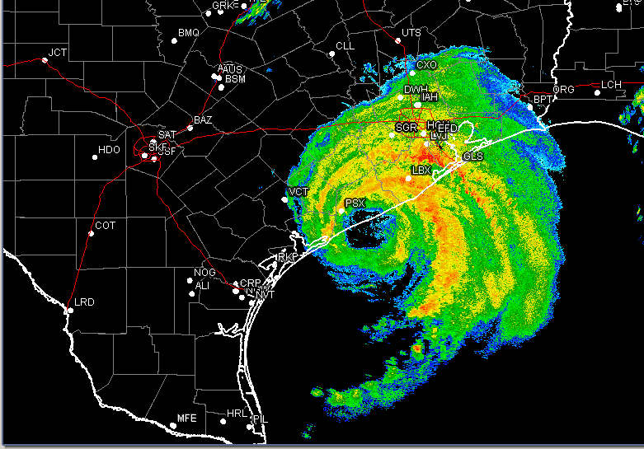
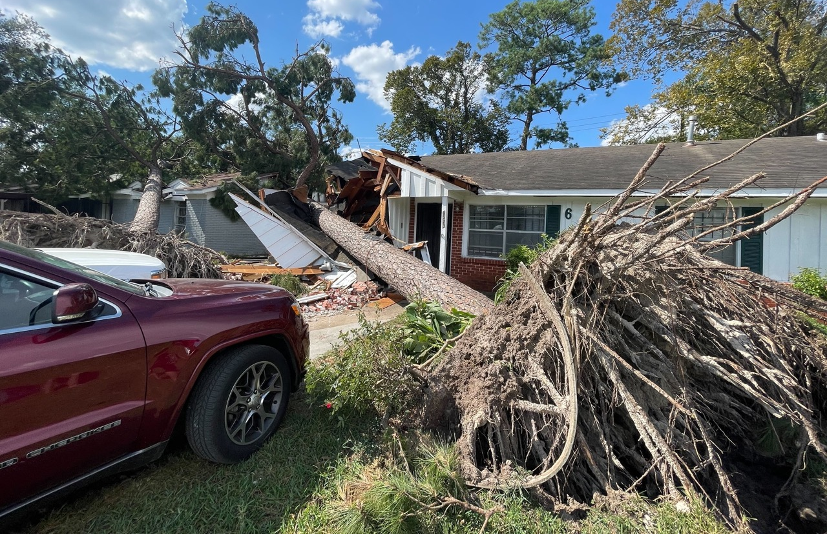
COOLING STRATEGIES
Hurricane Beryl
July 2024: “Roughly 2.2 million customers lost power after the Category 1 hurricane struck the Houston area on July 8. CenterPoint restored power to 1 million in the first 48 hours and finished restoring power to all remaining customers who are able to receive power on July 20.”
At least 14 Houston-area deaths were confirmed to be hurricane-related, including seven people – ranging in age from 50 to 110 – who died from “heat exposure due to power loss,” …
Source: CNN
Need effective, low-cost, low-energy-burden cooling strategies
Notes:
Air conditioning is widely prevalent in the US. However…
Can we focus on cooling individuals rather than spaces?

Slide 10
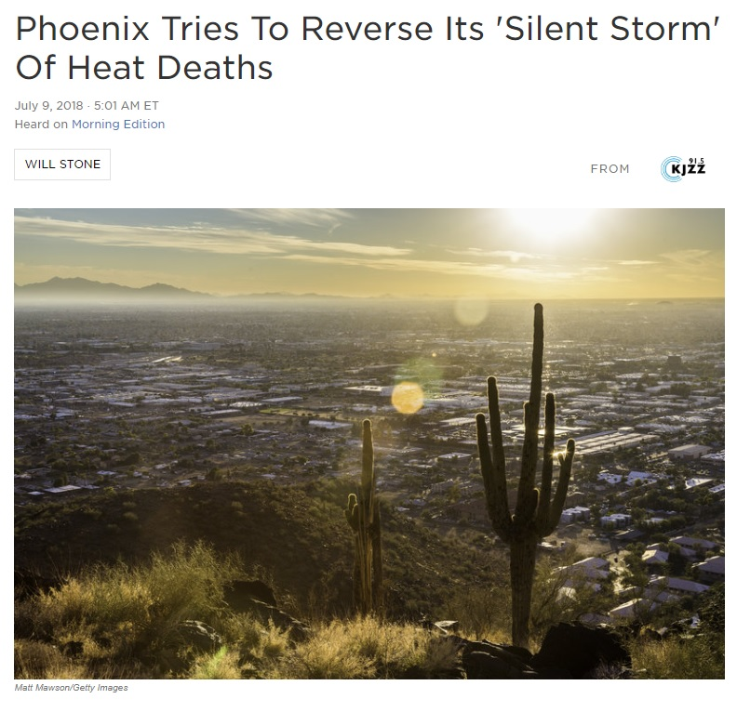
“You do the imitation swamp cooler” the man says. “Get clothes wet and hope you catch a good breeze."
https://www.npr.org/2018/07/09/624643780/phoenix-tries-to-reverse-its-silent-storm-of-heat-deaths
Notes:
Last summer, NPR ran an article titled “Phoenix tries to reverse its silent storm of heat deaths”. Just like in the case of Chicago, Phoenix has identified that heat deaths primarily affect older people, those who are socially isolated, those who do not have a working A/C unit, as well as homeless people.
They interviewed a homeless man, and asked him what strategies he uses to avoid getting too hot in extreme heat. His response was…
So I thought: this guy’s a genius. Let’s test that an quantify how well such a strategy would work. - Cramer

Slide 11
COOLING MODALITIES
To evaluate low-energy cooling strategies at mitigating the physiological consequences of extreme heat in the elderly…

Slide 12
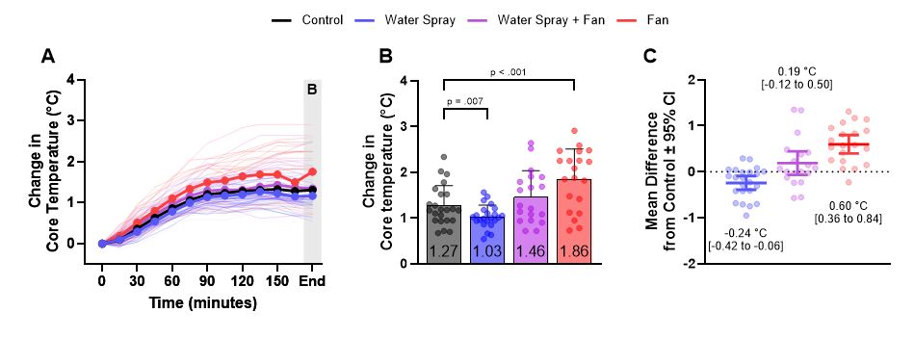
COOLING MODALITIES
Control: 2 of 20 (~10%)
Water Spray: 0 of 20 (0%)
Water Spray + Fan: 3 of 20 (~15%
Fan only: 10 of 20 (~50%)

Slide 13
Notes:
427 x 3 = 1281 = 3843
306 x 3 = 918 x 3 = 2754 (~1 L less fluid loss over a 9 hour period)

Slide 14



ACKNOWLEDGEMENTS
Funding
Zachary McKenna PhD
Josh Foster PhD
Whitley Atkins PhD
Courtney Hakes RN
Tom Sarma MD
James MacNamara MD
5R01AG069005 (CC)
23POST1023065 (ZM)
1F32HL168826 (ZM)

