Slide 1



Changing the Health System to Improve the Health of Older Patients
Janet Prvu Bettger, ScD, FAHA
Director of Health Policy and Implementation Science
Associate Professor, Department of Orthopaedic Surgery
Co-Director, Duke Clinical and Translational Institute Pilot Accelerator Program Duke University School of Medicine
janet.bettger@duke.edu
@jpbettger

Slide 2
Presentation overview:
What are health systems
Health systems research to scale
Approaches to accelerate adoption & translation
Janet Bettger, "Achieving and Sustaining Behavior Change to Benefit Older Adults" Dec 6-7, 2018

Slide 3
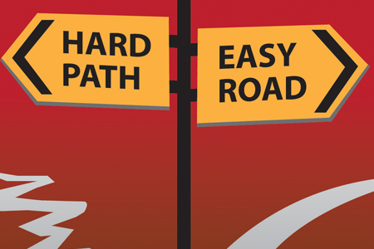
Health Systems Research Making the Healthy Behavior the Easier Behavior

Slide 4
HEALTH SYSTEM
ESTABLISHING COMMON GROUND

Slide 5
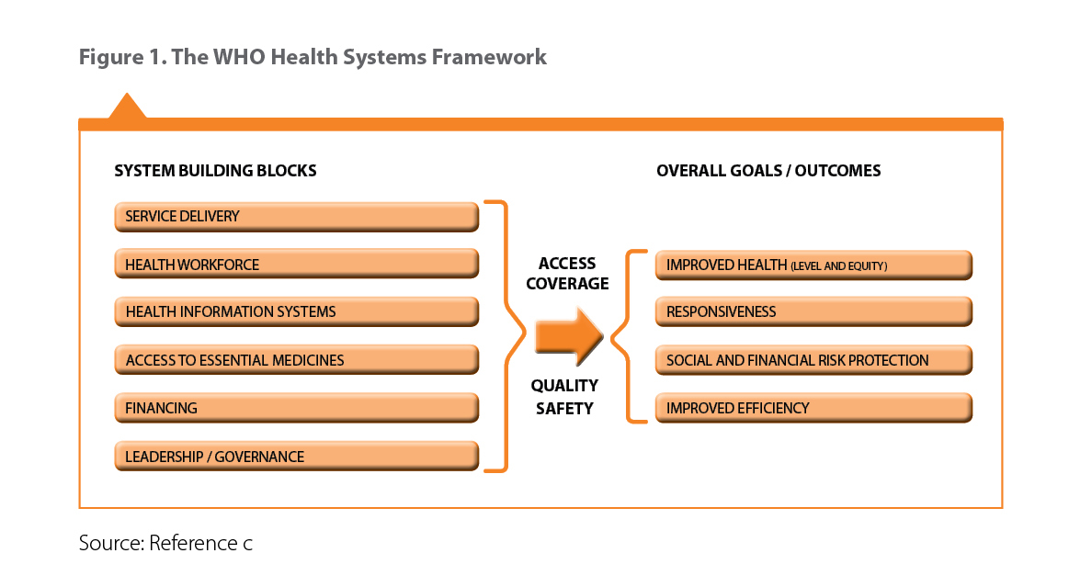
What is a Health System?
WHO Health System Framework
A health system consists of all the organizations, institutions, resources and people whose primary purpose is to improve health
Janet Bettger, "Achieving and Sustaining Behavior Change to Benefit Older Adults" Dec 6-7, 2018
WHO 2007. Strengthening health systems to improve health outcomes.

Slide 6
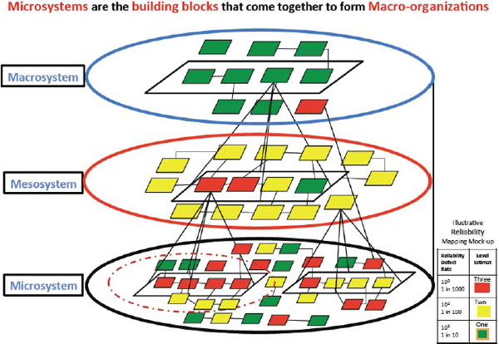
NAP 2015. Collaboration between healthcare and public health: Workshop in Brief. Figure c/o Mary Applegate, medical director of the Ohio Dept. of Medicaid

Slide 7
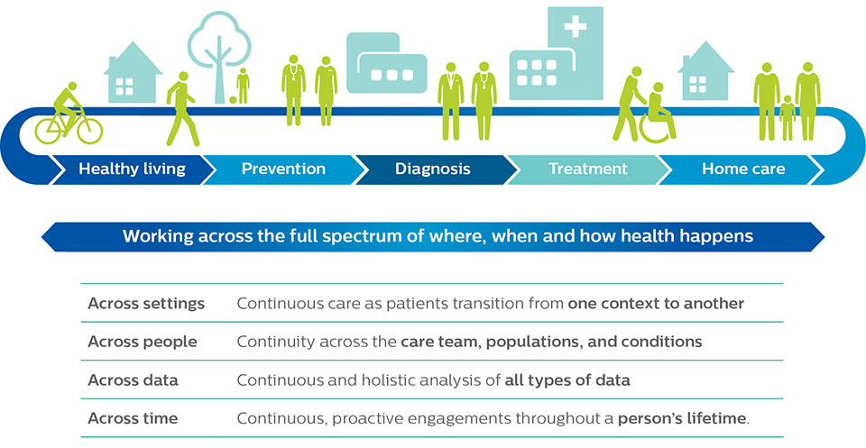
Across the Continuum of Health, Healthcare and Public Health
philips.co.il

Slide 8
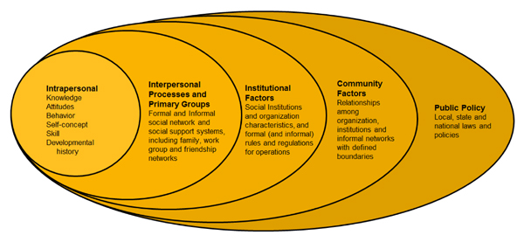
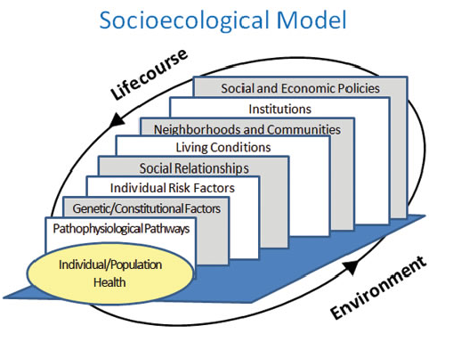
Social System Influence on Individuals: Socioecological Model
Theory-based framework for understanding the multifaceted and interactive effects of personal and environmental factors that determine behaviors, and for identifying behavioral and organizational leverage points and intermediaries for change.
1. Direct impact from subsequent level; 2. Reciprocal/dynamic interactions between
Originally conceptualized as Urie Bronfenbrenner's Ecological Framework for Human Development

Slide 9
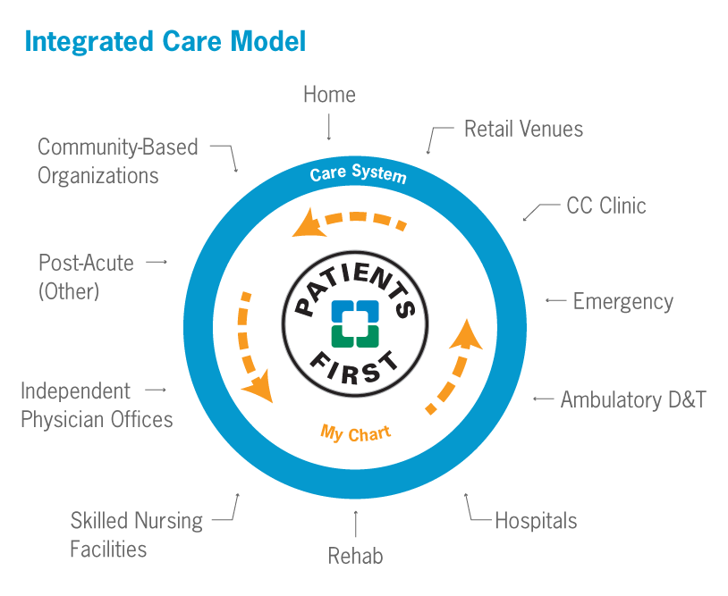
Example from Cleveland Clinic

Slide 10
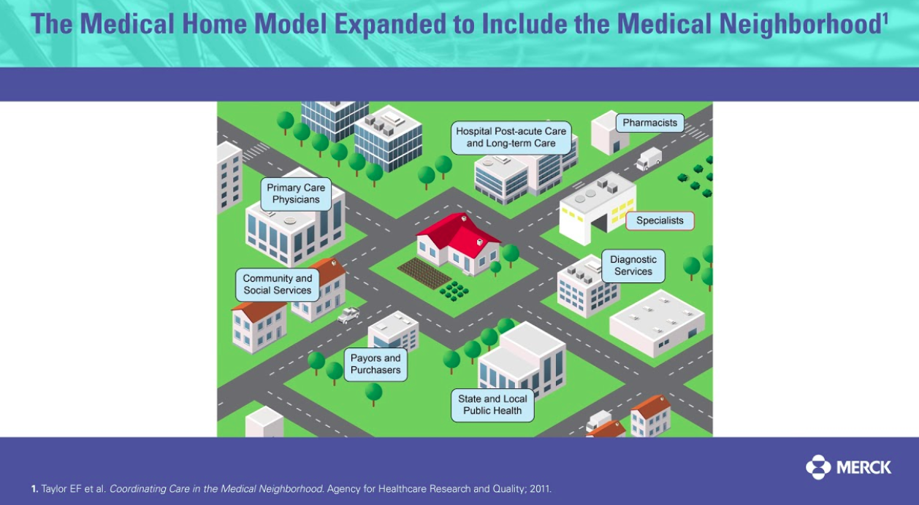

Slide 11
HEALTH SYSTEM INTERVENTIONS
WHAT ARE WE STUDYING AND HOW

Slide 12
Research at the Health System Level = Complex Interventions (interventions that contain several interacting components)
What makes an intervention complex?
Number of and interactions between components within the experimental and control interventions
Number and difficulty of behaviors required by those delivering or receiving the intervention
Number of groups or organizational levels targeted by the intervention
Number and variability of outcomes
Degree of flexibility or tailoring of the intervention permitted
Examples:
HELP
TCM
PCMH→N
CCM: DM
Gerofit
http://www.mrc.ac.uk/complexinterventionsguidance
Janet Bettger, "Achieving and Sustaining Behavior Change to Benefit Older Adults" Dec 6-7, 2018

Slide 13
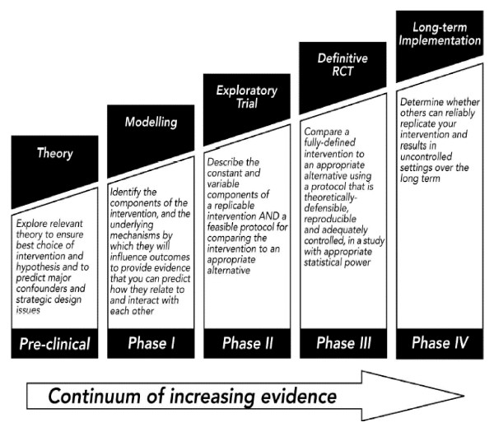
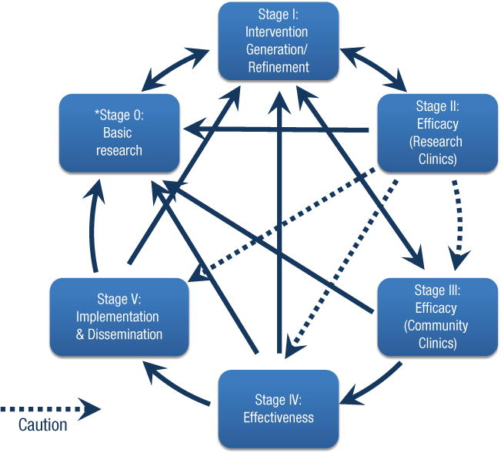
Designing and Testing Complex Interventions
MRC Complex Interventions
NIH Stage Model
Janet Bettger, "Achieving and Sustaining Behavior Change to Benefit Older Adults" Dec 6-7, 2018

Slide 14
ADOPTION AND TRANSLATION
Actively addressing the 17 year evidence to practice gap

Slide 15
The Path Less Taken: Possible with Planning
Total Patients Exposed
Pragmatic effectiveness, implementation and continuous assessment and refinement
I II
Time
Janet Bettger, "Achieving and Sustaining Behavior Change to Benefit Older Adults" Dec 6-7, 2018

Slide 16
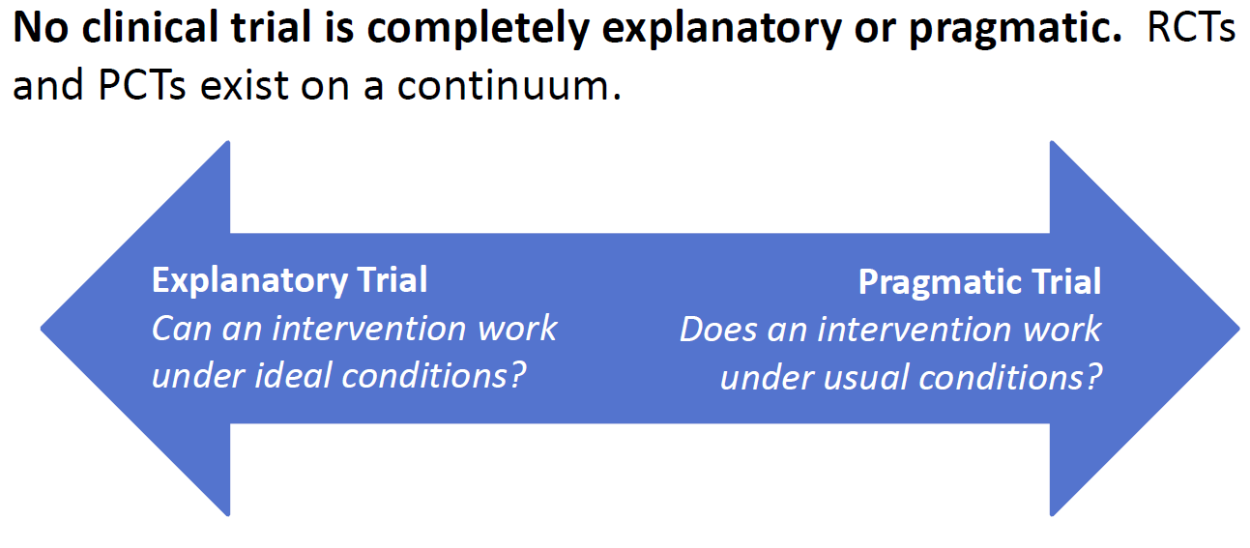
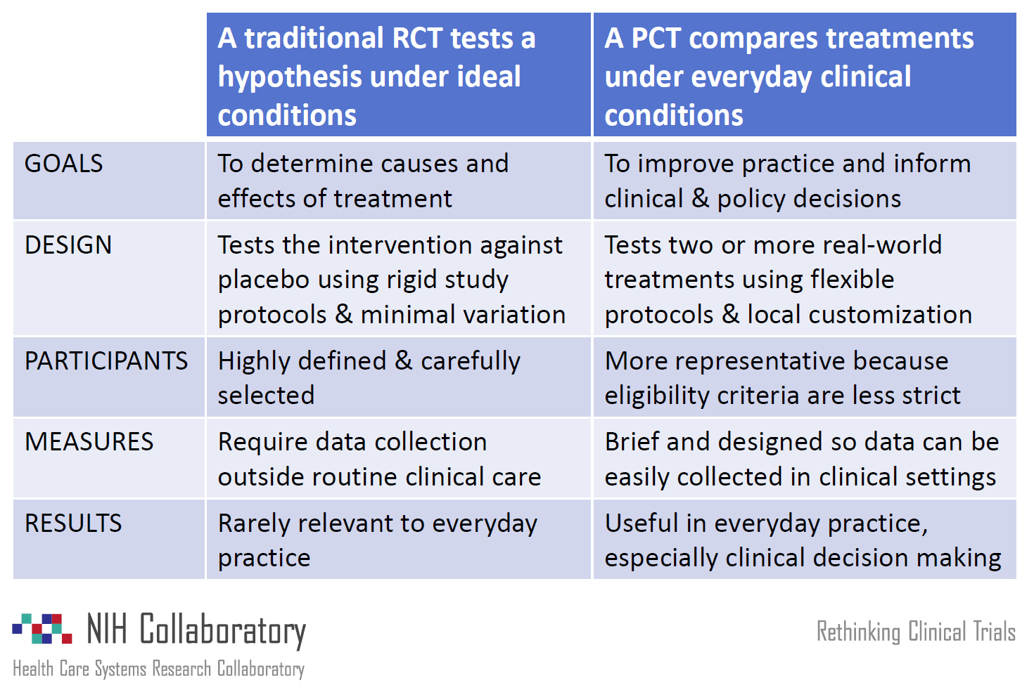
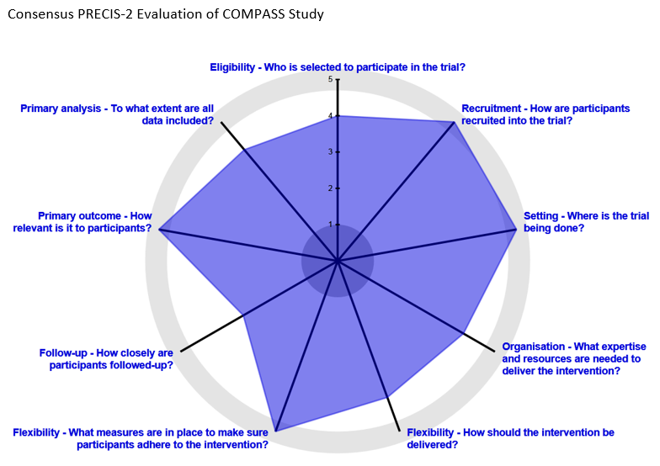
No clinical trial is completely explanatory or pragmatic

Slide 17

Design with implementation and broad uptake in mind

Slide 18
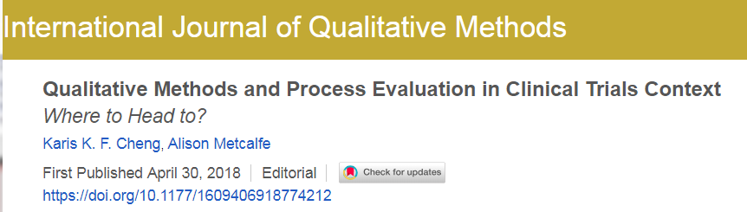
Most Common But Not as Frequent in Aging Research
Janet Bettger, "Achieving and Sustaining Behavior Change to Benefit Older Adults" Dec 6-7, 2018

Slide 19
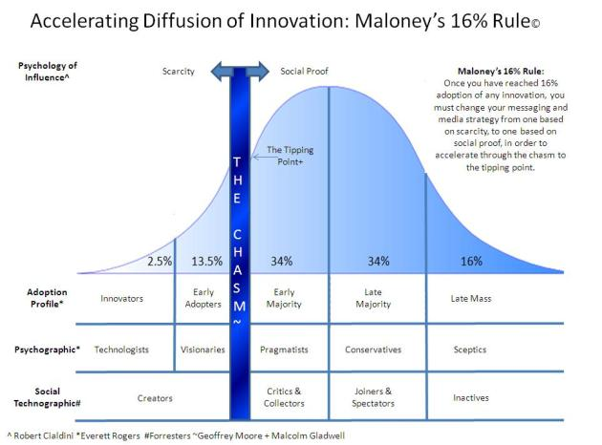
Diffusion of Innovation
Key Elements: Innovation (relative advantage, compatibility, complexity, trialability, testability, reinvention potential, observed effects); Individual Adopters (ability, motivation, meaning, symbolic, connectedness); Organizational Adopters (tension for change, fit, implications); Decision Process (5 stages) and level (optional, collective, authority), Communication Channels (social networks-relational, structural, proximity, bound; homo- vs. heterogeneity; media), Social System (interrelated network), Time
+ Theory of Change
Janet Bettger, "Achieving and Sustaining Behavior Change to Benefit Older Adults" Dec 6-7, 2018

Slide 20
Diffusion-Dissemination-Implementation Continuum
Discovery/ Development Delivery
DIFFUSION 1. Research diffusion …the passive process by which a growing body of information about an intervention, product, or technology is initially absorbed and acted upon by a small body of highly motivated recipients (Lomas, 1993). 2. Diffusion research …centers on the conditions which increase or decrease the likelihood that a new idea, product, or practice will be adopted by members of a given culture (Rogers, 1995). | DISSEMINATION 1. Research dissemination …active process through which the information needs (pull) of target groups working in specific contexts (capacity) are accessed, and information is "tailored" to increase awareness of, acceptance of, and use of the lessons learned from science (Kerner, 2007). 2. Dissemination research …the study of processes and variables that determine and/or influence the adoption of knowledge, interventions or practice by various stakeholders (Lomas, 1997). | IMPLEMENTATION 1. Research implementation …the utilization of strategies or approaches to introduce or modify evidence-based interventions within specific settings. This involves the identification of and assistance in overcoming barriers to, the application of new knowledge obtained from a disseminated message or program (Lomas, 1993). 2. Implementation research …research that supports the movement of evidence-based interventions and approaches from the experimental, controlled environment into the real world of actual delivery contexts where the programs, tools, and guidelines will be utilized, promoted, and integrated into the existing operational culture (Rubenstein & Pugh, 2006).
Table from: http://cancercontrol.cancer.gov/is/definitions.html

Slide 21
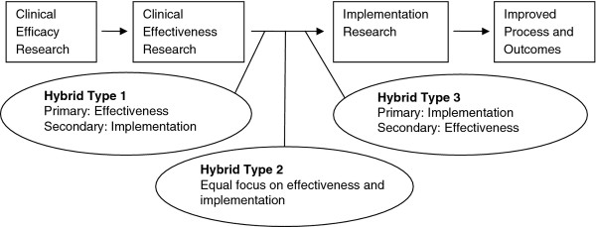
Hybrid Effectiveness Implementation Designs
Curran et al., 2010
Janet Bettger, "Achieving and Sustaining Behavior Change to Benefit Older Adults" Dec 6-7, 2018

Slide 22
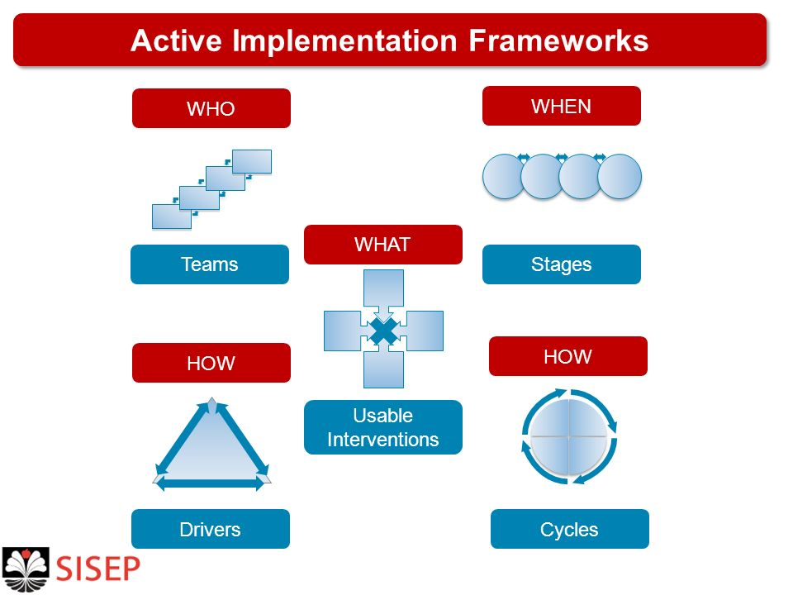
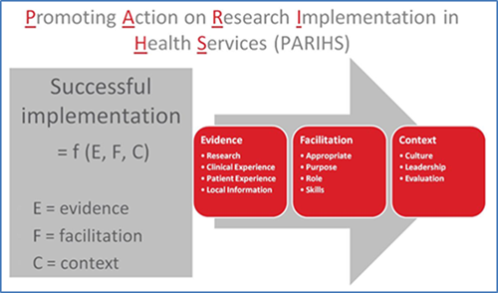
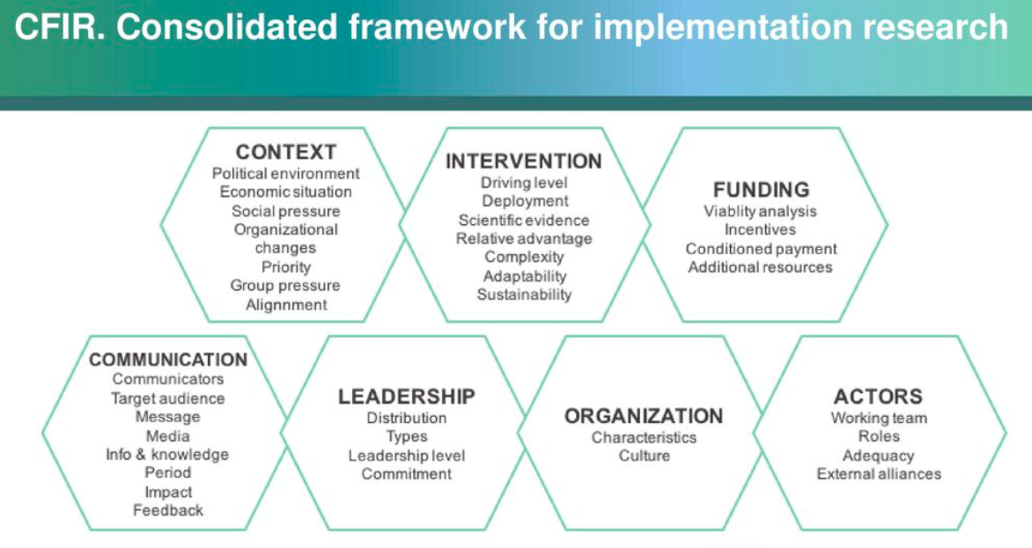
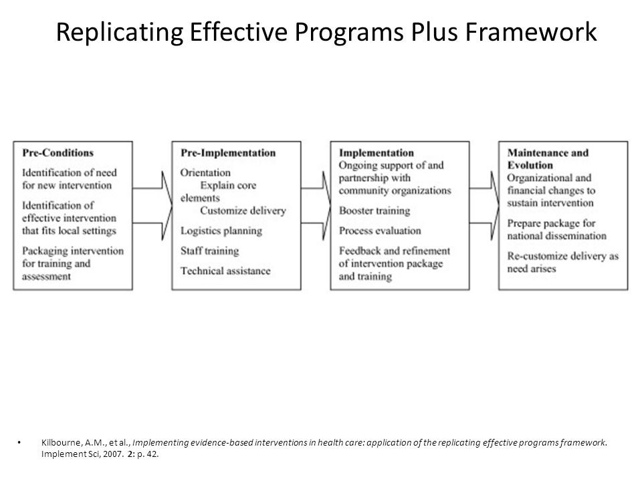
Janet Bettger, "Achieving and Sustaining Behavior Change to Benefit Older Adults" Dec 6-7, 2018

Slide 23
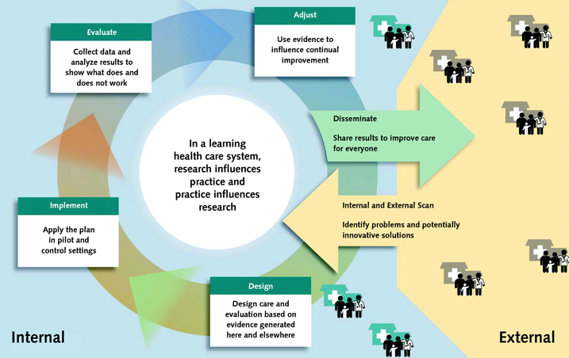
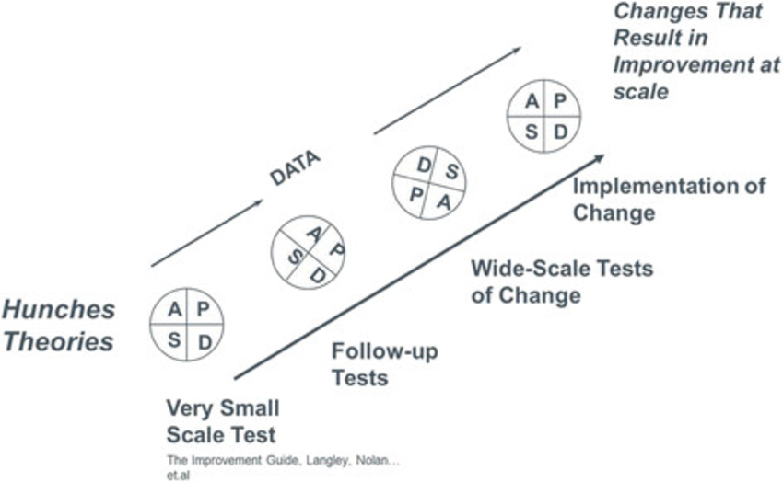
Implementing the Learning Health System
Ann Intern Med. 2012;157(3):207-210. Langley et al. The improvement guide; 2009

Slide 24
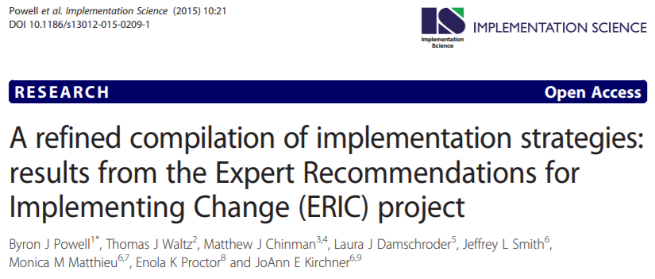
At the Core:
The smallest representation of full scale
Includes components of a self-contained functional unit (i.e., the people, processes and structures)
Re-check building blocks to ensure all components of building capacity are addressed in the design (and test)
DEFINE THE SCALABLE UNIT
(innovation)
DEFINE THE STRATEGIES USED
(mechanisms)
Janet Bettger, "Achieving and Sustaining Behavior Change to Benefit Older Adults" Dec 6-7, 2018

Slide 25
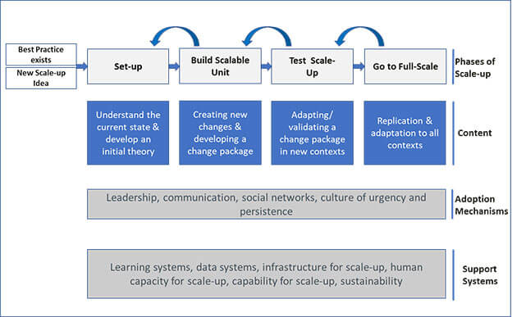
IHI Scale-up Framework
Janet Bettger, "Achieving and Sustaining Behavior Change to Benefit Older Adults" Dec 6-7, 2018

Slide 26
OPPORTUNITIES WITHIN THIS NETWORK
SIZE, SITES, SCALE

Slide 27

Janet Bettger, "Achieving and Sustaining Behavior Change to Benefit Older Adults" Dec 6-7, 2018

Slide 28
Changing the Health System to Improve the Health of Older Patients
Janet Prvu Bettger, ScD, FAHA
Duke University School of Medicine
janet.bettger@duke.edu
@jpbettger

