Slide 1

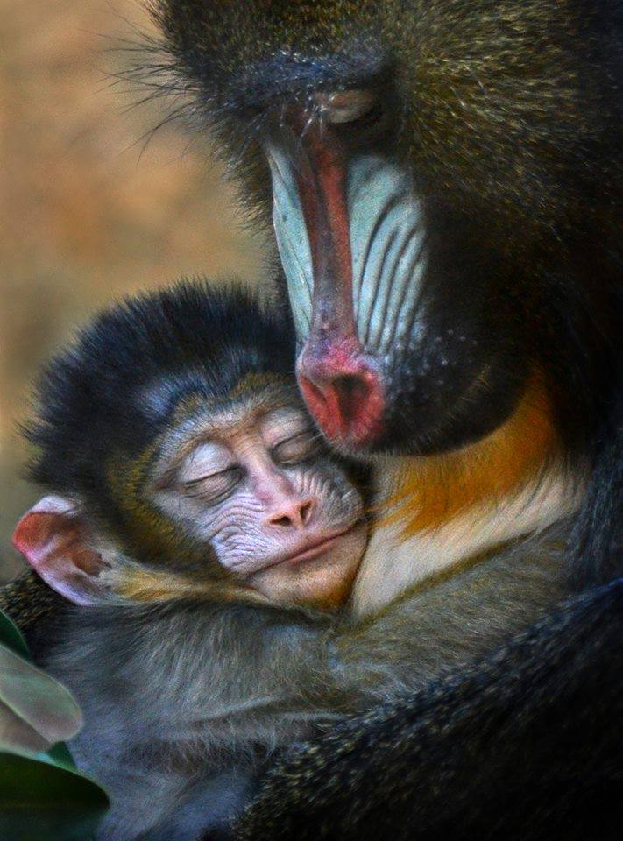
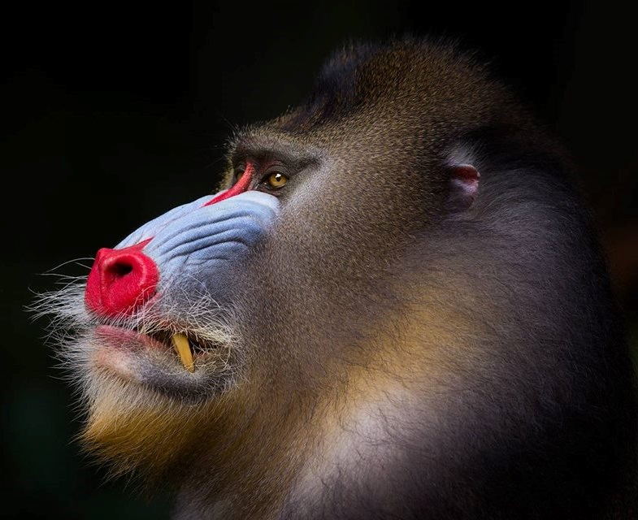
Comparative Biology of Sex & Longevity
Steven N. Austad, PhD
University of Alabama at Birmingham

Slide 2
News flash! Women live longer than men
Human mortality database

Slide 3
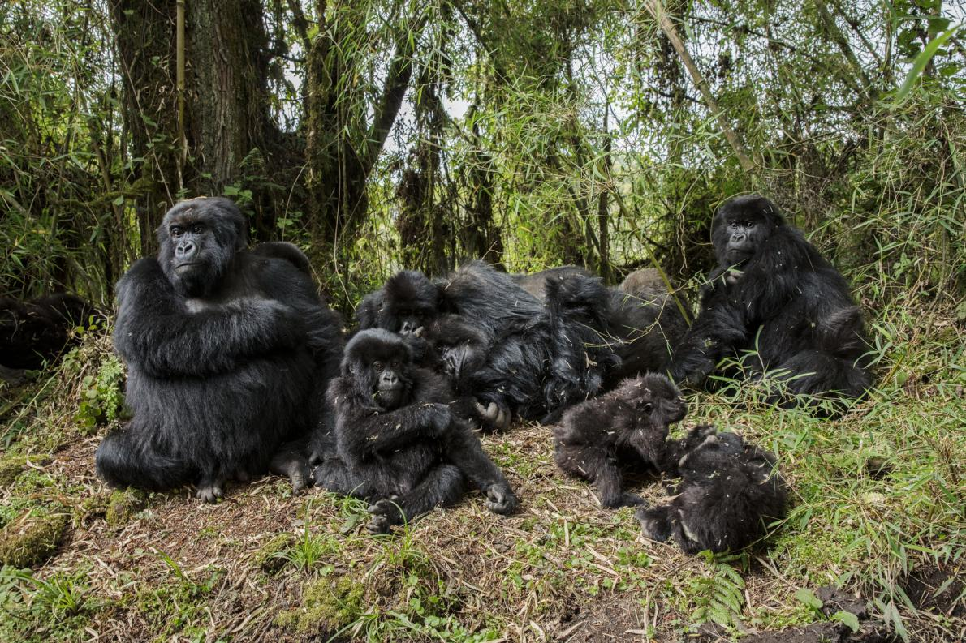
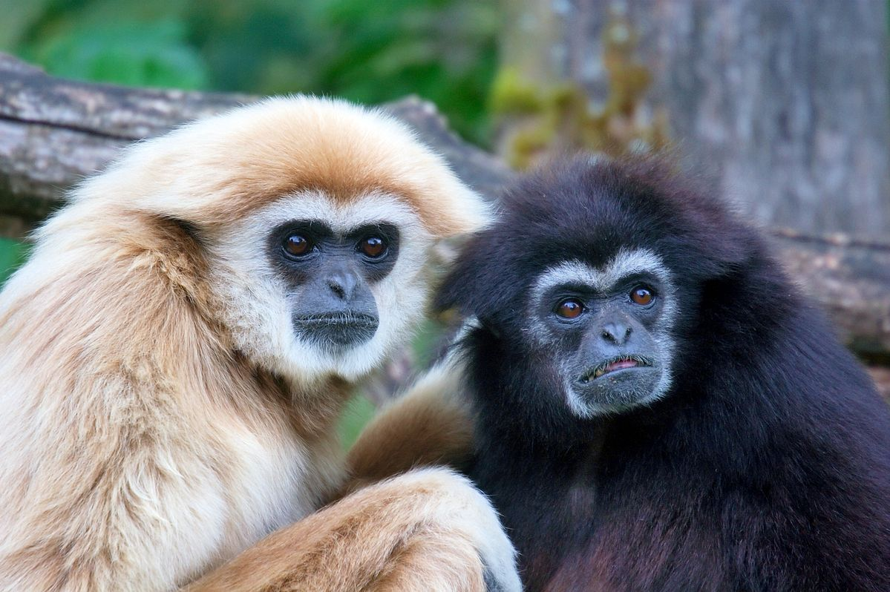
Gorilla and gibbon females live longer than males too
Allman, et al. (1998) PNAS

Slide 4
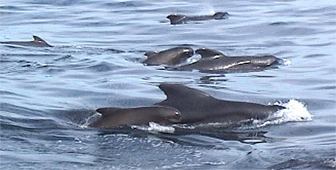
Some female longevity bias is extreme
(Short-finned pilot whale)
Male Life Expectancy: 12 years
Female Life Expectancy: 23 years
Kasuya & Marsh, 1984

Slide 5

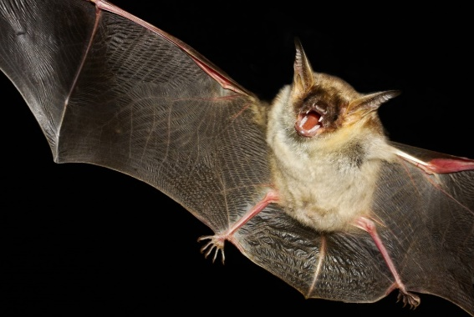
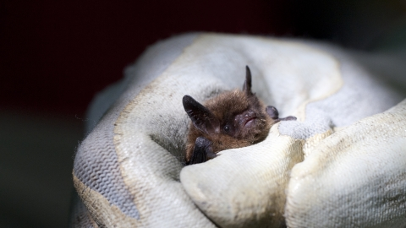
There are extreme male longevity biases too (Brandt’s bat)
1544 bats of both sexes banded (1960 – 1964)
Sex | Banded bats re-located, age at least…
Age | 20 | 24 | 28 | 32 | 36 | 41
Males | 67 | 41 | 5 | 4 | 2 | 1
Females | 0 | 0 | 0 | 0 | 0 | 0
Podlutsky, et al. (2005) J. Gerontol.

Slide 6
And some species are highly variable (Laboratory mouse)
C57BL/6
Austad (2011)

Slide 7
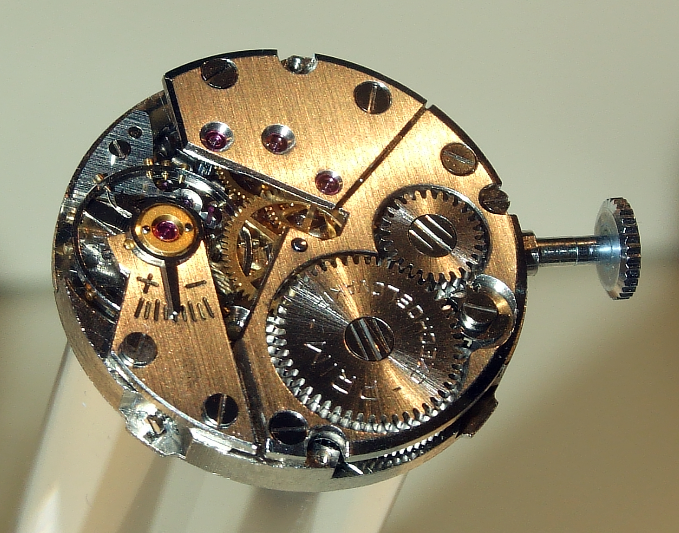
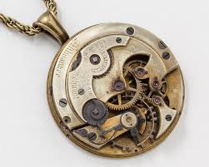
Why investigate sex differences in the biology of longevity??
To discover hitherto unknown features of sex-specific biology
To refine our knowledge about the biological aging processes generally

Slide 8
General questions about sex differences: Why? How?
WHY??
Heterogametic sex hypothesis
Parental Care Hypothesis
Sexual selection hypothesis
Extrinsic hazards hypothesis

Slide 9
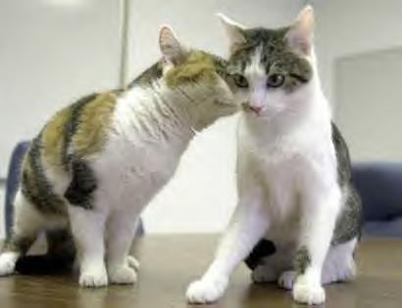
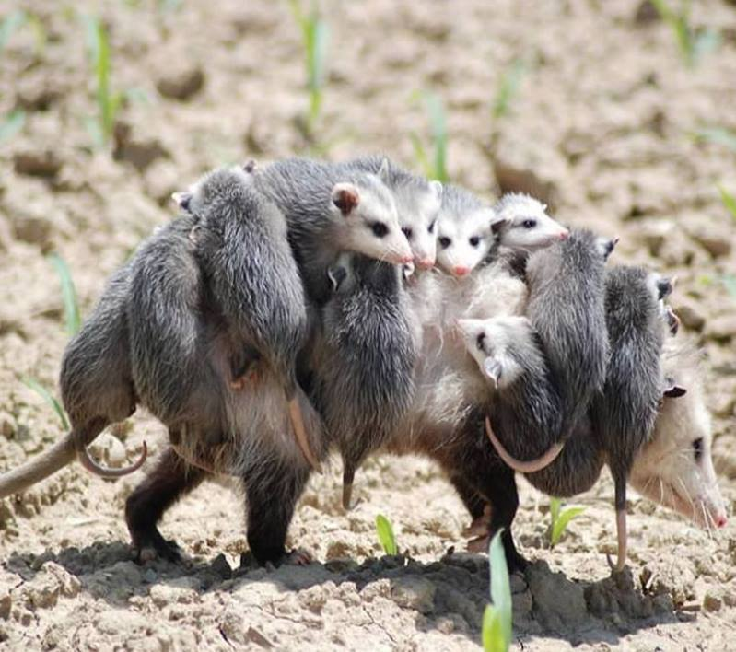
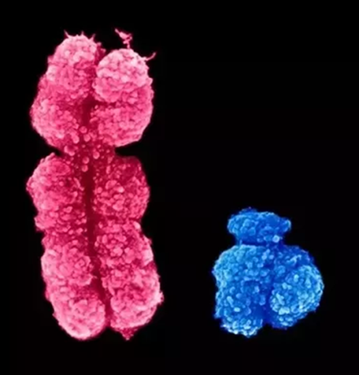
General questions about sex differences
How??
X-inactivation
Y-chromosome gene activity
Investigate them in a range of species

Slide 10
Y chromosomes have different genes in different species
Cortez, et al. (2014) Nature

Slide 11
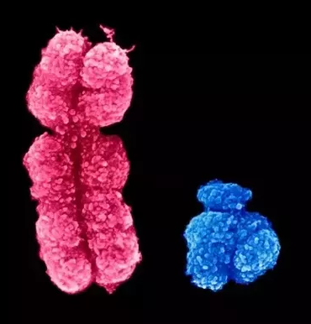
(Human) Y chromosome
568 genes
71 with “protein coding potential”
27 unique protein coding genes
109 lnc or snc RNA’s
388 pseudogenes
Maan, et al. Europ. J. Hum. Genetics (2017)

Slide 12
Where are y-chromosome genes expressed?
Maan, et al. Europ. J. Hum. Genetics (2017)

Slide 13
Thanks. QUESTIONS???

